Slide 1
M&M
Nisha Agasthya, MD, Neha Longani, MD, Kareen Jones, MD, Jennifer Nestor, MD
October 6, 2026

Slide 2
CME
Text 1(904)506-7609
Successful completion of this CME activity, which includes participation in the activity, with individual assessments of the participant and feedback to the participant, enables the participant to earn 1.0 MOC Part 2 points in the American Board of Pediatrics (ABP) Maintenance of Certification (MOC) program. It is the CME activity provider's responsibility) to submit participant completion information to ACCME for the purpose of granting ABP MOC credit.
Today’s code:
MUHHOQ

Slide 3
CONFIDENTIAL PATIENT SAFETY WORK PRODUCT
Quality Assurance Information – Protected under Florida Statute #766.101
Protected under the Patient Safety and Quality Improvement Act. Do not disclose unless authorized by the Nemours Vice President for Quality & Safety or his/her designee.
All patient-identifying information is confidential and may not be disseminated outside of the committee setting, except as permitted by state or federal law

Slide 4
Learning Objectives
Review quality improvement/patient safety initiatives in the PICU
Review monthly adverse events, resuscitations and mortality
Understand current processes, procedures and environment of practice
Work to improve individual and group practice within the context of Nemours Children’s Hospital

Slide 5
Morbidities
RRT review
Metastatic neuroblastoma with intratumor hemorrhage
Code BERT/ RRT for aggressive patient
Unplanned decannulation
Intraoperative PTX, PSF wound infection
Cardiac arrest in chronic renal failure
Sedation after cerebral angiography
Multiple arrest events, Klebsiella UTI

Slide 6
RRT Review
6-week-old male with a history of 33-week prematurity and a 14-day NICU stay initially admitted to the inpatient unit and then transferred to the PICU as an RRT with acute hypoxic respiratory failure in the setting of RSV bronchiolitis
Child escalated to 2ml/kg HFNC/50% oxygen on the floor prior to transfer, with further escalation to NIPPV (different interfaces trialed) upon arrival to the PICU, with addition of continuous albuterol, HTS, and steroids.
Significant respiratory distress/failure persisted despite escalating interventions, and the patient was promptly intubated soon after PICU arrival.

Slide 7
RRT Review
WHAT WENT WELL?
WHAT COULD BE BETTER?
RRT called - more RRTs are being called, yay!
Prompt escalation of care by PICU team
Gaps in RRT escalations: continued opportunity to ensure every at-risk child is identified and escalated in a timely manner
Medication override for bedside procedures

Slide 8
Metastatic neuroblastoma, hemorrhage
5 yo M with metastatic neuroblastoma of the left adrenal gland admitted to heme/onc on 8/18 for initiation of Cycle 3 of chemo. Described as having 3-5 stools daily but otherwise ok. Stool volume continued to increase, initially thought to be mucositis, with nausea and vomiting attributed to chemo. Electrolytes followed closely and replaced, recommendation for close monitoring of I’s and O’s (stool counts mostly recorded).
8/22 stool output recorded at 2L, continued to replace fluids and electrolytes
8/23 persistent electrolyte derangements resulting in transfer to the PICU

Slide 9
Child continues with 2-7 L of stool output every 24 hours.
Surgery consulted (note on 8/28), recommended sending VIP level (8/25-363 ng/dL –normal <88)→ no change in plan, continue supportive management, continue 4 cycles of chemo with evaluation of tumor burden post 4th cycle for amenability to resection
Child managed with analgesia, IV nutrition (REALLY well optimized, kudos to GI fellow!). Loperamide and octreotide infusion initiated.
9/1 - Octreotide infusion unsuccessful, surgery re-engaged. Further conversations had nationally regarding surgical care of this child, declined early surgical intervention and recommended “continuing chemotherapy and optimizing nutrition while minimizing diarrhea.”
CT scan obtained after cycle 3 completed (8/29) no improvement in tumor burden
Child remains tachycardic, poorly nourished and with ongoing voluminous stool output. Clinical exam consistent with increasing size of abdomen.

Slide 10
9/7- cycle 4 of chemotherapy initiated. Child had increasing challenges managing the fluid volume and was noted to now have an oxygen requirement.
9/8- cycle 4 paused, patient care conference with IR, Heme/Onc, General surgery and PICU. Size of tumor and impact of chemotherapy discussed along with respiratory insufficiency and poor nutritional status despite high volume and high calorie TPN.
9/9- child taken to IR for embolization
  5AM- Hgb-11 2:45 pm Hgb 6.8
  Child in IR suite with catheters in, transfused PRBC and IR able to identify ruptured aneurysm and coil off
  The rest of the tumor was embolized safely and child returned to the PICU intubated and sedated.
9/10- child taken to OR for surgical resection
  Successful gross total resection of the tumor, however “bulky lymphadenopathy intwined in the major vessels” left behind.
Child had resolution of his diarrhea
9/16 VIP level- 16
9/20- able to go to the oncology floor for ongoing management

Slide 11
Metastatic neuroblastoma, hemorrhage
WHAT WENT WELL?
WHAT COULD BE BETTER?
Interdisciplinary communication
IR

Slide 12
Code bert/rrt for aggression
14 yr old female with in foster care, psychiatric issues admitted to acute care unit for seizure like events which upon work up were confirmed as “pseudoseizures”.
Multiple CODE BERTs called on 9/15 for continued aggressive behavior – IN versed given
CODE BERT at 1 pm patient received – 5 mg IM Haldol given, neurology team also bedside
RRT called shortly after due to continued behavioral issues
Continued verbal and physical aggression and violent behaviors – 4 point restraints ordered but not placed by security
Staff bitten – eventually staff restrained patients and applied restraints
Transferred to the PICU and another dose 5 mg IM Haldol administered with eventual resolution of aggression
Discharged from PICU next day to group home.

Slide 13
Code bert/rrt for aggression
WHAT WENT WELL?
WHAT COULD BE BETTER?
Attempts made by PHM team to deescalate with multiple CODE BERT responses
PICU response in RRT
SW : discharge back to group home
Restraint placement and security response
Staff physically hurt
Override meds for CODE BERT – Haldol – pathway has Olanzepine as first line -

Slide 14
Unplanned decannulation
3yM with genetic variant PAFAH1B1 (VUS), epileptic encephalopathy with intractable seizures, chronic respiratory failure with tracheostomy and nocturnal ventilator dependence, dysphagia with GT admitted with increased seizure frequency, hypercarbic respiratory failure found to have MRSA tracheitis
Receiving around the clock ventilator support on home vent while titrating antiepileptics and recovering from tracheitis; noted to have normal gas exchange, ETCO2 intermittently unreadable as patient with cuffless trach
  Not replaced with cuffed trach as it was likely to irritate child & cause increased seizures
HD5, received bath with RN overnight, noted to be desaturating, decannulation appreciated, staff assist called – RN/RT replaced trach
  VBGs/TCOM WNL

Slide 15
Unplanned decannulation
WHAT WENT WELL?
WHAT COULD BE BETTER?
Quick ID by bedside team
Replacement of trach and patient stabilization
Policy re: cuffless trach and ETCO2?

Slide 16
Intraoperative ptx, spinal wound infection
11yM with history of MTM1 gene mutation (myotubular myopathy), neuromuscular scoliosis, chronic respiratory failure/restrictive lung disease requiring nocturnal BIPAP, seizure disorder admitted 7/17 for HALO placement, T2-pelvis PSF on 8/27, return to OR for wound dehiscence on 9/10 with plastics closure
Patient returned to floor where wound ultimately with increased drainage, fever → OR return on 9/16 with orthopedics and plastics
Acute difficulty with ventilation and desaturations intraoperatively (~1800), PICU called for assistance
  Arrived to OR, patient prone, PEEP 8, TV 5mL/kg, PIP 45 100% FiO2
  Wound closed, patient turned supine and hand ventilated with minimal air movement or breath sounds – suction resulted in evacuation of small, bloody plugs

Slide 17
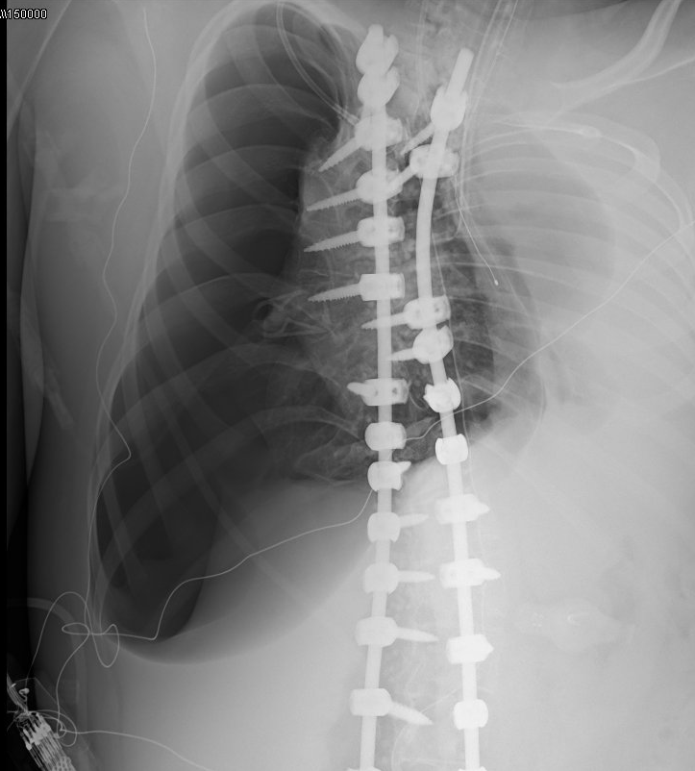
Intraoperative ptx, spinal wound infection
Recruitment maneuvers attempted without sustained improvement; albuterol + epi given
  Hypotensive requiring volume, epi, norepi
CXR obtained → large R tension PTX → needle decompression → reaccumulated → CT placed with improved saturations and BPs
Returned to PICU intubated, requiring pressors
Repeat surgery for definitive closure scheduled 9/22 given desire for morning OR slot and availability of anesthesia/orthopedics + plastics
CT remained through 9/29, multiple bronchoscopies, extubated to BIPAP 10/4

Slide 18
Intraoperative ptx, spinal wound infection
WHAT WENT WELL?
WHAT COULD BE BETTER?
Teamwork in the OR
  Call for help
PICU placement of chest tube
Postop management of air leak
Multiple washouts → antibiotic coverage?
Return to OR sooner

Slide 19
Cardiac arrest, chronic renal failure
2yM with hx of congenital hypothyroidism, congenital nephrotic syndrome, hypogammaglobulinemia, anemia 2/2 stage 4 CKD, GT dependence, chronic respiratory failure with OSA on home HFNC, seizures, CP admitted initially to the floor on 9/26 with irritability and crying
Infectious work-up initiated, evaluated for fracture with known hypercalcemia; intra-abdominal etiology assessed → pancreatitis (lipase >1600)
NPO, IVF → lipase downtrending
AKI worsened with inc Cr, oliguria and significant fluid overload leading to respiratory distress + need for escalating diuretic
RRT called and patient transferred to PICU on 9/29
  Placed on BIPAP, dexmedetomidine & Lasix infusion → no major desaturations overnight
9/30 0800 – RT at bedside for treatment and care, removed BIPAP mask and noted patient to have progressive bradycardia ultimately with loss of pulses (was not preceded by hypoxia by report)
Code blue called 0820 – CPR initiated, 4 mins + 1 dose of epinephrine → ROSC
Intubated, CVL + dialysis catheter placed
Remains intubated and on CRRT with oliguria

Slide 20
Cardiac arrest, chronic renal failure
WHAT WENT WELL?
WHAT COULD BE BETTER?
Code blue
Procedures
Rapid ID of code
Why????

Slide 21
Sedation after cerebral angiography
6-year-old male with a cerebellar AVM that was embolized once before in a different country, presenting to the PICU post-AVM embolization with IR in preparation for planned AVM resection with neurosurgery on 9/29/2026.
Uncomplicated IR course; extubated postoperatively and brought to the PICU extubated. Required precedex upon admission to PICU for emergence delirium
Patient required MRI prior to next-day surgical intervention and required repeat sedation for scan.

Slide 22
Sedation after cerebral angiography
WHAT WENT WELL?
WHAT COULD BE BETTER?
Exquisite NRSGY/Anesthesia/PICU care of this patient ☺
NRSGY taking accountability for miscommunication
Need for multiple sedation events in a 24-hour period
Communication amongst the multidisciplinary team
Cerebrovascular program pathway- Dr. Rolle to discuss on 10/13

Slide 23
Multiple arrest events, klebsiella uti
9 month old, ex 25 weeker with severe BPD and tracheobronchomalacia with several cardiac arrest events
9/5 Code Blue – high PIP alarms attended by RT → suctioning done and trach in place → low MV → asystole, TCOM 90s with 1 min CPR and BMV → ROSC
9/26 – Patient with Klebsiella UTI, sepsis pathway
1759 - Staff assist called for desaturation and bradycardia, CPR initiated at 1800 , 1803 epinephrine and atropine given, 1805 ROSC
9/27 – Prolonged cardiopulmonary arrest, 35 mins CPR , iNO initiation, 9 doses of EPI, remained on 2 vasoactives

Slide 24
Multiple arrest events, klebsiella uti
WHAT WENT WELL?
WHAT COULD BE BETTER?
Good quality CPR
Call for back up
Inconsistent Mapleson bag utilization
Family understanding of critical illness

Slide 25
mortalities
Neonatal meningitis
Post-arrest death by neurological criteria

Slide 26
Neonatal meningitis
3 week old female transferred from NCH Pensacola PICU with Klebsiella meningitis, septic shock and multiorgan failure.
Course complicated by status epilepticus, failed extubation due to neuromuscular weakness and MRI findings of multiple areas of diffucion restriction including corticospinal tracts of brainstem and frontoparietal pseudolaminar cortical necrosis.
Given poor neurologic prognosis family elected to transition to comfort care and limiting suffering.
Extubated on 9/17 at 720 am, received morphine and ativan and remained comfortable until passing away at 921 am

Slide 27
Neonatal meningitis
WHAT WENT WELL?
WHAT COULD BE BETTER?
Goals of care and communication with family
Palliative care consultation

Slide 28
Post arrest death by neurological criteria
17 y/o previously healthy male; unwitnessed cardiac arrest → field CPR, intubation, epinephrine
Arrival: GCS 3 → 4T; sluggish pupils, absent gag/blink, myoclonus; no evidence of trauma
Cardiac: elevated troponin, septal wall motion abnormality on echo, widened QRS on ECG
Toxicology screen negative except THC
EEG: burst suppression with NCSE → diffuse suppression, loss of reactivity; progressive cerebral edema
Management: seizure control, ICP therapy, vasopressors for cardiogenic shock, DI management
HD 4: brain death confirmed by exam and apnea test (2nd test) with date and time of death 9/29/26 at 1354
Arrest etiology unclear; genetic evaluation considered (Marfanoid features)

Slide 29
Post arrest death by neurological criteria
WHAT WENT WELL?
WHAT COULD BE BETTER?
Introduction of Palliative Care early
Control of in-PICU matters
Communication with the family
Strengthening the hospital’s response to high-conflict family situations, including how security is involved and how escalation pathways work
Traffic control outside of the PICU

Slide 30
Mortality Totals 2026

Slide 31
PICU Quality & Safety Metrics 2026 TOTALS
CLABSI: 0 for 2026
CAUTI: 0 for 2026
UE: 2 for 2026
UD: 6 for 2026
HAPI (all stages): 18 for 2026
Falls: 5 for 2026

Slide 32
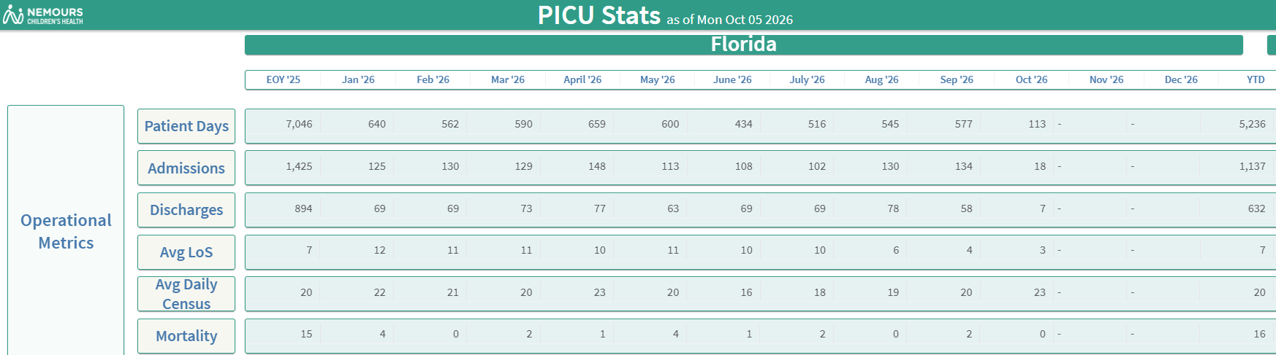
Operational metrics

Slide 33
Safety themes
Code blue vs staff assist alerts
Standardizing PCT responsibilities in codes, code cart location for all codes
UD and trach care bundle
Airway guardian

Slide 34

THE END

