Slide 1
M&M
Nisha Agasthya, MD, Neha Longani, MD, Kareen Jones, MD Jennifer Nestor, MD
June 2, 2026

Slide 2
CME
Text 1(904)506-7609
Successful completion of this CME activity, which includes participation in the activity, with individual assessments of the participant and feedback to the participant, enables the participant to earn 1.0 MOC Part 2 points in the American Board of Pediatrics (ABP) Maintenance of Certification (MOC) program. It is the CME activity provider's responsibility) to submit participant completion information to ACCME for the purpose of granting ABP MOC credit.
Today’s code: DAQYAV

Slide 3
CONFIDENTIAL PATIENT SAFETY WORK PRODUCT
Quality Assurance Information – Protected under Florida Statute #766.101
Protected under the Patient Safety and Quality Improvement Act. Do not disclose unless authorized by the Nemours Vice President for Quality & Safety or his/her designee.
All patient-identifying information is confidential and may not be disseminated outside of the committee setting, except as permitted by state or federal law

Slide 4
Learning Objectives
Review quality improvement/patient safety initiatives in the PICU
Review monthly adverse events, resuscitations and mortality
Understand current processes, procedures and environment of practice
Work to improve individual and group practice within the context of Nemours Children’s Hospital

Slide 5
Morbidities
Unplanned extubations
Unplanned line removals
EVD clamping error
Unplanned reintubation/Disruptive visitor
IO infiltrate/Compartment syndrome
Near herniation with posterior fossa tumor

Slide 6
Unplanned Reintubation, disruptive visitor
9 yo male with history of TBI and severe subglottic stenosis recovering form single stage laryngotracheal reconstruction that was complicated by graft failure and critical illness myopathy causing 2 previous failed extubations,extubated for the third time in the OR requiring reintubation after about 24 hours for acute hypoxic respiratory failure.
Reintubation likely due to critical illness myopathy and need for increased airway clearance. Reintubated by anesthesia team without incident. Underwent bronchoscopy after with removal of mucus plugs and thick secretions.
Parent trespassed after verbally abusing staff.

Slide 7
Analysis
What went well?
What could be better?
Rapid recognition of distress and appropriate management
Multidisciplinary team work
behavioral escalation pathway; more clarity?
Utilization of documentation in red flags section of EPIC for behavioral concerns
  A banner or chart pop-up to notify of safety concerns/trespassing – could be helpful across disciplines
Continued empowerment of staff to utilize behavioral contracts

Slide 8
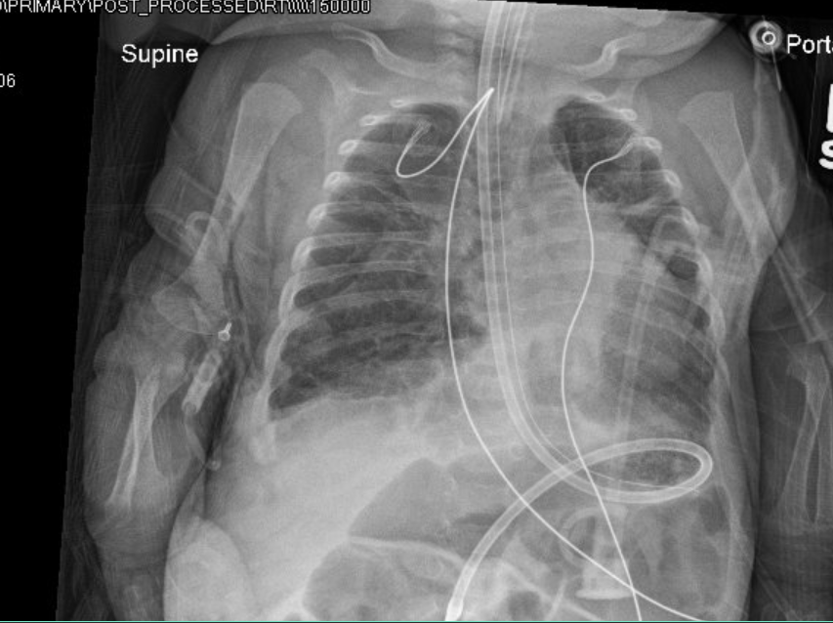
Unplanned Extubation
Patient: 6 mo ex-premature infant, chronic respiratory failure, pulmonary HTN, PV stenosis s/p balloon angioplasty/septoplasty, on sirolimus with ongoing acute on chronic respiratory failure needing invasive mechanical ventilation
Event: On the morning of 5/7, it was noted on the morning X-ray that the ETT was very high. Patient not in distress and still with end tidal, likely due to the tube being at the glottic opening. Uneventful re-intubation.

Slide 9
Analysis
What went well?
What could be better?
Prompt recognition of ETT malposition by bedside nurse
Quick action by care team to exchange ETT
Good communication amongst staff regarding plan of care
Family appropriately informed
Recognition came from an X-ray rather than at the bedside
Consider XR post mobilization (to parents’ arms, imaging, upright to chair)
  Do we need mobilization safety checklist? ETT position, line check
  RT systems check

Slide 10
Unplanned Extubation
Patient: 9 yo male, ex-23-weeker, HD 35 with complex chronic respiratory, neurologic, and GI comorbidities with acute hypoxic and hypercapnic respiratory failure with recurrent mucous plugging and atelectasis requiring invasive mechanical ventilation
Event: A nasally intubated patient with a 5.0 ETT hubbed at the right nare required a 5.5 ETT connector to extend the length for ventilator circuit connection. The larger connector progressively dilated the ETT, causing repeated circuit dislodgement. The tube became trapped in the nare and could not be removed or reconnected. ETT was removed orally. The left nare was found non-patent, could not pass a 10F catheter. The patient required oral re-intubation.

Slide 11
Analysis
What went well?
What could be better?
Team recognized the problem and escalated quickly
Successful oral reintubation with glideslope
Patient did not suffer prolonged loss of airway, hypoxia, or atelectasis
Shared mental model and team communication regarding tube length and connection issues
Use of a workaround without anticipation of downstream consequences
Standardize taping of nasal tubes
Magill access in D pod cart – assess what’s readily available

Slide 12
Unplanned line removals
Patient: 6 mo ex-premature infant, chronic respiratory failure, pulmonary HTN, PV stenosis s/p balloon angioplasty/septoplasty, on sirolimus with ongoing acute on chronic respiratory failure needing invasive mechanical ventilation
Event: Sutured CVL noted to have significantly migrated out on exam and noted to be in the neck on CXR→ required removal

Slide 13
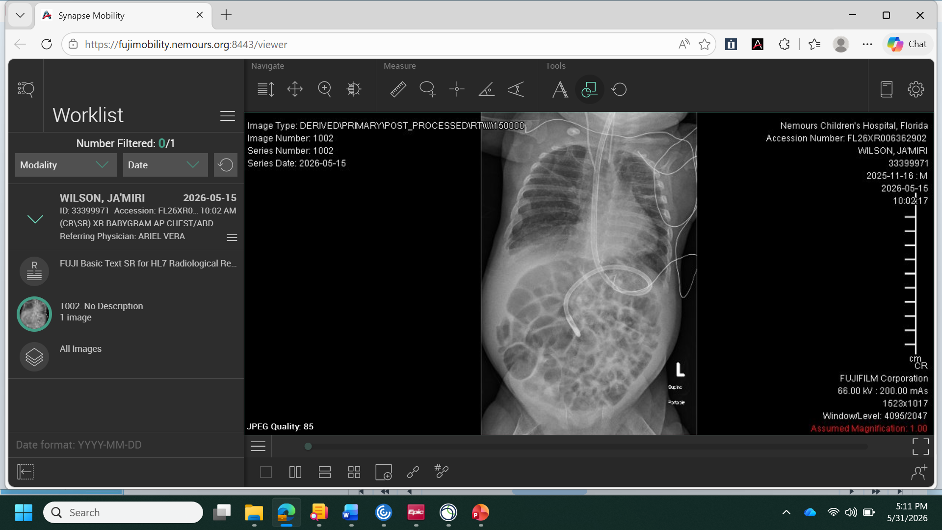
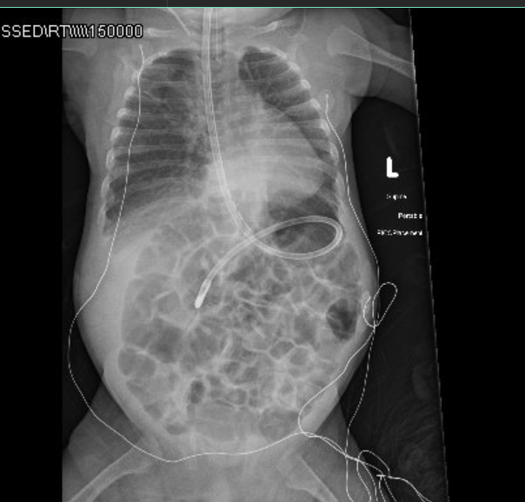
Unplanned line removals
5/15/26
5/17/26

Slide 14
Analysis
What went well?
What could be better?
Prompt recognition and removal
Communication with mom
Daily cxr?

Slide 15
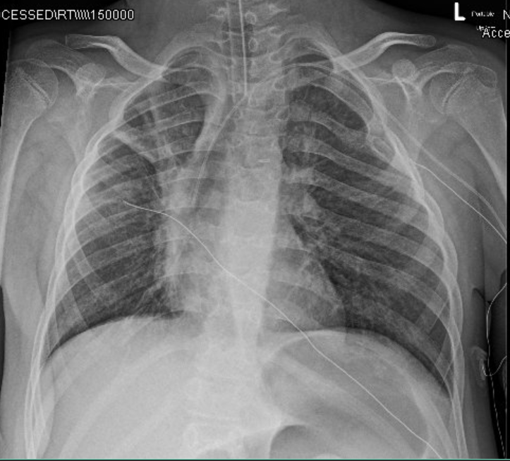
Unplanned line removals
Patient: 9 yo male, ex-23 weeker, HD 35 with complex chronic respiratory, neurologic, and GI comorbidities with acute hypoxic and hypercapnic respiratory failure with recurrent mucous plugging and atelectasis requiring invasive mechanical ventilation
Event: PICC line inadvertently removed during a diaper change

Slide 16
Analysis
What went well?
What could be better?
Communication with mom
Alternative to Opsite?
Proactive safety huddle opportunity

Slide 17
EVD Clamping error
3 year old with resected medulloblastoma with concern for meningitis, CSF leak from scalp
Transferred as RRT on 5/1
5/4 EVD placed and IV antibiotics
5/11 order placed to clamp EVD which occurred , however no ICP monitoring occurred
5/12 MRI completed and ICP monitoring initiated
5/13 EVD was removed

Slide 18
analysis
What went well?
What could be better?
Standardize clamping practices
  Should be at the drainage system
  Nursing policy/EVD training
  Order clarity
  Order set?

Slide 19
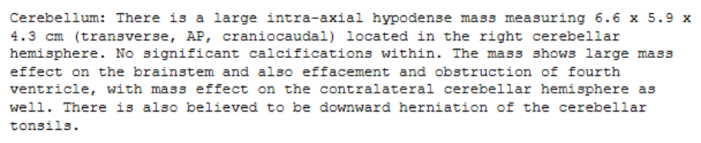
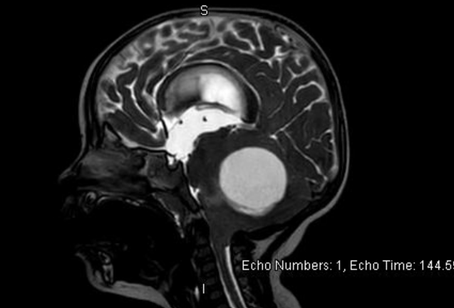
Near herniation with posterior fossa tumor
18 month old F previously healthy presenting on 5/28 with 1-2 weeks of ataxia, refusal to bear weight, several episodes of vomiting
PCP → ER
CTH obtained in ER revealing large posterior fossa mass, admitted to PICU for close neuromonitoring, facilitate brain MRI on 5/29 with anesthesia
6x6x5cm, likely pilocytic astrocytoma
Initiated on decadron per neurosurgery

Slide 20
Near herniation
Remained at baseline mental status with normal VS, tolerating PO post anesthesia on 5/29, plan for de-bulking on 6/3 (earliest available for neurosurgeon?)
Overnight 5/30 – 5/31, developed back arching, irritability and bradypnea without apnea
Acutely on 5/31 @ 11am, developed severe bradycardia to 40s, BPs to 120/90 , AMS (moaning, crying only with painful stimuli)
Hypertonic saline given, patient intubated and hyperventilated; repeat CTH obtained with increased hydrocephalus and worsening mass effect on brain stem
OR with neurosurgery for placement of R EVD, aspiration of cystic portion of mass, insertion of drain into cystic lesion, posterior fossa pressure monitor
Remains in PICU awaiting OR for complete debulking on 6/3

Slide 21
analysis
What went well?
What could be better?
Rapid identification of emergent change in status with appropriate management of increased ICP
Engagement with on call neurosurgeon to get to OR
Delayed debulking of tumor leading to significant morbidity and near mortality

Slide 22
Mortalities
Post cardiac arrest (+ IO use and compartment syndrome)
Leukemia, liver failure secondary to VOD, fungemia
Submersion
Pineoblastoma

Slide 23
Post-cardiac arrest, io infiltration with compartment syndrome
Patient: 2-year-old ex-premature infant, grade IV IVH, developmental delays, bronchopulmonary dysplasia, chronic respiratory failure with baseline oxygen requirement, and epilepsy, admitted to PICU s/p cardiac arrest following severe dehydration with associated metabolic derangements due to Rotavirus enterocolitis on 5/8.
Cardiac arrest occurred at OSH following intubation with ROSC achieved after 20 min CPR. Resuscitation was performed via IO
Patient arrived with 4.5 uncuffed ETT and IO infusing vasoactive infusions

Slide 24
Post-cardiac arrest, io infiltration with compartment syndrome
Event: severe IO infiltration with compartment syndrome
  Patient required ETT exchanged to a cuffed ETT due to a large leak. Upon medication administration through IO, it was noted not to be working as the patient was still moving, and the leg was noted to be significantly swollen. Both legs were notably poorly perfused. Epi is still infusing through the IO line.
  Another IO was placed for intermittent medications for the intubation. Subsequently, an arterial line and a CVL were placed, and epinephrine, norepinephrine, and vasopressin infusions were started through the new line. Prior IO is still being used up to this point (~1 hour).
  Ongoing leg swelling/mottling→ IO removed and Ortho consulted→ Ortho found child with compartment syndrome and performed fasciotomy with wound vac placement at bedside.

Slide 25
analysis
What went well?
Where can we improve?
Diagnosis and management
Ortho response

Slide 26
Post-cardiac arrest, io infiltration with compartment syndrome
Patient’s clinical condition continued to worsen with catastrophic hypoxic-ischemic brain injury with tonsillar herniation confirmed on head CT on 5/12 and the development of DI.
Neurologic exam was grim, and he progressed to clinical brain death. Brain death testing was aborted due to spontaneous patient movement. EEG was severely depressed with a nonreactive background and no EEG correlate to spontaneous upper extremity movement
On 5/13, a nuclear medicine cerebral blood flow study confirmed the absence of intracranial blood flow, consistent with brain death. A singular formal brain death test was completed, without an apnea test, with all prerequisites met and no confounding factors.

Slide 27
Post-cardiac arrest, io infiltration with compartment syndrome
Family elected to make patient DNR/DNI
He was pronounced dead on 5/13/2026 at 18:26 after withdrawal of life-sustaining support.

Slide 28
analysis
What went well?
What could be better?
Ability to get a nuclear medicine study quickly
Family communication/family needs met
In person Haitian Creole interpreter
Autopsy form?
  Accidental use of DE valley form
Concern about delayed Our Legacy approach
  What are best practices? What should approach be?

Slide 29
Leukemia, liver failure secondary to vod, fungemia
10yM with precursor B cell ALL on consolidation chemotherapy, history of vincristine-induced SIADH, non-TB mycobacterium infection of port-a-cath site and cellulitis admitted with fever, neutropenia to heme-onc floor on 4/30
Sepsis work-up completed, initiated on meropenem and vancomycin
  +REV, giardia in stool, pseudomonas in blood culture
  Oncology team noted patient to be hiding home oral therapies in shoe (linezolid, azithro, Na, Bactrim, augmentin, mercaptopurine)

Slide 30
Leukemia, liver failure secondary to vod, fungemia
Continued progression of poor perfusion with delayed cap refill, tachycardia, worsening mental status necessitating PICU transfer on 5/4
  LP deferred 2/2 fever, instability for natural airway sedation
  Concern for typhilitis with abdominal pain, addition of flagyl + restarted vanco + micafungin
  CT CAP obtained - +pneumonia, bowels collapsed; RUQ US with doppler with ascites
  Karius sent
5/5 – initiated defibrotide with concern for VOD (ascites, elevated bilirubin, refractory thrombocytopenia); no flow reversal
5/6 – intubation for hypotension, refractory pain, WOB
5/7 – Diffuse rash, +Candida tropicalis (moderate) on Karius, 5/8 – micafungin to amphotericin with recurrence of fever
Intermittent hypotension requiring vasoactives, significant fluid overload → Lasix infusion → CRRT on 5/11 with fluid overload, worsening hypoxemia; not an ECMO candidate

Slide 31

Leukemia, liver failure secondary to vod, fungemia
PLEX initiated 5/12 for continued liver failure (?asparaginase hypersensitivity reaction)
Continued uptitration of pressors to include epi, NE and vaso
Continued elevation of ammonia
Ongoing discussions with family, WOLST on 5/14

Slide 32
analysis
What went well?
What could improve?
Medical management of liver failure, fluid overload, fungemia
Benefit to amphotericin throughout? Earlier fungal treatment?
Standardized visitor policy, when to deviate? Who decides? Options?
Discuss at quarterly heme-onc joint M&M → to invite ID
  Discuss early palliative involvement
Approach to anticoagulation on CRRT with liver failure

Slide 33
Submersion
20 month old female with developmental delays and recent diagnosis of PPA2 gene mutation who presented post nonfatal submersion and cardiac arrest with ROSC after 15 rounds of CPR and epi, Bicarb x 4 doses and intubation (OSH), requiring vasoactive infusions for safe transport to NCH.
On arrival, child was managed for ARDS requiring high peep ventilation and iNO along with escalation of vasoactives with worsening hemodynamics. With continued clinical deterioration, progressive multiorgan failure, no appreciable responsiveness, family made the decision to withdraw care.

Slide 34
Analysis
What went well?
Where can we improve?
Family support
Valiant resuscitative efforts

Slide 35
Pineoblastoma
7moF with known pineoblastoma and previously placed VP shunt presenting with lethargy, vomiting, +coronavirus positive
Received initial care at Joe DiMaggio Children’s Hospital – family was offered no further chemotherapy or surgical options, transferred care to NCH
Admitted 4/14 – 4/23 – evaluated by neurosurgery, oncology → oral chemotherapy offered to family, no surgical interventions offered
  Discharged home with slight improvement in exam, taking PO hydration, return to care discussed with family
  Parents not amenable to DNR status during admission
Arrived to PICU early AM 5/13, pupils unequal, no response to sternal rub, repeat imaging with increased ventricle size, tumor size stable

Slide 36
Pineoblastoma
Repeat CTH, HTS for worsening pupillary asymmetry
At 11p on day of admission, developed posturing, irregular breathing
  Diazepam given after discussion with family
Staff assist called for apnea shortly thereafter
  Flumazenil administered without improvement in breathing pattern
Discussed with family impending death and signs and symptoms of progression and irreversibility of her disease
Family opted to make her comfortable, deceased on 5/14

Slide 37
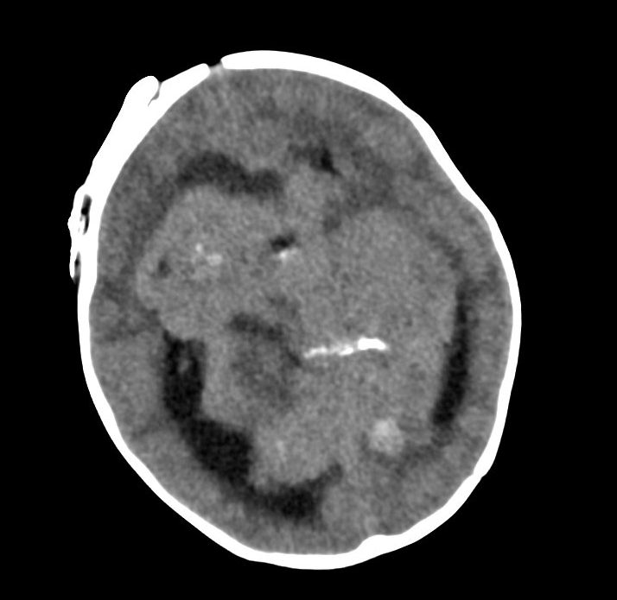

Slide 38
Analysis
What went well?
What can we improve
Able to guide family to DNR at time of rapid progression to herniation
Time at home for child/family
Involvement of palliative care team
Meghan!!

Slide 39
Mortality Totals 2026

Slide 40
Quality & Patient Safety Corner

Slide 41
PICU Metrics 2026 TOTALS
CLABSI: 0 for 2026
CAUTI: 0 for 2026
UE: 2 for 2026
UD: 4 for 2026
HAPI: 11 for 2026
Falls: 2 for 2026

Slide 42
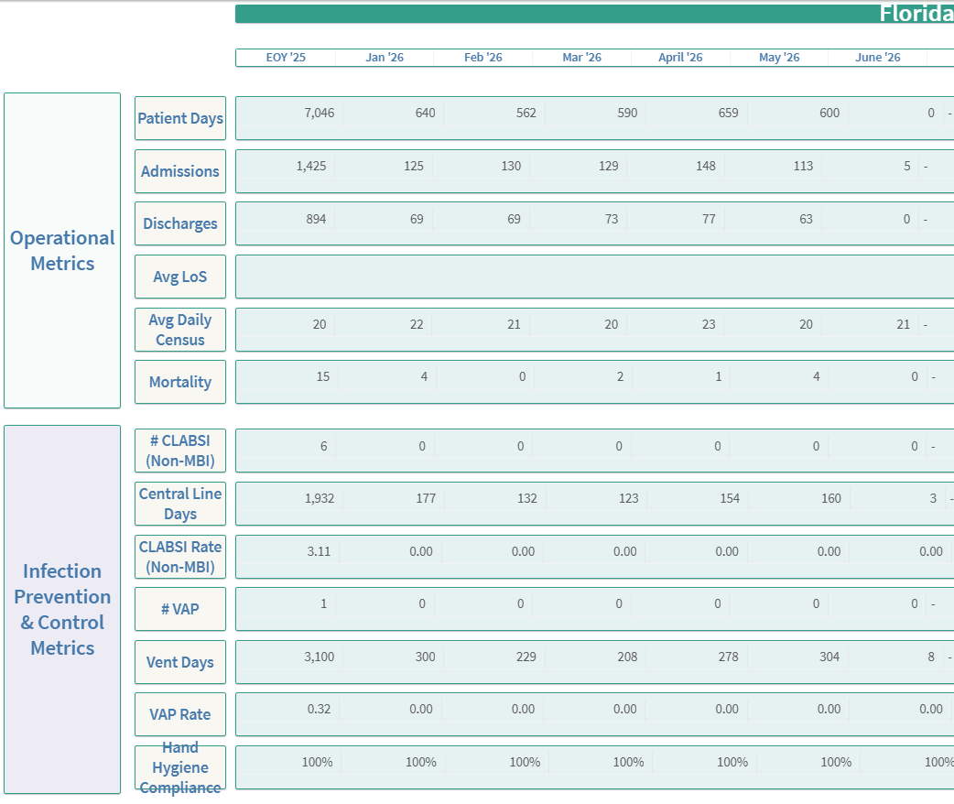
Operational metrics

Slide 43
Safety themes
ACA – UD and UE – May 2026 ( still ongoing)
Sedation for ETT re-taping
Definition of “Critical Airway”

Slide 44

THE END

