Slide 1
M&M
Nisha Agasthya, MD, Neha Longani, MD, Kareen Jones, MD, Jennifer Nestor, MD
September 1, 2026

Slide 2
CME
Text 1(904)506-7609
Successful completion of this CME activity, which includes participation in the activity, with individual assessments of the participant and feedback to the participant, enables the participant to earn 1.0 MOC Part 2 points in the American Board of Pediatrics (ABP) Maintenance of Certification (MOC) program. It is the CME activity provider's responsibility) to submit participant completion information to ACCME for the purpose of granting ABP MOC credit.
Today’s code:
LUVCUW

Slide 3
CONFIDENTIAL PATIENT SAFETY WORK PRODUCT
Quality Assurance Information – Protected under Florida Statute #766.101
Protected under the Patient Safety and Quality Improvement Act. Do not disclose unless authorized by the Nemours Vice President for Quality & Safety or his/her designee.
All patient-identifying information is confidential and may not be disseminated outside of the committee setting, except as permitted by state or federal law

Slide 4
Learning Objectives
Review quality improvement/patient safety initiatives in the PICU
Review monthly adverse events, resuscitations and mortality
Understand current processes, procedures and environment of practice
Work to improve individual and group practice within the context of Nemours Children’s Hospital

Slide 5
Morbidities
Aspiration event in MRI
JIA with MAS, MOD
Emergent EVD placement
  Code blue – bronchospasm
Code blue - severe BPD
Post-op appendectomy with abscess
Shunt malfunction to PICU prior to OR

Slide 6
Aspiration event in mri
13yM with history of 27-week prematurity, IVH with resultant profound developmental delay, SQCP, GT dependence, scoliosis and intractable epilepsy presenting after sEEG lead placement on 8/24
Uncomplicated lead placement with no issues on postop CT scan, due to undergo MRI on POD1 with subsequent transfer to EMU
Placed on dexmedetomidine postoperatively, weaned to 0.4 mcg/kg/hr overnight
MRI slot on POD1 at 3pm, dexmedetomidine infusion continued
Brought to MRI by sedation team on same infusion
Large volume coffee ground emesis while flat in MRI scanner, resulting in WOB and hypoxia, placed on NC

Slide 7
Aspiration event in mri
Patient developed fever, worsening respiratory distress and hazy infiltrates on XR necessitating HFNC
Planned to intubate in the afternoon POD3 to obtain MRI but work of breathing necessitated AM intubation
Remains in PICU, extubated on POD7 – continues to require HFNC support

Slide 8
Aspiration event
WHAT WENT WELL?
WHAT COULD BE BETTER?
Care in MRI with sedation team (scan aborted)
Early intubation
Plan generated with neurology, neurosurgery
Other sedation approach? Airway?
Case selection for sEEG lead placement
EMU bed reassigned prior to discussion with attending

Slide 9
Jia with MAS, MOD
10yF with history of JIA presenting on 8/3 with fever and painful lymphadenopathy
Initially admitted to general pediatrics, VS WNL
  Sepsis workup initiated, heme/onc consulted, IL2 sent for HLH consideration
  Anakinra dose increased
  Lymph node biopsy obtained
8/6 RRT generated by hospitalized team for fever, tachycardia, new O2 requirement of 2L NC – PICU evaluated at bedside – child generally well appearing (eating snacks in bed), overall stable, remained on floor
  Re-evaluated by PICU team 3-4 hours later, fever improved but remained slightly tachycardic – IVF recommended

Slide 10
JIA with MAS, MOD
Repeat RRT generated with hypotension with SBP in 60s on 8/7 @ 0400, several episodes of emesis and ongoing tachycardia
  IV fluid bolus given
  Remained hypotensive, transferred to PICU
Acute decompensation at 0900 with persistent hypotension requiring pressor
  Intubated, CVL and arterial line placed
Significant concern for MAS
Bonus:
  Significant emapalumab infiltrate (administered via PIV on 8/8, 8/11, 8/14)
  Required administration of 2nd half of dose via CVL

Slide 11
JIA with MAS, Mod
WHAT WENT WELL?
WHAT COULD BE BETTER?
Appropriate use of RRT system
Identification of progression on floor
Swift critical management after decompensation
IV infiltrate – should this have been given via CVL?

Slide 12
Post Op Epilepsy Surgery and Cerebral Edema and near herniation
2 year old male admitted post op after posterior quadrant disconnection on the left side of brain for intractable epilepsy on 8/10 (POD#0)
Left sided EVD and subgaleal JP drain placed intra op
Extubated post op and maintained on neuroprotective measures post op
POD#1 emesis with continuous feeds , EVD open at 10 above tragus and ICP ranged 10-15
POD#2 ICP WNL – spaced to every 6 hours , EVD open and draining 6-20 ml/hour

Slide 13
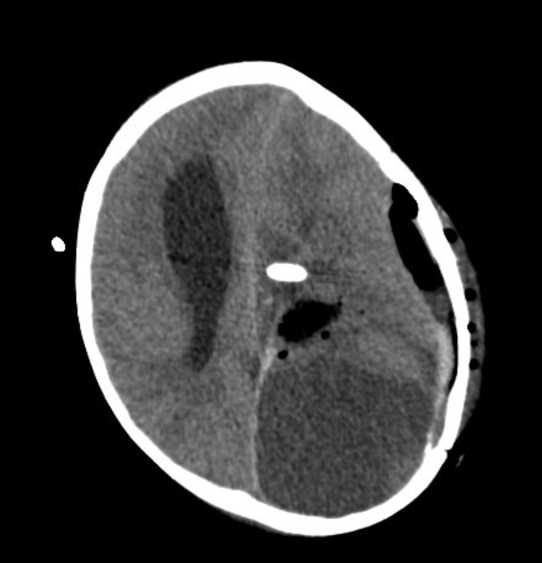
Post Op Epilepsy Surgery and Cerebral Edema and near herniation
POD#3 continued emesis, US abdomen negative , pupils equal and reactive 4 mm b/l
POD# 4 continued emesis, ICP 18 overnight – at 7 am noted to have left pupil 7 mm and right pupil 4 mm and non reactive – EVD remains at 10 above tragus – ICP 26-28
Emergent Head CT 1. Interval worsening of the midline shift from left to right, now 10 mm, previously 4mm. Para falcine herniation of the cerebral parenchyma to the right. 2. Increased compression and distortion of the brainstem. 3. Interval increase in the effacement of the left lateral ventricle and interval increase in the dilatation of the right lateral ventricle as described.

Slide 14

Post Op Epilepsy Surgery and Cerebral Edema and near herniation
POD#4 emergent intubation bedside and right sided EVD placed
Pupils near equal post intubation
Neuroprotective measures continued and extubated on POD#9
Neuro exam returned to previous baseline during PICU admission
Transferred from PICU to floor on 8/24
RRT on 8/25 for pupils being slightly unequal which was new post op baseline, normal neuro exam , CT head with resolved edema and improved post op changes
Remained in PICU for parental concern for oral secretions and monitoring of feeds – tolerated Pedialyte without issues
8/27 (POD#18) with increased creatinine from 0.4 to 1.5 , FENa 13%
Worsening renal function with hemolysis and thrombocytopenia – now with post op TMA on CRRT +PLEX since 8/28

Slide 15
Learning
What went well ?
What can be better ?
Neurosurgeon bedside and recognized pupil change and updated team during handoff
Neurosurgeon in CT when patient taken down by PICU team
Quick mobilization of personnel and equipment for emergent intubation
ICP measurements spaced to every 6 hours
ICP measurements not frequent when noted to be 18 overnight – unclear if provider was notified
Recurrent emesis sign of elevated ICP ?

Slide 16
Cardiac arrest secondary to hypoxemia
Same patient experienced sudden O2 desaturation on 8/28
Intubated earlier in the day and underwent renal biopsy and dialysis catheter placement in IR
O2 desaturation to 30% and difficulty hand ventilation – ventilator with high PIP alarms
Pulseless and 2 min CPR
CPR started immediately
Epi administration in 1 min
ROSC at 2 min pulse check
Bronchospasm and secretions – responded to albuterol with improved compliance

Slide 17
Learning
What went well ?
What could be better?
Immediate recognition for need for CPR
Staff assist response called by Laura Mohr
Code leader identification
Early Epi administration
Adult pads placed when zoll arrived

Slide 18
Severe cystic BPD and tracheobronchomalacia – cardiac arrest from BPD spell and pulmonary HTN
8 month old , born at 25 weeks now in PICU with desaturation during bowel movement on 8/25
On PEEP 22 – recognized by bedside RN during diaper change to saturate
Staff assist called for desaturation to 40%
Propofol and roc given and hand ventilation started with asystole
CPR started immediately
Hand ventilation with high PEEP – initially with self inflating bag and no chest rise – then switched to flow inflating bag with ROSC
Patient was sedated on opioid and precede infusion and vecuronium for 24 hours

Slide 19
Learning
What went well ?
What can be better ?
No delays in CPR
Vest handed to code leader by Dr. Nestor
Bag mask switched quickly when effective chest rise not achieved which resulted in ROSC
Etco2 was disconnected by RT during emergent need for BMV and recognized when CPR initiated and added to trach

Slide 20
Post-op appendectomy with abscess
10 year old male admitted to the general surgery service 3 days after being discharged home from laparoscopic appendectomy (POD 9) with ongoing fever and RLQ pain.
  Ultrasound demonstrated 2 large abscesses, confirmed with CT scan demonstrating up to 5.8 cm abscess in the RLQ and 4.6 cm abscess in the deep pelvis and diffuse inflammatory changes with small pockets of complex fluid.
  Child initiated on ceftriaxone and flagyl with ongoing conversation to identify best surgical intervention ie IR vs general surgery
Clinically well appearing in all documentation, noted only to have persistent fever with intermittent tachycardia and prolonged INR necessitating FFP.

Slide 21
Team decided to move forward with IR guided abscess draining
Procedure delayed by 1 day due to a prolonged IR case (adm 8/8, drained 8/11
Intraprocedure, the child developed a severe inflammatory response requiring significant doses of vasoactives for hemodynamic support
Post procedure, child admitted to PICU intubated and on high doses of vasoactives
Weaned off vasoactives overnight and extubated the following day with discharge home 3 days later.

Slide 22
analysis
What went well?
Where can we improve?
Shock state quickly recognized and managed aggressively intraprocedure
Appropriate transition of care to PICU with appropriate de-escalation
Great communication between PICU and all teams
Was there a delay in care?

Slide 23
Was there preventable harm?

Slide 24
Shunt malfunction
16 yo mal with autism, CP and shunted hydrocephalus presenting with decreased level of consciousness, emesis and found to have significant hydrocephalus on CT at outside hospital concerning for shunt malfunction. Child emergently transferred to NCH with original plans to go straight to the OR, then to PICU.
Non Nemours transport team conducted transport
Child arrived to PICU first, was then taken to OR for decompression
Child returned to PICU after shunt revision and was discharged home the following day

Slide 25
Shunt malfunction
What went well?
Where can we improve?
Child received the care needed
Communication lapse when non-Nemours transport team in charge of transport

Slide 26
July Mortalities
From month of July 2026, previous session
  Submersion injury
  Salmonella meningitis and septic shock

Slide 27
Submersion injury
17 month old F, admitted to PICU on 7/8/26 from Palm Bay after cardiac arrest secondary to unwitnessed submersion injury with unknown downtime. Neuroprotective strategies and post cardiac arrest management in PICU.
On 7/9 stat head CT significant for HIE and severe generalized cerebral edema with descending herniation of the cerebellar tonsils with normal CT of the C spine.
On 7/10 she was taken for c spine MRI which was consistent with acute ischemic injury and cord edema from the craniocervical junction to C6. Again it was noted that cerebellar tonsillar herniation into the upper cervical spinal cord. She was then cleared from the C-collar.
First Brain death exam was completed 7/11 and was consistent with brain death.
Worsening hemodynamics on 7/12 with escalating vasoactives. Family resistant to Second Brain death examination planned to be completed 7/12 during day shift . Ongoing discussion with family who discussed legal plans with medical team. Nuclear medicine flow scan requested by family and declined by team and CT Brain repeated on 7/12 which showed worsening cerebral edema and concern for brain death on reading.
Patient with hemodynamic issues and eventually made patient DNR and maxed on vasoactives. Extubated on 7/13 per family request and cardiac death on 7/13 at 0110.

Slide 28
Submersion injury
WHAT WENT WELL?
WHAT COULD BE BETTER?
PICU leadership support
Risk management notified early
Limited engagement from hospital leadership outside the PICU with families directly in shared decision-making conversations with burden of providing medical management and navigating family’s preferences to delay/avoid BD testing
Child life engagement with memory making

Slide 29
Salmonella meningitis, brain death
2 month old male twin born FT via C-section, UTD on vaccines, admitted as a transfer on 7/18-19
Patient brought to ER on 7/17 for fever and decreased PO x 3 days
  Blood culture obtained, discharged home
  Returned to care after blood culture positive for gram negative rods
  Given CTX & transferred
On arrival, bulging fontanelle and seizure like activity, lactatemia to 3.7, thrombocytopenia, AKI, heart failure with EF of 40%
  LP initially deferred, brain US c/f meningitis
  Initiated on milrinone
Intubated on 7/19 for c/f for ICP increase – NR pupils, A/Bs; LP later obtained
7/20, blood culture at OSH positive for Salmonella, ciprofloxacin added
On EEG with status epilepticus, increasing AED needs, worsening AKI
  Midazolam, fosphenytoin, Keppra, phenobarbital

Slide 30
salmonella meningitis, brain death
  7/20 – MRI obtained
    Diffuse cerebral edema with effacement of the basilar cisterns indicative of herniation; diffuse restricted diffusion involving the supratentorial and infratentorial brain
    Conversation re: results with mother, church community
  Anuria, AKI – nephro consulted → dialysis would be futile
    Bumetanide and calcium infusions
  7/23 – neurology signs off – “patient is likely brain dead”
  Phb and free phenytoin levels trended, Phb < 10 on 7/26 @ 0900, first brain death exam completed, consistent with brain death; family not amenable to repeat testing
  Second exam completed on 7/27 @ 1300, time of death 1402

Slide 31
salmonella meningitis
WHAT WENT WELL?
WHAT COULD BE BETTER?
Decision to not offer CRRT clear from nephrology
Timeline for brain death testing

Slide 32
Mortality Totals 2026

Slide 33
Quality & Patient Safety Corner

Slide 34
PICU Quality & Safety Metrics 2026 TOTALS
CLABSI: 0 for 2026
CAUTI: 0 for 2026
UE: 2 for 2026
UD: 3 for 2026
HAPI (all stages): 15 for 2026
Falls: 3 for 2026

Slide 35
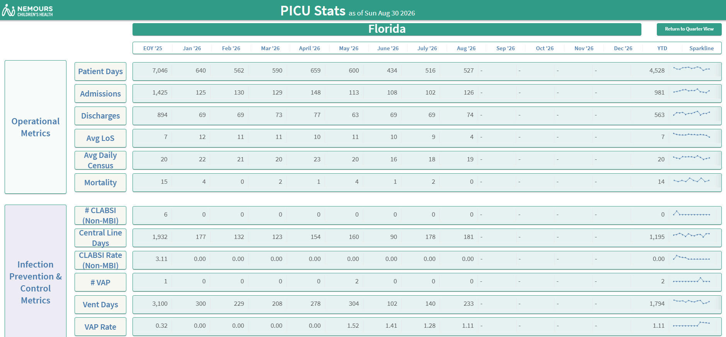
Operational metrics

Slide 36
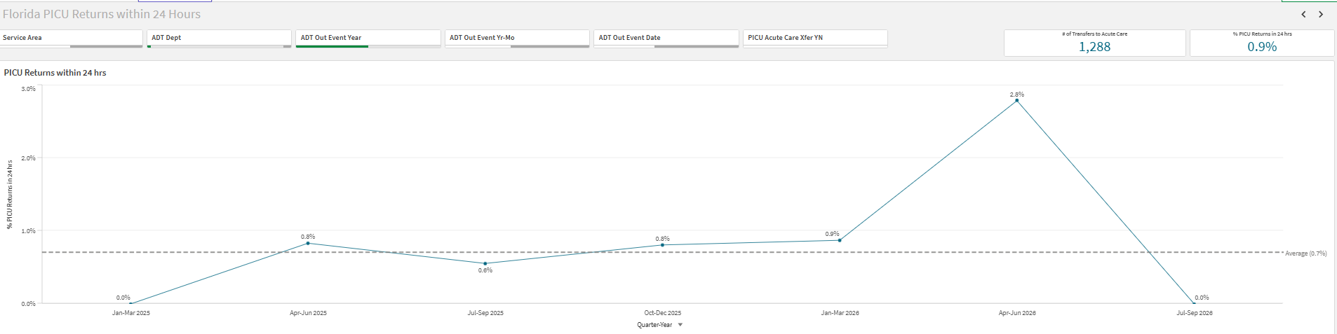
PICU returns within 24 hours

Slide 37
Safety themes
PICU / Neurology Learning teams – LTM and SEEG communication pathway ongoing discussion
Mock Code Blue Program to focus on nursing , PCT roles and responsibilities over the next quarter

Slide 38

THE END

