Slide 1
M&M
Nisha Agasthya, MD, Neha Longani, MD, Kareen Jones, MD, Jennifer Nestor, MD
July 7, 2026

Slide 2
CME
Text 1(904)506-7609
Successful completion of this CME activity, which includes participation in the activity, with individual assessments of the participant and feedback to the participant, enables the participant to earn 1.0 MOC Part 2 points in the American Board of Pediatrics (ABP) Maintenance of Certification (MOC) program. It is the CME activity provider's responsibility) to submit participant completion information to ACCME for the purpose of granting ABP MOC credit.
Today’s code:
SUPTUT

Slide 3
CONFIDENTIAL PATIENT SAFETY WORK PRODUCT
Quality Assurance Information – Protected under Florida Statute #766.101
Protected under the Patient Safety and Quality Improvement Act. Do not disclose unless authorized by the Nemours Vice President for Quality & Safety or his/her designee.
All patient-identifying information is confidential and may not be disseminated outside of the committee setting, except as permitted by state or federal law

Slide 4
Learning Objectives
Review quality improvement/patient safety initiatives in the PICU
Review monthly adverse events, resuscitations and mortality
Understand current processes, procedures and environment of practice
Work to improve individual and group practice within the context of Nemours Children’s Hospital

Slide 5
Morbidities
Cardiac tamponade with delayed RRT
Multiple floor/PICU transfers
CSF leak after tumor excision
CODE BERT
Baker Act with parent trespassing
PLEX catheter fracture

Slide 6
Cardiac tamponade, rrt delay
11-year-old with epilepsy and global developmental delay secondary to cardio-facio-cutaneous syndrome who presented to OSH with prolonged fevers, hematochezia, worsening acral edema of extremities, and petechial rash, pleural and pericardial effusions thought to be inflammatory or due to immunodeficiency.

Slide 7
Cardiac tamponade, rrt delay
Timeline;
  6/6: Transferred from Pensacola to CVICU for management of large pericardial effusion, managed with IV diuretics and serial Echos. Pericardial effusion stable
  6/8: Transferred to Hospitalist service for ongoing management. Persistently tachycardic (HR 115-130; otherwise, VS stable)
  6/11: Echo revealed worsening pericardial effusion with tamponade physiology. RRT called, and the patient was transferred to the PICU.
Rest of course: Continued management with diuretics and ultimately had a pericardial window with drain on 6/19. Discharged from CVICU on 6/25 with resolution of lab abnormalities, stable VS (HR 90-100s), and NG feeds

Slide 8
Cardiac tamponade
What went well?
What could be better?
RRT initiation ask from PICU nursing
Transfer to hospitalist team?
Clear communication with family, shared mental model
Drainage sooner

Slide 9
Multiple transfers
11 week old female, ex-37 weeker, with PFO, laryngomalacia, dysphagia, NGT dependence, reflux, and FTT admitted to the PICU initially for viral bronchiolitis and worsening stridor.
05/30 0302 Admitted to Nemours Children's Hospital, Florida, PICU from ED 06/02 1747 Transferred out of Nemours Children's Hospital, Florida, PICU
06/05 0549 Transferred to Nemours Children's Hospital, Florida, PICU
(RRT for acute onset retractions requiring HFNC and tx to PICU)
06/06 1159 Transferred out of Nemours Children's Hospital, Florida, PICU
(Weaned off HFNC, racemic epi x 1 dose and transferred to floor)
06/07 1134 Transferred to Nemours Children's Hospital, Florida, PICU
(RRT for worsening stridor with intermittent desats, decadron given, ENT called for assessment)

Slide 10
Multiple transfers
What went well?
What could be better?
ENT intervention sooner

Slide 11
CSF Leak after tumor excision
20 month old with ataxia initially admitted to PICU on 5/28 found to have posterior fossa tumor and obstructive hydrocephalus
Demonstrated evidence of herniation, requiring emergent EVD placement and intubation
Underwent craniotomy on 6/3 for gross total resection, pathology consistent with pilocytic astrocytoma, EVD removed 6/5
Downgraded to floor on 6/9 requiring ongoing monitoring of sodium levels (in the setting of salt wasting) and continued morphine wean
Per note on 6/10, swelling/bogginess of R occipital region noted without drainage
Transferred to rehab service on 6/12, 6/13 neurosurgery note with “small pseudomeningocele without CSF leak”
6/14 – CSF leak noted, sutures placed at bedside by neurosurgery

Slide 12
CSF Leak after tumor excision
6/14 – developed sustained tachycardia, sepsis work-up initiated and antibiotics started
Transferred to PICU given ongoing tachycardia on 6/15
  LP and CT obtained
  Fluid resuscitation
  ID engaged
MR brain obtained – no evidence of meningitis, ventriculitis
Tachycardia improved, cultures negative, inflammatory markers downtrended – antibiotics stopped on 6/20 – aseptic meningitis?
Discharged 6/21

Slide 13
CSF Leak after tumor Excision
WHAT WENT WELL?
WHAT COULD BE BETTER?
Obtaining appropriate studies for evaluation in a timely fashion
ID engagement
Delay in transfer?
Sedation for sutures?
Neurosurgery involvement?

Slide 14
CODE BERT
16 years 8 mos old male at Hospital Day with hx of 2 months of psychosis admitted with altered mental status secondary to autoimmune encephalitis vs primary psychiatric disorder.
Code BERT on 6/22, 6/30, 7/1 – requiring chemical and mechanical restraints
Injury to several staff members during attempts to deescalate patient

Slide 15
Code bert
WHAT WENT WELL?
WHAT COULD BE BETTER?
Triggering Code BERT for security assistance
Duress badge use by nurses
Restraint education and training on appropriate positioning and size
Consider Earlier transfer of patient to facility with psychiatry services ?

Slide 16
Baker act with trespass
16 year old male with past medical history of ADHD that presents to outside hospital due to seizure like activity and diphenhydramine overdose of unclear intent
Patient admitted to neurologist about intent to self harm and overdose – however denied these concerns to PICU and psychologist
Baker act deemed to be essential per neurologist report and documentation , however neurologist did not sign Baker act following day

Slide 17
Baker act with trespass
WHAT WENT WELL?
WHAT COULD BE BETTER?
Collaboration with risk management on steps to initiate Baker act
Neurology team collaboration
Risk management follow up with neurologist for not following Baker act process ?

Slide 18
Plex catheter fracture
16yM with no major history presenting with acute AMS (hallucinations, agitation, echolalia) with psychosis x 2 days, admitted 6/19
Underwent work-up for autoimmune encephalitis including CT/MRI of brain, lumbar puncture and serum evaluation
Had seizure and significant dysautonomia with bradycardia, hypertension
Received IVIG, high dose steroids with waxing and waning mental status
Ultimately with persistent encephalopathy, was intubated on 6/22
  PLEX catheter placed and secured in R IJ to begin plasmapheresis

Slide 19
Plex catheter fracture
  Plan for 5 treatments, every other day; initiated on 6/22; tolerated well
  Improved mental status, able to mouth around tube, follow commands; Extubated on 6/25 – remained in soft bilateral wrist restraints with ongoing confusion and pulling at lines, sitter at bedside
  At ~8am on 6/28, staff assist called as patient pulled on and twisted CVL, tearing tubing of one lumen between clave and skin insertion, distal to dressing
  Team to bedside, hemostat placed and patient sedated with lorazepam
  Required propofol boluses, infusion to rewire CVL; dexmedetomidine to facilitate PLEX #4
  Ultimately completed 5 treatments (dexmedetomidine and lorazepam required for 5th treatment); intermittent dosing of lorazepam and Haldol for continued agitation and confusion

Slide 20
Plex catheter fracture
WHAT WENT WELL?
WHAT COULD BE BETTER?
Quick action to secure catheter and sedate patient after issue identified
Replacement of line under sedation
Maintained line without additional issues thereafter
Restraint functionality?
Sitter/dialysis team intervention?

Slide 21
Robotic Chole/Intraperitoneal Hemorrhage with Hemorrhagic Shock
17-year-old medically complex patient with VSD and RVOT obstruction, aortic coarctation, s/p multiple cardiac surgeries, most recent on 4/30, initially admitted on 6/19 for choledocho/acute pancreatitis, transferred to AdventHealth on 6/20 for ERCP, though not done, now transferred back to NCH PICU for cholecystectomy on 6/24. Following robotic chole, patient transferred to the floor.

Slide 22
Robotic Chole/Intraperitoneal Hemorrhage with Hemorrhagic Shock
Timeline:
  6/24: Uneventful robotic cholecystectomy. Transfer to floor on surgical team service
  6/24 (3 hours post op): RRT called for hypotension, BP 70/30s. Pt pale, hypothermic, with blue lips. Found to be acidotic with a pH of 7.18 and a lactic acidosis of 2.99. Fluid resuscitation ongoing with improvement in lactic acidosis and metabolic acidosis (1.7 and 7.38, respectively). Hgb 10.5. Stable echo. and patient placed on HFNC. Pain control
  6/25: Improvements in BP with some intermittent lows. Asymptomatic without tachycardia. Advancing diet. Discharge planning
  6/25: Patient again hypotensive 60/40s with HR 140s with rising lactate of 5 and pale on exam. Slight improvement with fluid resuscitation. Hgb 5.8. ECHO with hyperdynamic LV with no RV dilation. Abdominal US with free fluid in the abdomen. Patient taken back to OR for emergent ex-lap and found to have arterial bleed of cystic plate.

Slide 23
Robotic Chole/Intraperitoneal Hemorrhage
WHAT WENT WELL?
WHAT COULD BE BETTER?
RRT
Imaging on initial presentation of hypotension
Faster return to the OR

Slide 24
Alexander disease, comfort care
15 mo old female chronic ongoing medical hx of Alexanders disease, epilepsy monoallelic mutation of GFAP gene, macrocephaly and mild persistent asthma , oropharyngeal dysphagia on NJ feeds, with persistent stridor with severe work of breathing refractory to nebulized epinephrine and steroids with acute hypoxemic respiratory failure from severe extra thoracic airway obstruction likely from laryngotracheobronchitis vs airway malacia from baseline neuromuscular weakness.

Slide 25
Alexander disease, comfort care
Her respiratory status required escalation to high-flow nasal cannula, heliox, systemic steroids, and airway clearance therapies to alleviate stridor, with intermittent attempts to wean off heliox resulting in recurrence of symptoms and necessitating its reinstitution. Further operative ENT evaluation was deferred due to concerns regarding her ability to be extubated post-procedure, given her advanced neuromuscular weakness and poor prognosis.
Despite maximal medical therapy, her stridor and respiratory distress persisted, and after multidisciplinary discussions with the PICU and palliative care teams, her family lovingly elected to transition to DNR/DNI status on 6/11/2026, prioritizing comfort and quality of life.
Intravenous fluids and enteral nutrition were discontinued to minimize discomfort and avoid fluid overload, while oxygen and enteral medications were continued for comfort. Palliative care and child life services were engaged to support the family and facilitate memory-making activities.
Gabriella died on 6/12/2026 at 11:47 due to progressive respiratory failure secondary to worsening neuromuscular weakness from infantile Alexander syndrome.

Slide 26
Alexander disease
WHAT WENT WELL?
WHAT COULD BE BETTER?
Family engagement
Palliative engagement
Thoughtful management with QOL considerations

Slide 27
Mortality Totals 2026

Slide 28
Quality & Patient Safety Corner

Slide 29
PICU Quality & Safety Metrics 2026 TOTALS
CLABSI: 0 for 2026
CAUTI: 0 for 2026
UE: 4 for 2026
UD: 4 for 2026
HAPI (all stages): 13 for 2026
Falls: 3 for 2026

Slide 30
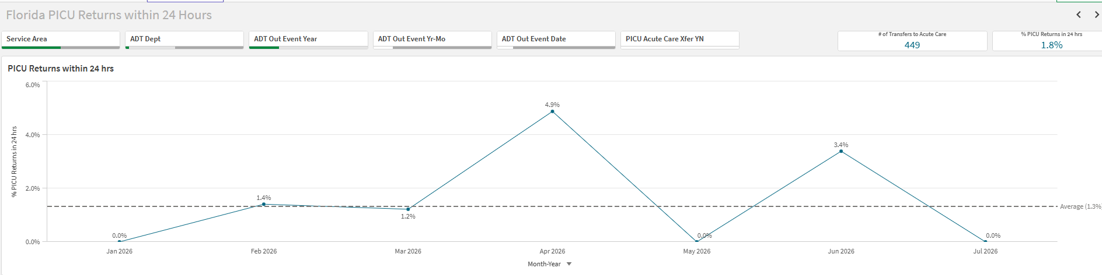
Operational metrics
PICU Returns within 24 hours

Slide 31
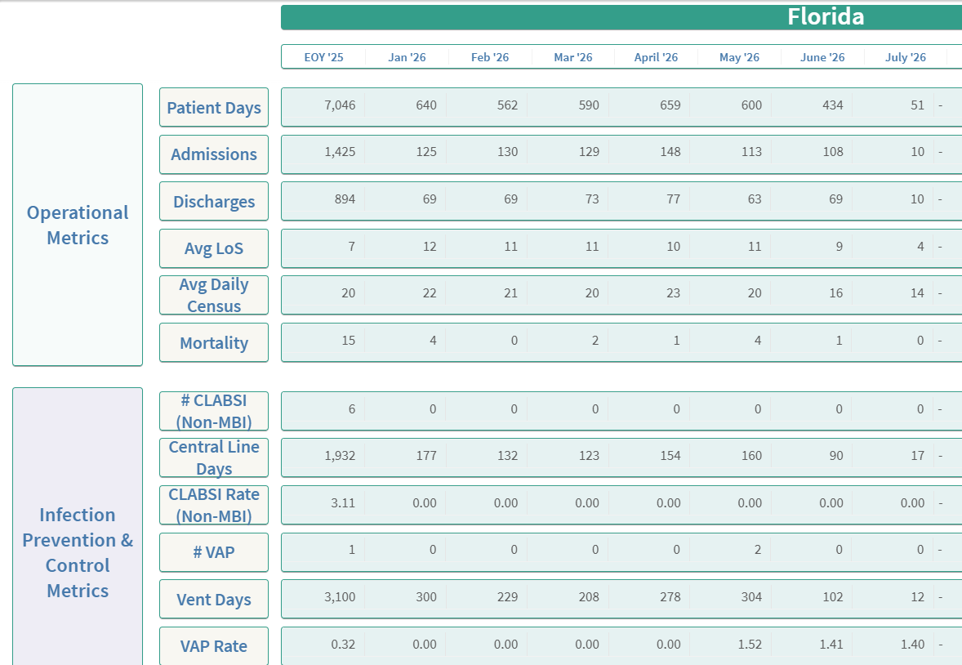
Operational metrics-dashboard

Slide 32
Safety themes
PICU dashboard page almost complete – sharepoint access
Secure chat/ communication survey
ACA- Unplanned extubation/ Decannulations – post event debrief (RT driven)
Proactive safety huddle note - Physician/ APP note documenting huddle and details ( epic note template to be finalized)
Rounding Script
  Pre-assigning roles/Including daily cxr

Slide 33

THE END

