Slide 1
M&M
Nisha Agasthya, MD, Neha Longani, MD, Kareen Jones, MD, Jennifer Nestor, MD
August 4, 2026

Slide 2
CME
Text 1(904)506-7609
Successful completion of this CME activity, which includes participation in the activity, with individual assessments of the participant and feedback to the participant, enables the participant to earn 1.0 MOC Part 2 points in the American Board of Pediatrics (ABP) Maintenance of Certification (MOC) program. It is the CME activity provider's responsibility) to submit participant completion information to ACCME for the purpose of granting ABP MOC credit.
Today’s code:
SOQYOM

Slide 3
CONFIDENTIAL PATIENT SAFETY WORK PRODUCT
Quality Assurance Information – Protected under Florida Statute #766.101
Protected under the Patient Safety and Quality Improvement Act. Do not disclose unless authorized by the Nemours Vice President for Quality & Safety or his/her designee.
All patient-identifying information is confidential and may not be disseminated outside of the committee setting, except as permitted by state or federal law

Slide 4
Learning Objectives
Review quality improvement/patient safety initiatives in the PICU
Review monthly adverse events, resuscitations and mortality
Understand current processes, procedures and environment of practice
Work to improve individual and group practice within the context of Nemours Children’s Hospital

Slide 5
Morbidities
Pneumothorax after PSF
Severe PIVIE from PPN
Subdural hygroma & subgaleal fluid collection
Delay in appropriate ophthalmology care, inappropriate transfer
Hypothermia, resuscitation

Slide 6
Pneumothorax after psf
10yF with history of SMA 1, nocturnal BIPAP dependence and factor VII deficiency presenting after removal of MAGEC rods with definitive PSF T2 – pelvis
Orthopedics notified gen surg about violation of R pleural space intraop, no chest tube placed as size small, IR notified of PTX after patient returned to PICU
Returned to PICU intubated in hemorrhagic and distributive shock, requiring blood transfusions and pressors
Airway clearance held, PTX stable → extubated to baseline nasal BIPAP on 7/14 – POD#2
Serial XRs obtained with IR following with moderate sized PTX, visible generally on lateral view
Chest tube placed by IR on 7/16 (no intubation) – POD # 3

Slide 7
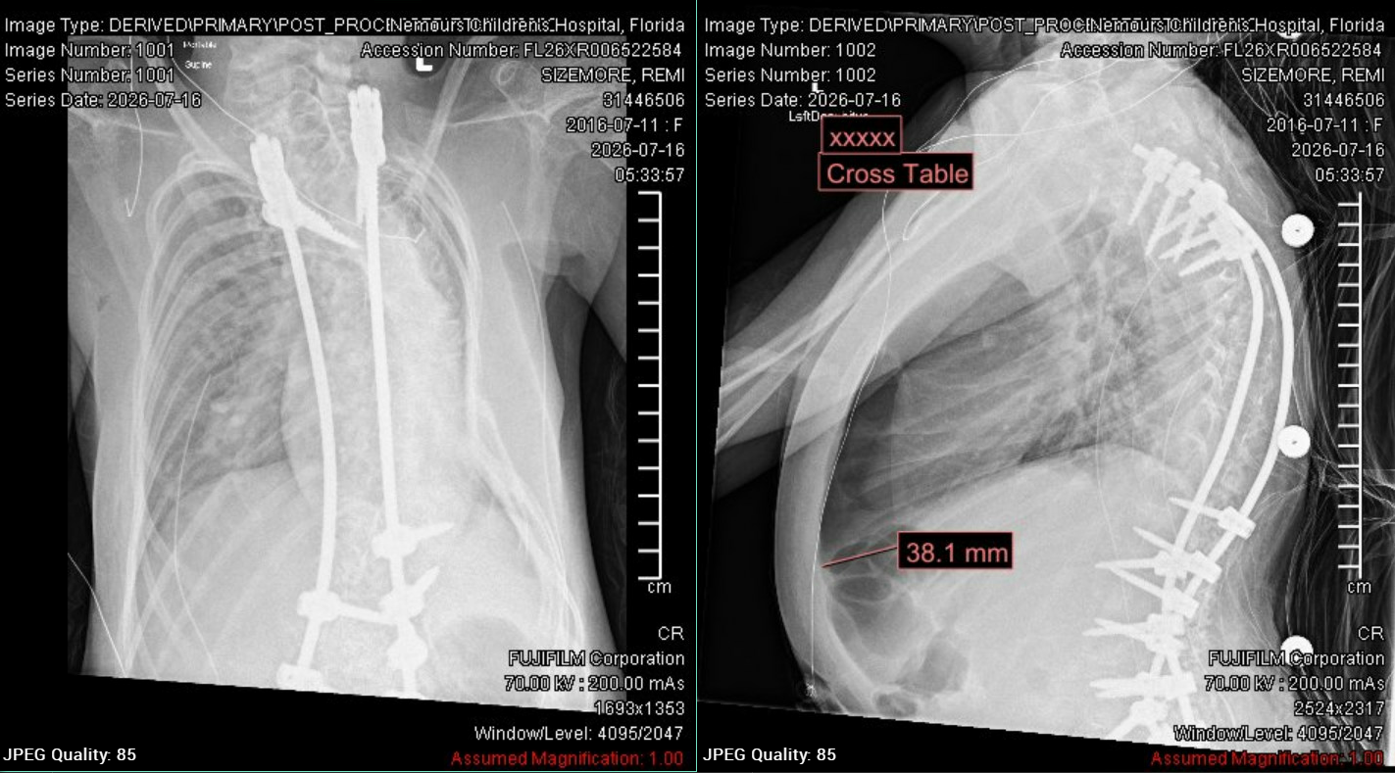

Slide 8
Pneumothorax after PSF
Multiple attempts at water seal with PTX reaccumulating
Chest tube removed on 7/28 (POD#12)
  Repeat XR after removal with moderate sized PTX
Chest CT obtained, THIRTY-EIGHT 2 VIEW CHEST XRAYS
Held airway clearance and overnight BIPAP for 48 hours, ultimately improved
Discharged on 8/2

Slide 9
Pneumothorax after psf
What went well?
What could be better?
IR engagement for placement
Immediate chest tube placement?
IR consultation in OR given body habitus?
Limiting XRs? Could we have done 1 views
Pulm plan postoperatively

Slide 10
Severe PIVIE from ppn
10yF with history of SMA 1, nocturnal BIPAP dependence and factor VII deficiency presenting after removal of MAGEC rods with definitive PSF T2 – pelvis
Hx of ileus and slow feeding tolerance post surgeries per parents
PPN initiated on 2/14 (POD# 3) due to ileus, persistent pneumothorax and potential need for surgical intervention and severe protein calorie malnutrition and to support wound healing.
PIV hand noted to be swollen slightly, seen by DIVA RN who assessed PIV patency by flushing under US guidance and deemed it was okay to use
Right hand later noted to be swollen and cool to touch and noted to be infiltrated
Hyaluronidase administered
PPN ordered OSM 992

Slide 11
Severe pivie from ppn
What went well?
What could be better?
DIVA team response
Gold standard for PIV patency is not US
Use of clinical assessment limited
Hyaluronidase subQ administration hesitancy from PICU RNs – can be administered by RNs
Neonatal <10 kg 10-40 kg >40 kg
0-1050 (hard max 1100) 0-1000 (hard max 1050) 0-950 (hard max 1050) 0-901 (hard max 1000)

Slide 12
Subdural hygroma and subgaleal Fluid Collection
9-year-old-male with a newly diagnosed mixed germ cell pineal tumor (mature teratoma and germinoma) on induction chemotherapy, status post subtotal resection and EVD placement for tumor-related mass effect. Transitioned to the floor with a stable but abnormal neurologic baseline (inability to open eyes spontaneously, fixed anisocoria, gaze deviation, following simple commands, moving all extremities), then developed progressive right-sided weakness and altered mental status in the setting of evolving subgaleal swelling, ultimately requiring emergent OR for subgaleal fluid aspiration and subdural-to-peritoneal shunt placement.

Slide 13
Subdural hygroma and subgaleal Fluid Collection
Timeline since floor transfer:
7/23 – Transferred to floor
7/24 – No concerns; stable baseline exam; participating with PT and speech
7/25 AM – Neurosurgery evaluation noted subgaleal swelling with a stable neuro exam; plan for head CT if it worsened
  Moved to heme/onc floor for closer monitoring and proximity to team; still responsive but inconsistently answering only yes/no questions (speech note attributed non-participation to low level of arousal)
  Bedside nurse on heme/onc floor uncomfortable with the swelling, prompting an earlier head CT
  Head CT 1830: enlarging fluid collection communicating with the intracranial compartment, new right-to-left midline shift
  Neurosurgery not immediately reachable; transferred to PICU for CT results, altered mental status, and resuscitation
  OR 7/25 2100 – Subgaleal-to-peritoneal shunt placement and drainage of subgaleal CSF fluid collection

Slide 14
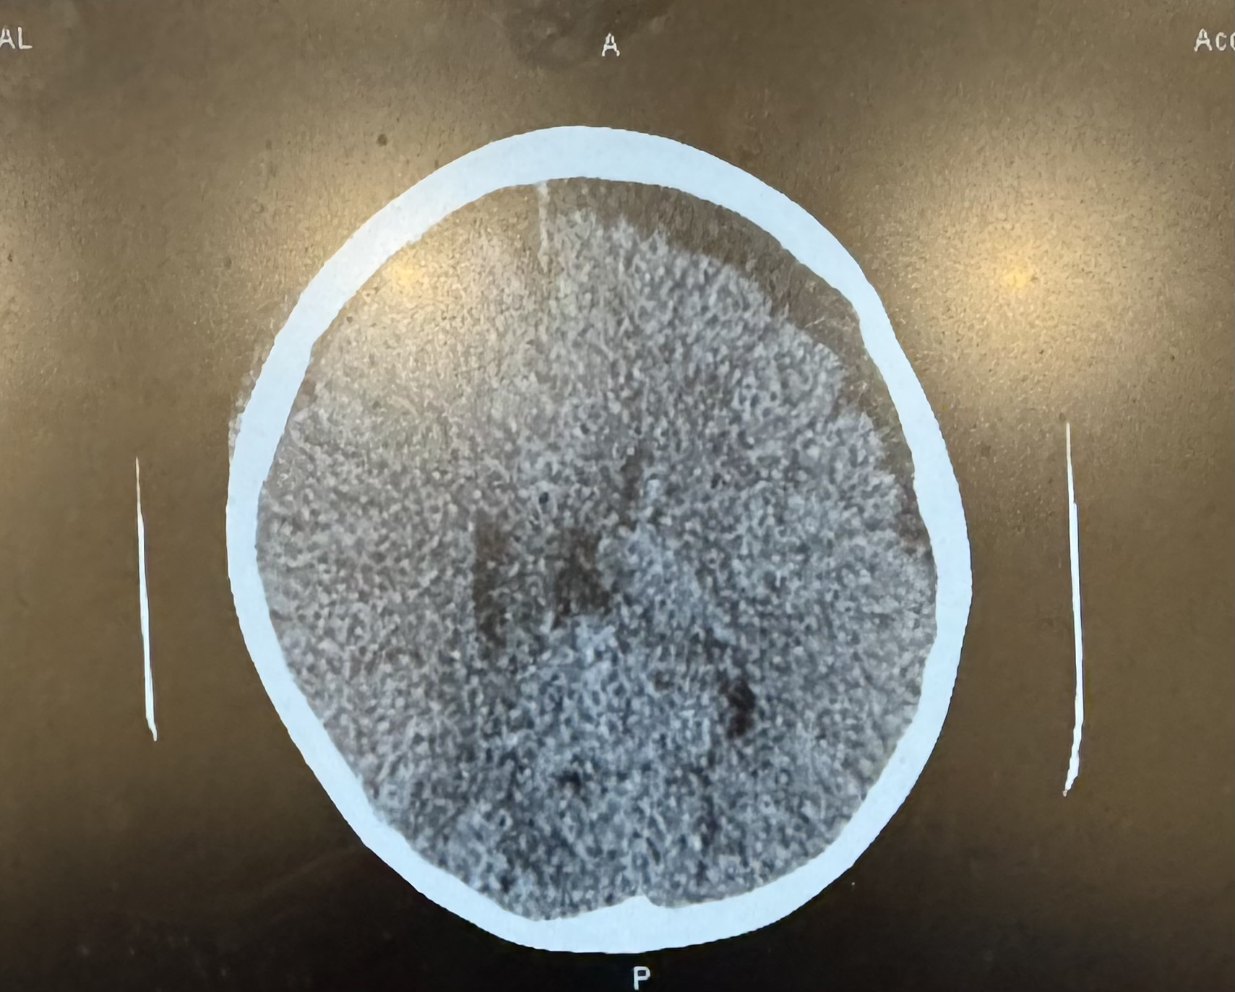
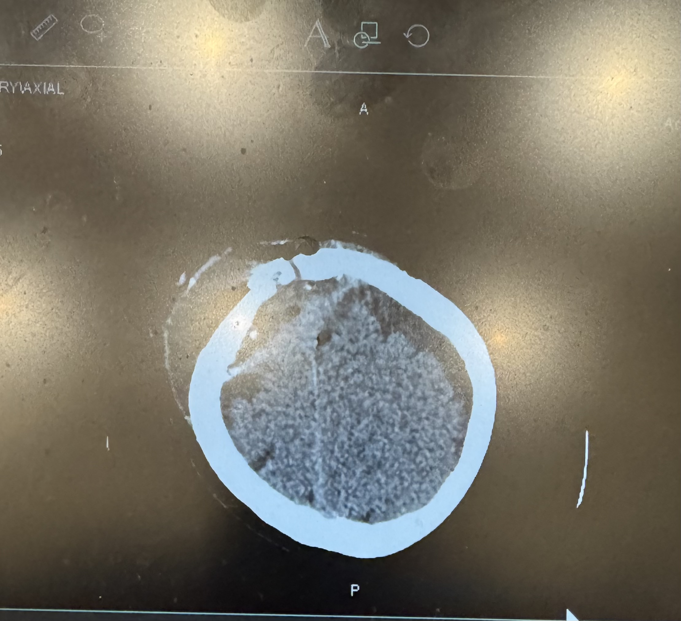
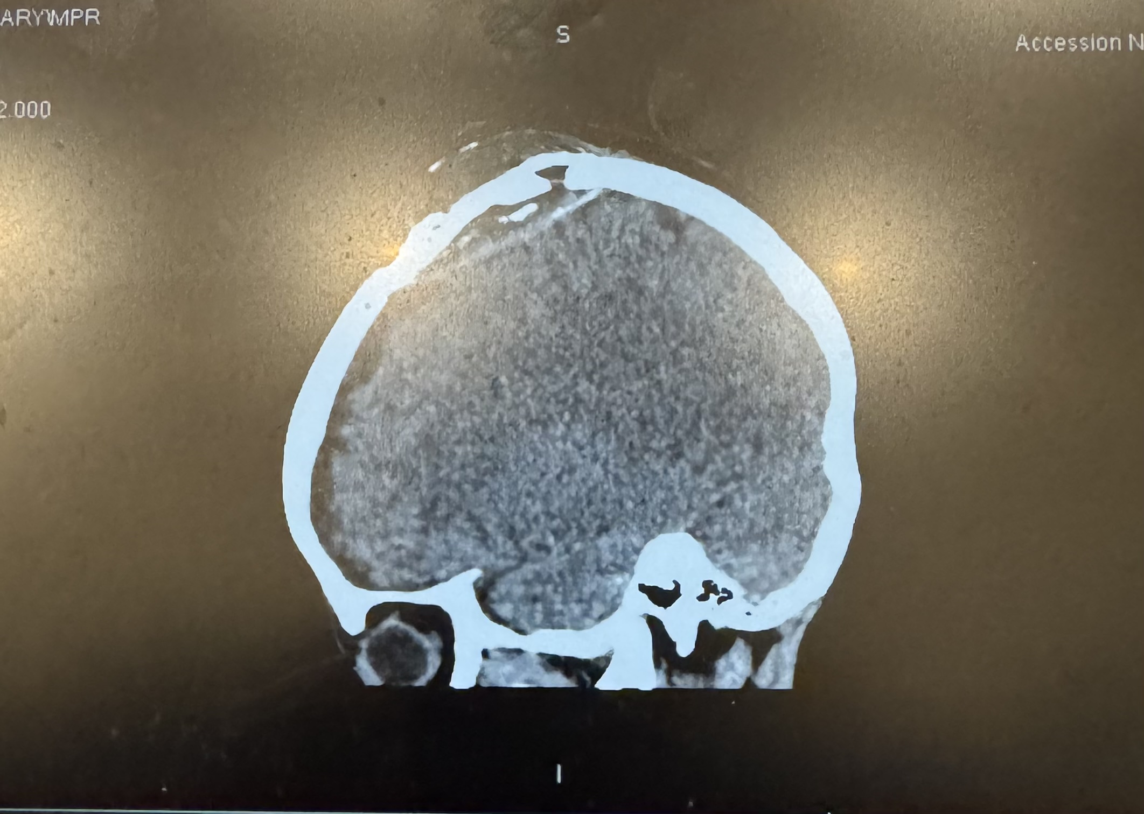
SUBDURAL HYGROMA AND SUBGALEAL FLUID COLLECTION
Head CT Imaging
Hypertensive subdural hygroma with midline shift and an associated, communicating subgaleal fluid collection.
Axial CT
Axial CT
Sagittal CT (MPR)

Slide 15
Subdural hygroma and subgaleal Fluid Collection
WHAT WENT WELL?
WHAT COULD BE BETTER?
Transfer to the heme/onc floor for closer monitoring and proximity to the primary team
Heme/onc nurse voiced discomfort with the subgaleal swelling, prompting an earlier head CT
Prompt ICU care
Earlier transfer to the PICU/earlier head CT
Communication of speech/language concerns

Slide 16
Delayed ophthalmology care for transfer
4 month old male with T21, CCAVC presenting as a transfer from HCA Lawnwood
Call received ~12:30pm for transfer; patient reportedly presented day prior (7/26) with bacterial conjunctivitis, sent home with eye drops and returned on 7/27 with acute hypoxic respiratory failure requiring intubation at 0400
MD to MD sign out with reported “preseptal cellulitis” on CT head
  Cultures drawn, antibiotics given
  Patient stable on PEEP 5, no pressors
  Reportedly attempted transfer to Jackson Memorial earlier in the morning, but unable to safely transfer ventilators
Transfer arranged via flight to Nemours

Slide 17
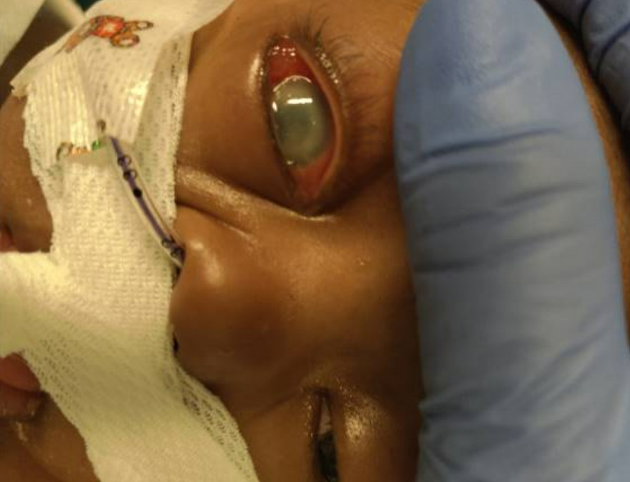
Delayed ophthalmology care
Arrived to NCH in stable condition at 1715
Basic labs obtained, vent adjustments made; significantly abnormal eye exam
  Ophtho consult placed
  Ophtho to bedside ~6pm, recommending immediate transfer to retina center with concern for fulminant endophtalmitis
Determined ophtho had seen patient at Lawnwood at 0320
Transferred to Jackson Memorial at 0015

Slide 18
Delayed ophthalmologic care
WHAT WENT WELL?
WHAT COULD BE BETTER?
Quick transfer out to higher level of care
Ophtho to bedside at Nemours early in care
Transfer information very limited
  Delay in adequate care for child
Unable to see records in EPIC until child arrived

Slide 19
Hypothermia, resuscitation
5yF with standard risk pre-B cell ALL in induction therapy, admitted to the heme-onc floor
  Found to have MSSA bacteremia and meningitis on cultures obtained on 7/21
  On antibiotics on hematology floor (cefepime, nafcillin, vanco locks to port)
On the evening of 7/25, developed intractable abdominal pain; found to be pale and tachycardic, difficulty obtaining temperatures
  0830 “unable to obtain temp” → 0931 bair huggar placed
RRT ultimately called with SBP decrease to 80s @ 1000
Patient transferred to PICU for septic shock

Slide 20
Hypothermia, resuscitation
Initially fluid resuscitation, dexmedetomidine (pain management), calcium replacement, broadening of antibiotics
7/27 AM – dilaudid initiated, ongoing grunting and tachypnea, poor perfusion
  Intubated
Intubation complicated by desaturations and hypotension requiring two pressors and hydrocortisone
  ECMO call placed
  Many providers present for resuscitation

Slide 21
Hypothermia, shock, resuscitation
WHAT WENT WELL?
WHAT COULD BE BETTER?
Team work
Nick’s art line skills
Successful debrief
“Low perfusion” pulse ox
Wear the vest!
  Better delineation of code roles with many hands
  Standard equipment set up – Capnography with BMV, have salem sump in room if placement requested by team

Slide 22
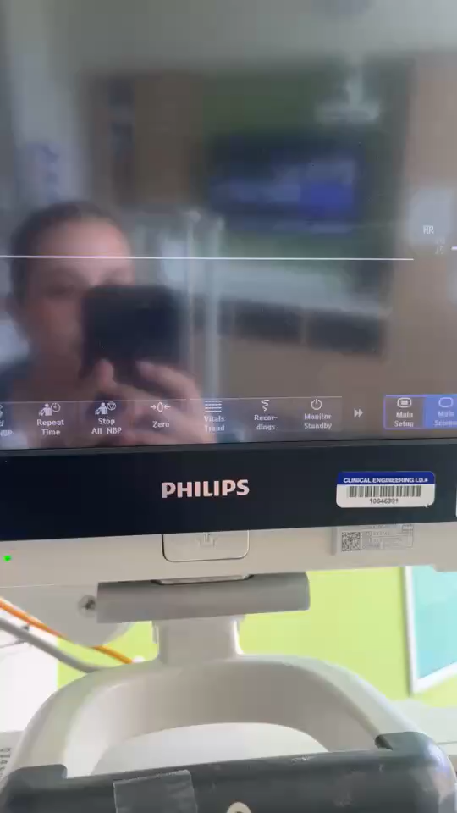

Slide 23
Mortalities
Submersion injury
Salmonella meningitis and septic shock

Slide 24
Submersion injury
17 month old F, admitted to PICU on 7/8/26 from Palm Bay after cardiac arrest secondary to unwitnessed submersion injury with unknown downtime. Neuroprotective strategies and post cardiac arrest management in PICU.
On 7/9 stat head CT significant for HIE and severe generalized cerebral edema with descending herniation of the cerebellar tonsils with normal CT of the C spine.
On 7/10 she was taken for c spine MRI which was consistent with acute ischemic injury and cord edema from the craniocervical junction to C6. Again it was noted that cerebellar tonsillar herniation into the upper cervical spinal cord. She was then cleared from the C-collar.
First Brain death exam was completed 7/11 and was consistent with brain death.
Worsening hemodynamics on 7/12 with escalating vasoactives. Family resistant to Second Brain death examination planned to be completed 7/12 during day shift . Ongoing discussion with family who discussed legal plans with medical team. Nuclear medicine flow scan requested by family and declined by team and CT Brain repeated on 7/12 which showed worsening cerebral edema and concern for brain death on reading.
Patient with hemodynamic issues and eventually made patient DNR and maxed on vasoactives. Extubated on 7/13 per family request and cardiac death on 7/13 at 0110.

Slide 25
Submersion injury
WHAT WENT WELL?
WHAT COULD BE BETTER?
PICU leadership support
Risk management notified early
Limited engagement from hospital leadership outside the PICU with families directly in shared decision-making conversations with burden of providing medical management and navigating family’s preferences to delay/avoid BD testing
Child life engagement with memory making

Slide 26
Salmonella meningitis, brain death
2 month old male twin born FT via C-section, UTD on vaccines, admitted as a transfer on 7/18-19
Patient brought to ER on 7/17 for fever and decreased PO x 3 days
  Blood culture obtained, discharged home
  Returned to care after blood culture positive for gram negative rods
  Given CTX & transferred
On arrival, bulging fontanelle and seizure like activity, lactatemia to 3.7, thrombocytopenia, AKI, heart failure with EF of 40%
  LP initially deferred, brain US c/f meningitis
  Initiated on milrinone
Intubated on 7/19 for c/f for ICP increase – NR pupils, A/Bs; LP later obtained
7/20, blood culture at OSH positive for Salmonella, ciprofloxacin added
On EEG with status epilepticus, increasing AED needs, worsening AKI
  Midazolam, fosphenytoin, Keppra, phenobarbital

Slide 27
salmonella meningitis, brain death
  7/20 – MRI obtained
    Diffuse cerebral edema with effacement of the basilar cisterns indicative of herniation; diffuse restricted diffusion involving the supratentorial and infratentorial brain
    Conversation re: results with mother, church community
  Anuria, AKI – nephro consulted → dialysis would be futile
    Bumetanide and calcium infusions
  7/23 – neurology signs off – “patient is likely brain dead”
  Phb and free phenytoin levels trended, Phb < 10 on 7/26 @ 0900, first brain death exam completed, consistent with brain death; family not amenable to repeat testing
  Second exam completed on 7/27 @ 1300, time of death 1402

Slide 28
salmonella meningitis
WHAT WENT WELL?
WHAT COULD BE BETTER?
Decision to not offer CRRT clear from nephrology
Timeline for brain death testing

Slide 29
Mortality Totals 2026

Slide 30
Quality & Patient Safety Corner

Slide 31
PICU Quality & Safety Metrics 2026 TOTALS
CLABSI: 0 for 2026
CAUTI: 0 for 2026
UE: 2 for 2026
UD: 3 for 2026
HAPI (all stages): 15 for 2026
Falls: 3 for 2026

Slide 32
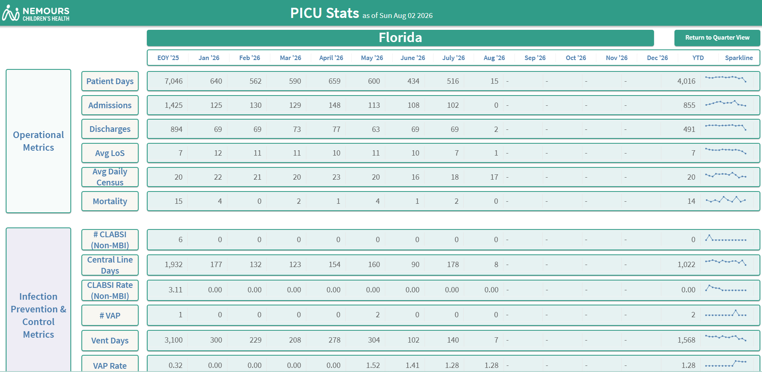
Operational metrics

Slide 33
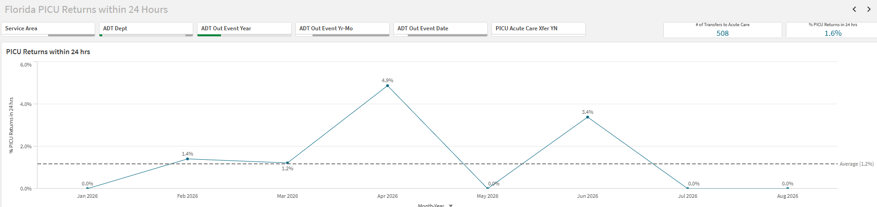
PICU returns within 24 hours

Slide 34
Safety themes
PICU dashboard page work ongoing complete – sharepoint access now available
PICU/ Neurology Learning Teams for EEG read communication issue
ACA Severe PIVIE completed
Rounding Script
  Pre-assigning roles/Including daily cxr

Slide 35

THE END

