Slide 1
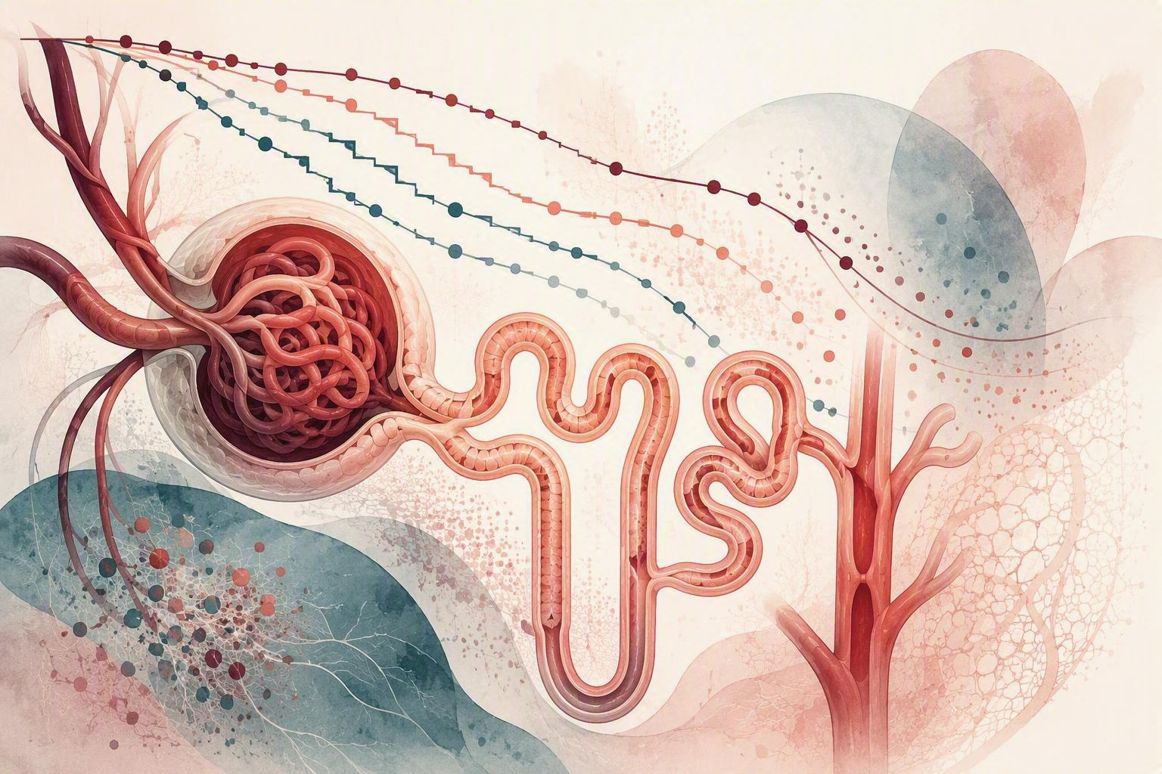
JOURNAL CLUB
Tacrolimus vs mycophenolate for frequently relapsing or steroid-dependent nephrotic syndrome
Sonia Solomon, DO • September 15, 2026

Slide 2
Clinical Case
6-year-old boy with new-onset nephrotic syndrome achieved remission after 2 weeks of prednisone.
Four months later, he relapsed and subsequently had three relapses within 6 months.
The family is ready to discuss a steroid-sparing strategy.
Which option would you choose?
A No additional therapy
B Mycophenolate mofetil
C Tacrolimus
D Rituximab
STAMP Trial • Pediatric Nephrotic Syndrome
2

Slide 3
Background: Pediatric Nephrotic Syndrome
Idiopathic nephrotic syndrome (INS) is the most common childhood glomerular disease (~3/100,000/year), marked by proteinuria, hypoalbuminemia, edema, and hyperlipidemia.
Glucocorticoids induce remission in 85–90% within 4–6 weeks.
However, ~50% develop FRNS/SDNS, causing recurrent disease and cumulative steroid toxicity.
IPNA guidelines recommend steroid-sparing agents (CNIs, cyclophosphamide, levamisole, or MMF), but the optimal choice is uncertain.
Uncontrolled studies suggest TAC may be as effective as MMF.
Study rationale: multicenter RCT comparing TAC vs MMF for efficacy and safety in children with FRNS/SDNS.
STAMP Trial • Pediatric Nephrotic Syndrome
3

Slide 4
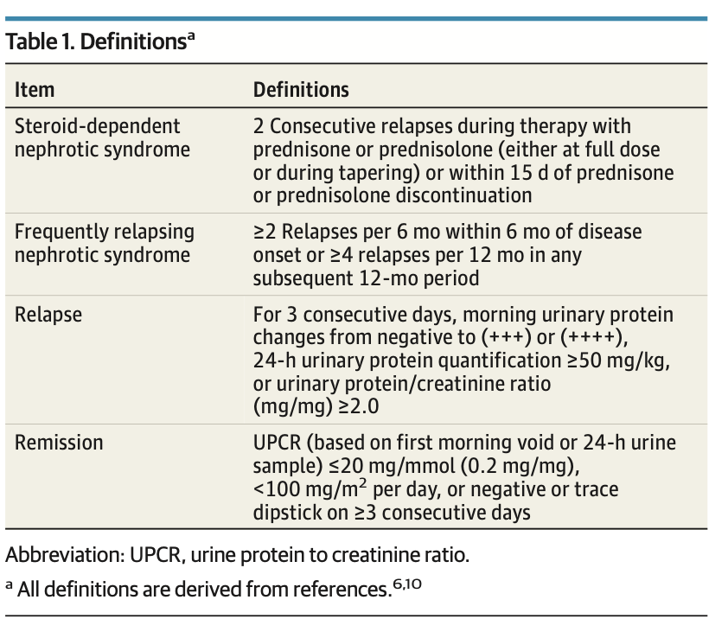
STAMP Trial • Pediatric Nephrotic Syndrome
4
Notes:
This is worth reviewing because it determines who is eligible for the study.
Frequently relapsing nephrotic syndrome
Steroid-dependent nephrotic syndrome
Then ask:
“Why does this distinction matter therapeutically?”
Answer: because repeated steroid exposure becomes a major driver of morbidity.

Slide 5
Tacrolimus vs Mycophenolate
 | Tacrolimus (TAC) | Mycophenolate Mofetil (MMF)
Drug class | Calcineurin inhibitor | Antimetabolite
Mechanism | ↓ Calcineurin → ↓ IL-2 → ↓ T-cell activation | IMPDH inhibition → ↓ purine synthesis → ↓ lymphocyte proliferation
Main target | T cells | T & B cells
Drug monitoring | Required – trough levels | Generally not required; MPA-AUC can be used
Key adverse effects | Nephrotoxicity Hypertension Tremor Hyperglycemia Hyperkalemia | GI toxicity Leukopenia Infections Hepatotoxicity
Renal effects | ⚠️ Potential nephrotoxicity | ✅ Not directly nephrotoxic
Other considerations | Monitor BP, creatinine/eGFR, electrolytes, glucose | Monitor CBC, liver enzymes
Major long-term concern | CNI-associated kidney injury | GI & bone marrow toxicity
STAMP Trial • Pediatric Nephrotic Syndrome
5

Slide 6
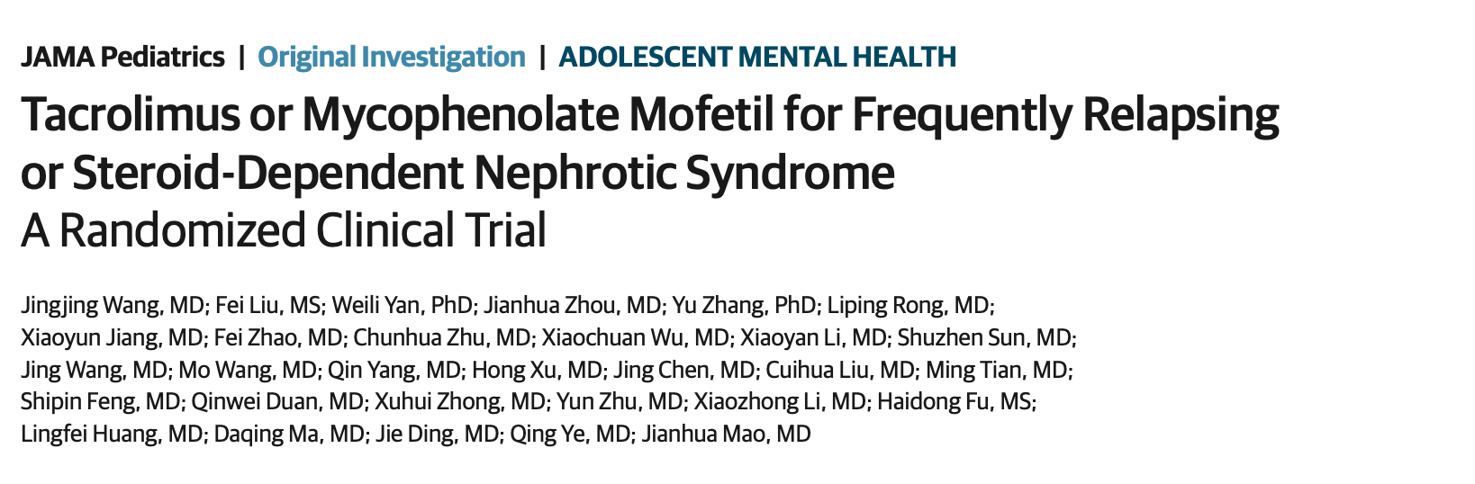
Article of the Day — STAMP Trial
STAMP Trial • Pediatric Nephrotic Syndrome
7

Slide 7
Objectives & Hypothesis
Study Objective
To compare the efficacy and safety of tacrolimus (TAC) vs mycophenolate mofetil (MMF) as steroid-sparing therapies in children with frequently relapsing or steroid-dependent nephrotic syndrome (FRNS/SDNS).
Specifically, to determine whether TAC provides better relapse prevention/relapse-free survival while reducing steroid exposure, without unacceptable adverse effects.
Hypothesis
Primary hypothesis:
  Tacrolimus would be superior to MMF in maintaining remission, resulting in a higher 1-year relapse-free survival.
Secondary hypothesis:
  TAC would reduce relapse frequency and steroid requirements compared with MMF, with a comparable safety profile
STAMP Trial • Pediatric Nephrotic Syndrome
8

Slide 8
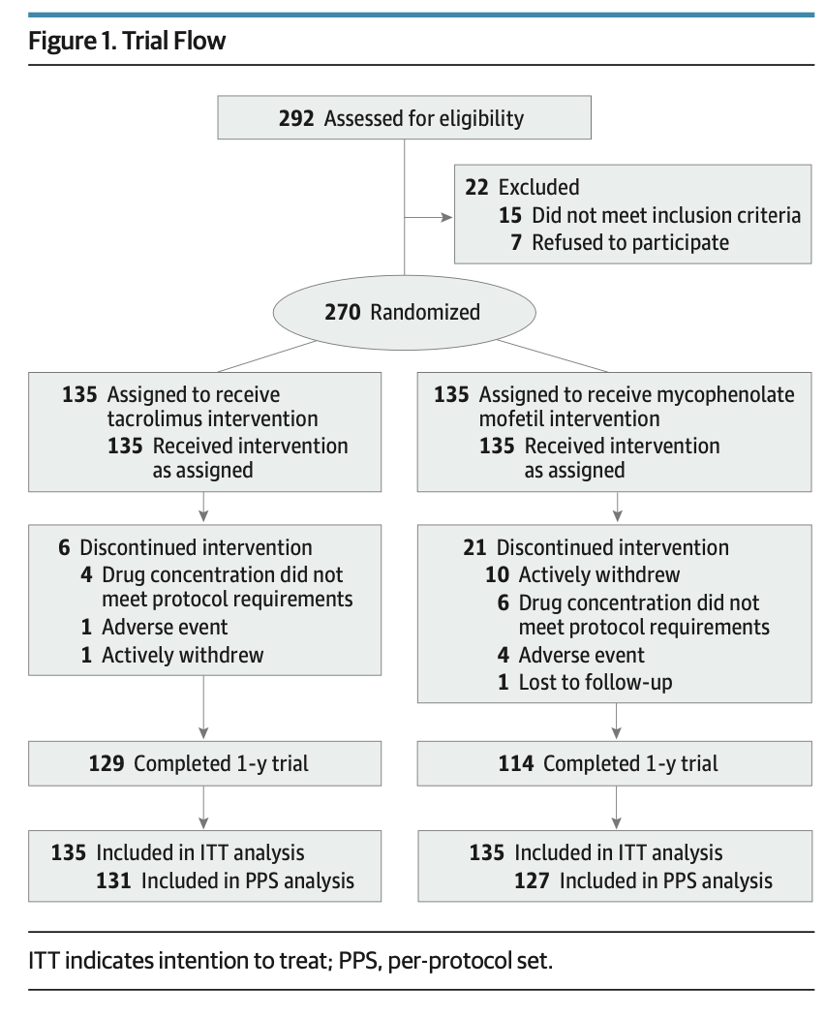
Study Design
STAMP Trial • Pediatric Nephrotic Syndrome
9

Slide 9
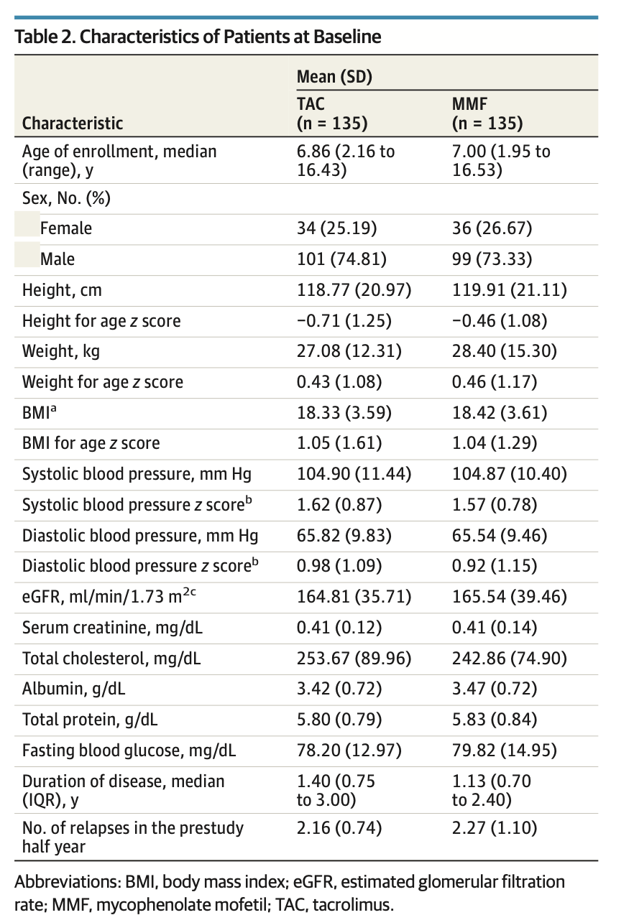
STAMP Trial • Pediatric Nephrotic Syndrome
10

Slide 10
Eligibility Criteria
Inclusion
Steroid-sensitive nephrotic syndrome with frequent relapse (FRNS) or steroid dependence
(SDNS);
Age: 2-18 years old;
Normal renal function: eGFR≥90mL/min/1.73m2;
At the time of enrollment, urinary protein <1+ or urinary protein/creatinine <0.2g/g (< 20 mg/mmol) in the morning for 3 consecutive days or more
No use of tacrolimus, mycophenolate mofetil, cyclosporine A, rituximab or cyclophosphamide within 2 years before enrollment
Exclusion
Steroid-resistant nephrotic syndrome (SRNS);
Family history of nephrotic syndrome, chronic glomerulonephritis or uremia;
Cytopenias
Chronic infection
Secondary nephrotic syndrome
Hematological, Endocrine system, Autoimmune diseases or primary immunodeficiency or tumors
Those who were known to be sensitized to tacrolimus, mycophenolate mofetil, glucocorticoids
Those who have participated in other clinical trials within three months before enrollment
STAMP Trial • Pediatric Nephrotic Syndrome
11
Notes:
- Steroid-resistant nephrotic syndrome (SRNS);
- Family history of nephrotic syndrome, chronic glomerulonephritis or uremia;
- Cytopenias Leukopenia (leukocyte ≤3.0*109/L); Moderate and severe anemia (hemoglobin < 9.0 g/dL); Thrombocytopenia (platelet count < 100*1012/L);
- Chronic infections - Those with positive HBV serological indexes (HBsAg or/and HBeAg or/and HBcAb), positive HCV or abnormal liver function (ALT or total bilirubin exceeding 2 times or more
of the upper limit, with a continuous increase for 2 weeks);
- Secondary nephrotic syndrome
hematological or endocrine system diseases as well as serious organ illness, other autoimmune diseases or primary immunodeficiency or tumors;
-Those who were known to be sensitized to tacrolimus, mycophenolate mofetil, glucocorticoids
or any ingredient of the above drugs;
- Those who have participated in other clinical trials within three months before enrollment;

Slide 11
Randomization
Eligible children randomized 1:1 to:
  Tacrolimus (TAC) + prednisolone
  Mycophenolate mofetil (MMF) + prednisolone
Treatment duration: 12 months
Computer-generated randomization
Allocation concealed using sequentially numbered, opaque, sealed envelopes
Envelopes opened after enrollment to reveal treatment assignment
Open-label: patients and study staff were not blinded
Randomization codes were not reused once assigned
STAMP Trial • Pediatric Nephrotic Syndrome
12

Slide 12
Intervention
Tacrolimus (TAC): 0.025–0.050 mg/kg BID
  Target trough: 5–10 ng/mL for 6 months
  Then maintained at <5 ng/mL
Mycophenolate mofetil (MMF): 10–15 mg/kg BID
  Target MPA-AUC: 30–50 μg·h/mL for 6 months
  Then ≤40 μg·h/mL
Monthly pre-dose blood samples for drug concentration monitoring
1-year follow-up: Weeks 1, 4, 8 → every 8 weeks through week 40 → final visit at week 52
Outcomes monitored:
  Relapses & corticosteroid dose, Adverse events, TAC levels & MPA-AUC, Kidney/liver function & lipids, Urine/proteinuria
Medication adherence: Daily medication & proteinuria diaries; medication counts performed at visits
STAMP Trial • Pediatric Nephrotic Syndrome
13

Slide 13
Outcomes
Primary Outcome
1-year relapse-free survival
Secondary Outcomes
Relapse frequency and time to first relapse
6-month relapse-free survival
Cumulative steroid dose
Blood pressure, height, and weight
Cholesterol and serum albumin
eGFR and other kidney function measures
Safety Outcomes
Vital signs: heart and respiratory rate
Liver function
Blood glucose
Adverse events/reactions
STAMP Trial • Pediatric Nephrotic Syndrome
14

Slide 14
Statistical analysis
Sample Size
Expected 1-year relapse-free survival:
  MMF 56% vs TAC 70%
80% power; α = .05; 1:1
Required: 229; planned: 270 (15% attrition, 135/group)
Statistical Analysis
  ITT primary; per-protocol sensitivity
  Kaplan-Meier + log-rank for relapse-free survival
  Cox regression for HRs (95% CI)
  Mixed-effects models for repeated eGFR and annual slope
  Baseline tests: t test, Wilcoxon, χ², or Fisher exact
STAMP Trial • Pediatric Nephrotic Syndrome
15

Slide 15
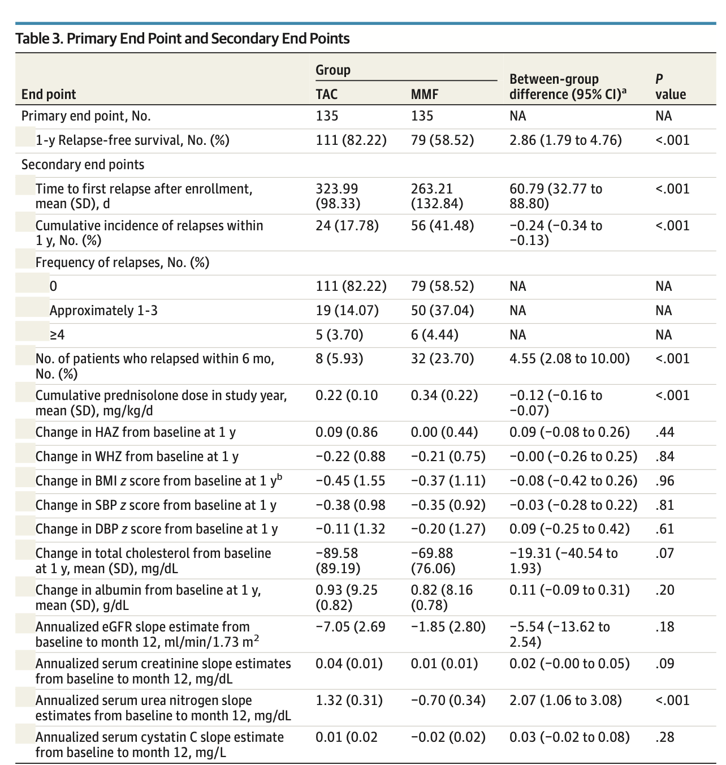
Outcomes
STAMP Trial • Pediatric Nephrotic Syndrome
16
Notes:
Were the groups actually balanced?”
And:
“Was there anything about the baseline population that might limit applicability to our patients?”

Slide 16
Results
292 patients assessed from 12 centers (Nov 2019–May 2022)
270 patients randomized 1:1
  TAC: n=135 vs MMF: n=135
Median age: 6.9 years (IQR 4.3–10.0)
25.9% female
243 patients completed the 1-year trial
  27 total dropouts: TAC: 6 and MMF: 21
Main reasons for dropout:
  Active withdrawal, Unable to reach target drug concentration, Adverse events, Loss to follow-up
Baseline characteristics were similar between groups
Medication diaries and pill counts indicated good adherence in both groups

Slide 17
Results: Primary Outcomes
Primary Outcome
1-year relapse-free survival
TAC: 82.2% vs MMF: 58.5%
TAC significantly superior to MMF
HR 2.86 (95% CI 1.79–4.76), P < .001
65% reduction in relapse risk with TAC
Notes:
The trial found that compared with MMF, 1 year of tacrolimus significantly prolonged relapse-free survival in children with FRNS/SDNS.
PPubMed
Show the paper's Kaplan-Meier curve.
Then verbally walk through:
Tacrolimus → longer relapse-free period
Don't immediately interpret it as:
Tacrolimus → better overall treatment
That distinction becomes important during your critical appraisal.

Slide 18
Results: Secondary Outcomes
Relapse rate
TAC: 17.8%
MMF: 41.5% (P < .001)
Number of relapse events
TAC: 43
MMF: 105
Time to first relapse
TAC: 324 days
MMF: 263 days (P < .001)
6-month relapse-free survival
TAC: 94.1%
MMF: 76.3% (P < .001)
TAC provided superior relapse prevention and reduced steroid exposure, with similar short-term safety to MMF, but its greater eGFR decline raises questions about long-term renal safety.
STAMP Trial • Pediatric Nephrotic Syndrome
20

Slide 19
Safety
Overall adverse events (AEs): similar between groups
  TAC: 94.8% vs MMF: 92.6% (P = .62)
Serious adverse events (SAEs): similar between groups
  TAC: 8.9% vs MMF: 10.4% (P = .84)
Infections were the most common SAE
  TAC: 66.7% of SAEs vs MMF: 71.4% of SAEs
Steroid exposure
  Lower with TAC: 0.22 vs 0.34 mg/kg/day
AE-related treatment withdrawal:
  0.74% in each group
Acute kidney disease:
  1 patient in each group
At 1 year, serum creatinine and eGFR remained within normal ranges in both groups
  TAC: 158.4 mL/min/1.73 m² vs MMF: 163.4 mL/min/1.73m²
Overall: Similar safety profiles, but greater decline in eGFR slope with TAC despite preserved overall kidney function.

Slide 20
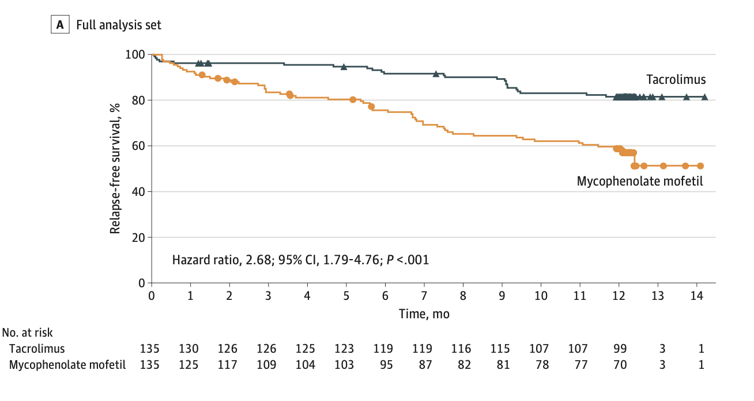
One-Year Relapse-Free Survival — ITT
STAMP Trial • Pediatric Nephrotic Syndrome
22
Notes:
Were the groups actually balanced?”
And:
“Was there anything about the baseline population that might limit applicability to our patients?”

Slide 21
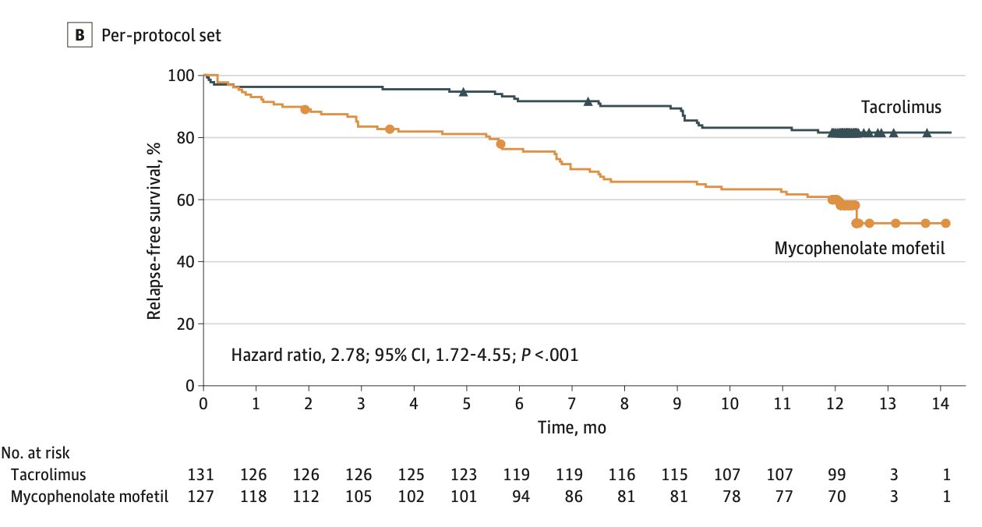
One-Year Relapse-Free Survival — Per Protocol
STAMP Trial • Pediatric Nephrotic Syndrome
23

Slide 22
Discussion
First large, multicenter RCT directly comparing TAC with MMF in pediatric FRNS/SDNS
TAC improved 1-year relapse-free survival and reduced relapse and steroid exposure
The benefit persisted after TAC was stopped or sustained remission was achieved
The greater eGFR decline keeps long-term nephrotoxicity central to treatment choice
TAC may be preferred when relapse control and steroid reduction outweigh kidney-safety concerns
STAMP Trial • Pediatric Nephrotic Syndrome
24

Slide 23
Adverse Events
Overall AEs were similar and mostly mild
Infections were the most common significant AE
Acute kidney disease occurred in 1 patient per group
TAC had a greater decline in eGFR slope:
−7.0 vs −1.9
Raises concern for subclinical CNI nephrotoxicity
STAMP Trial • Pediatric Nephrotic Syndrome
25

Slide 24
Limitations
Short follow-up:
  Treatment limited to 12 months, preventing assessment of long-term safety
No post-treatment data:
  Relapse outcomes after drug discontinuation were not evaluated
Limited generalizability:
  All participants were from China → need validation in diverse populations
Limited kidney pathology data:
  Particularly lacking post-1-year pathology after TAC exposure
Quality of life not assessed:
  Impact of TAC vs MMF on patient quality of life was not systematically evaluated

Slide 25
Critical Appraisal
Was it a well designed study?
Were the results statistically significant?
Were the results clinically significant?
How was the analysis completed?
Limitations?
STAMP Trial • Pediatric Nephrotic Syndrome
27
Notes:
Was the trial internally valid?
Randomization
Blinding
Follow-up
Analysis
The study reports both intention-to-treat and per-protocol populations, which gives you a good opportunity to discuss how those analyses compare

Slide 26
Questions for discussion
Can we apply these findings to our patients?
How do we incorporate the long-term risk of nephrotoxicity in our patients?
Does it matter that clinicians and patients knew which drug they were receiving?
Is relapse-free survival objective enough that lack of blinding probably doesn't matter much?
What would happen if the patient had a tacrolimus-related adverse effect?
Notes:
1. Was the result statistically significant?
Yes.
2. How large was the effect?
Show the actual effect estimate and confidence interval from the paper.
3. Is that effect clinically meaningful?
That's the more important question.
4. What would happen if the patient had a tacrolimus-related adverse effect?
This gets the group thinking beyond the p-value.

Slide 27
Strengths and Limitations
STRENGTHS
LIMITATIONS
Randomized trial
Multicenter
Direct head-to-head comparison
Clinically relevant outcome
Patient important outcomes
Open-Label
All centers were in China
Limited follow-up for long-term toxicity
Generalizability
Long-term CNI effects
Treatment strategy may differ from local practice
STAMP Trial • Pediatric Nephrotic Syndrome
31

Slide 28
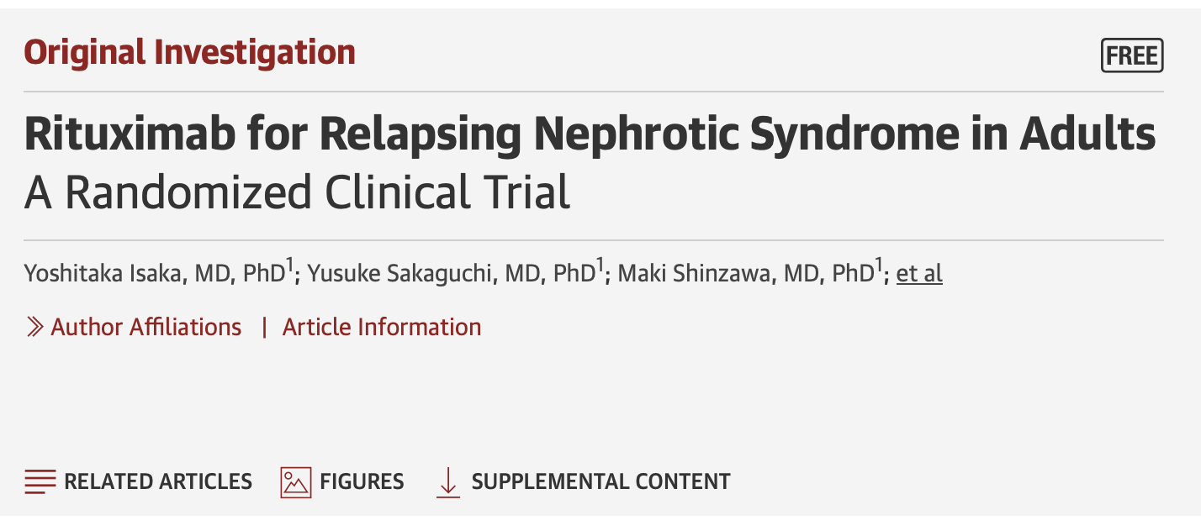
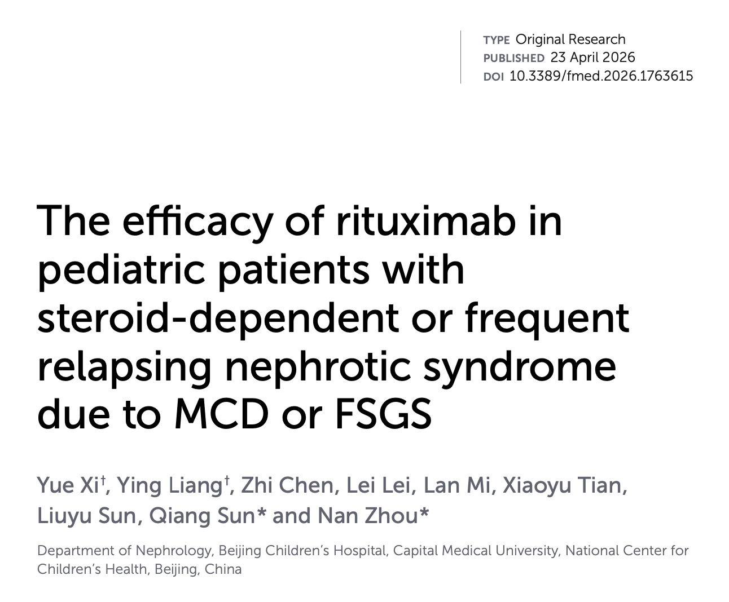
What about rituximab?
STAMP Trial • Pediatric Nephrotic Syndrome
30

Slide 29
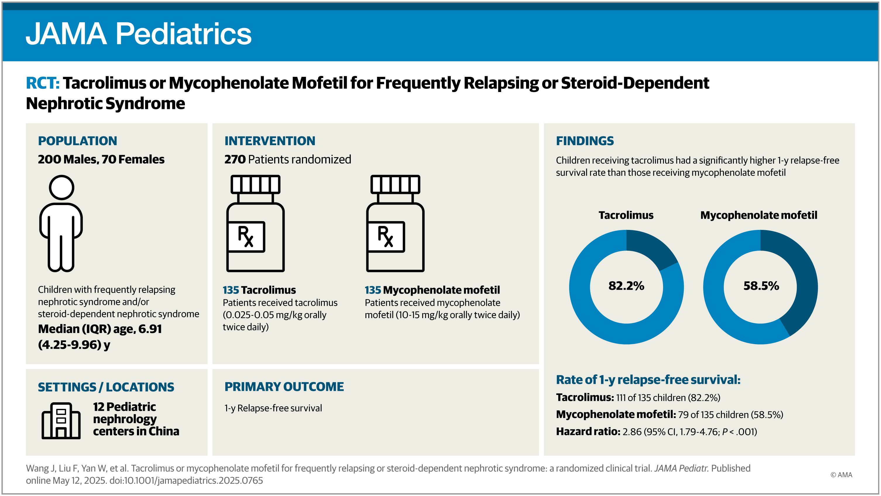
STAMP Trial • Pediatric Nephrotic Syndrome
32

Slide 30
What Would You Do?
A 6-year-old boy achieved remission after 2 weeks of prednisone, then relapsed four months later and had three relapses within six months.
The family wants a steroid-sparing option. Which strategy best balances relapse prevention and long-term safety?
A No additional therapy
B Mycophenolate mofetil
C Tacrolimus
D Rituximab
Revisit your initial choice.
STAMP Trial • Pediatric Nephrotic Syndrome
33

Slide 31
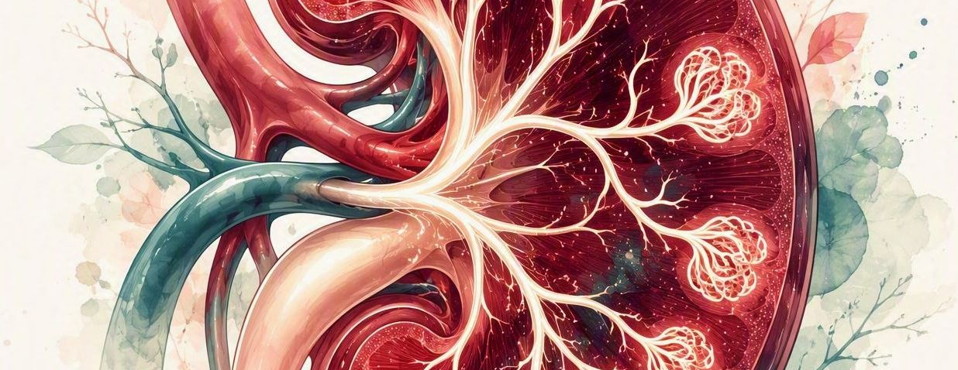
THANK YOU

