Slide 1
The Pediatric Oncology Patient in the OR:
A Comprehensive Guide to Perioperative
Management and Concerns
Jaimin Pandya, MD

Slide 2
Objectives
Analyze a high-risk pediatric cancer presentation (Anterior Mediastinal Mass).
Outline critical preoperative and case-specific anesthetic considerations.
Review common pediatric malignancies and procedural anesthesia requirements.
Evaluate current evidence on how anesthetic choice influences cancer recurrence and immune function.

Slide 3
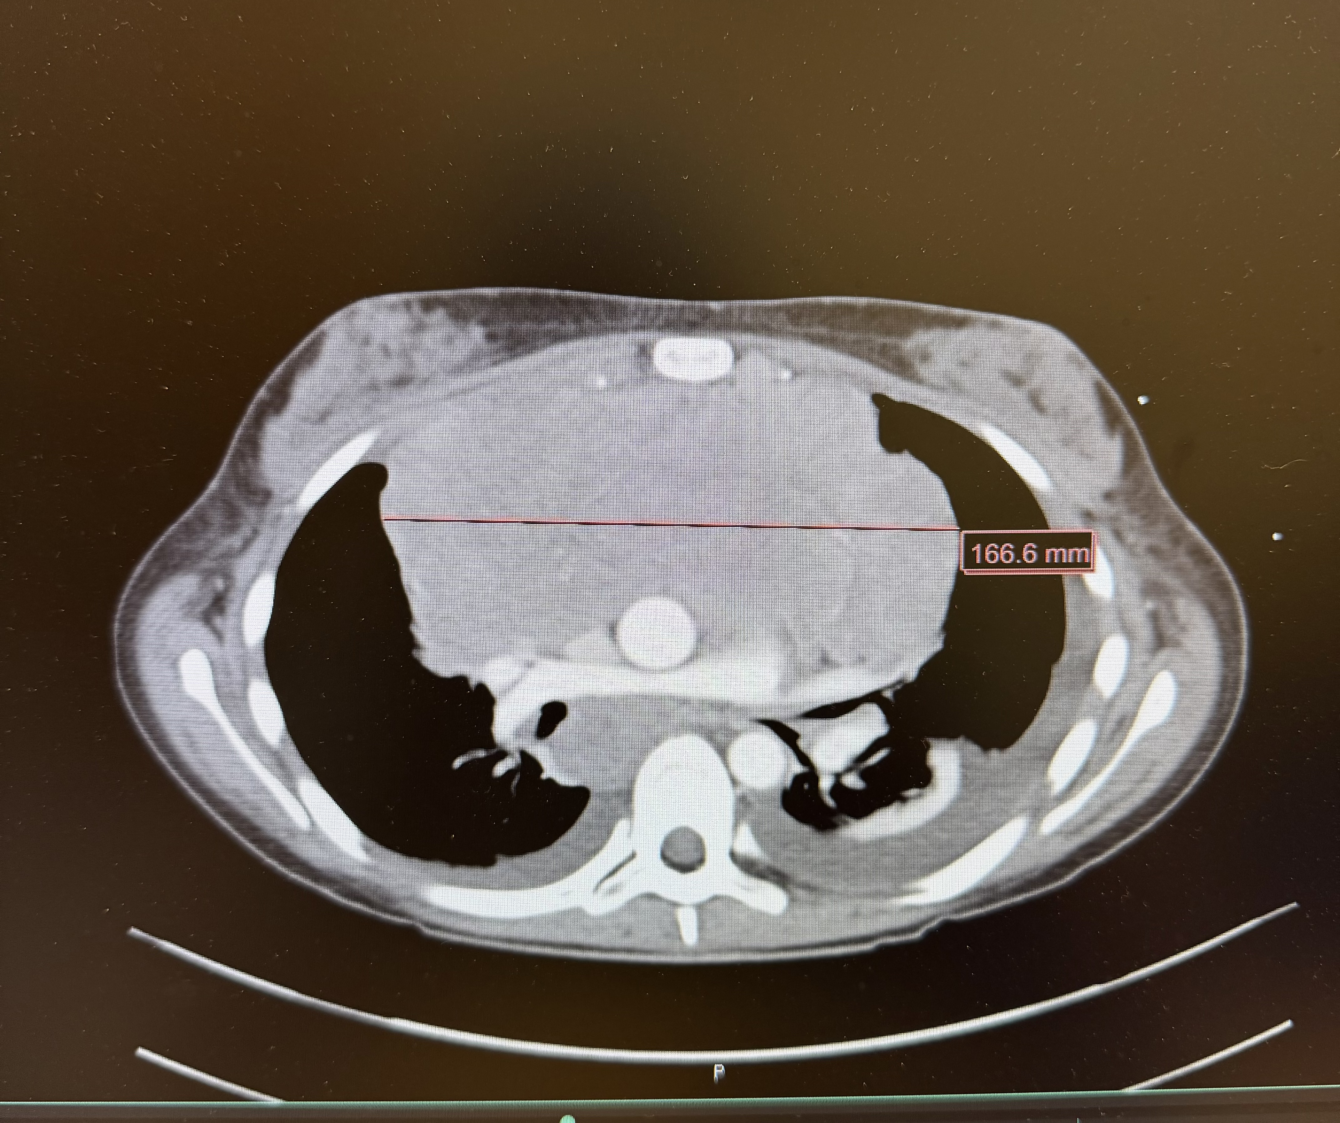
Case scenario
15-year girl presented to ED with malaise, SOB at rest, aches, fever emesis, night sweats, facial swelling, hepatosplenomegaly
CT scan reveled large mediastinal mass with SVC compression and echo showed moderate sized pericardial effusion
scheduled for mediastinal mass biopsy and PICC line placement
What can be the diagnosis, concerns and anaesthetic management for further procedures?

Slide 4
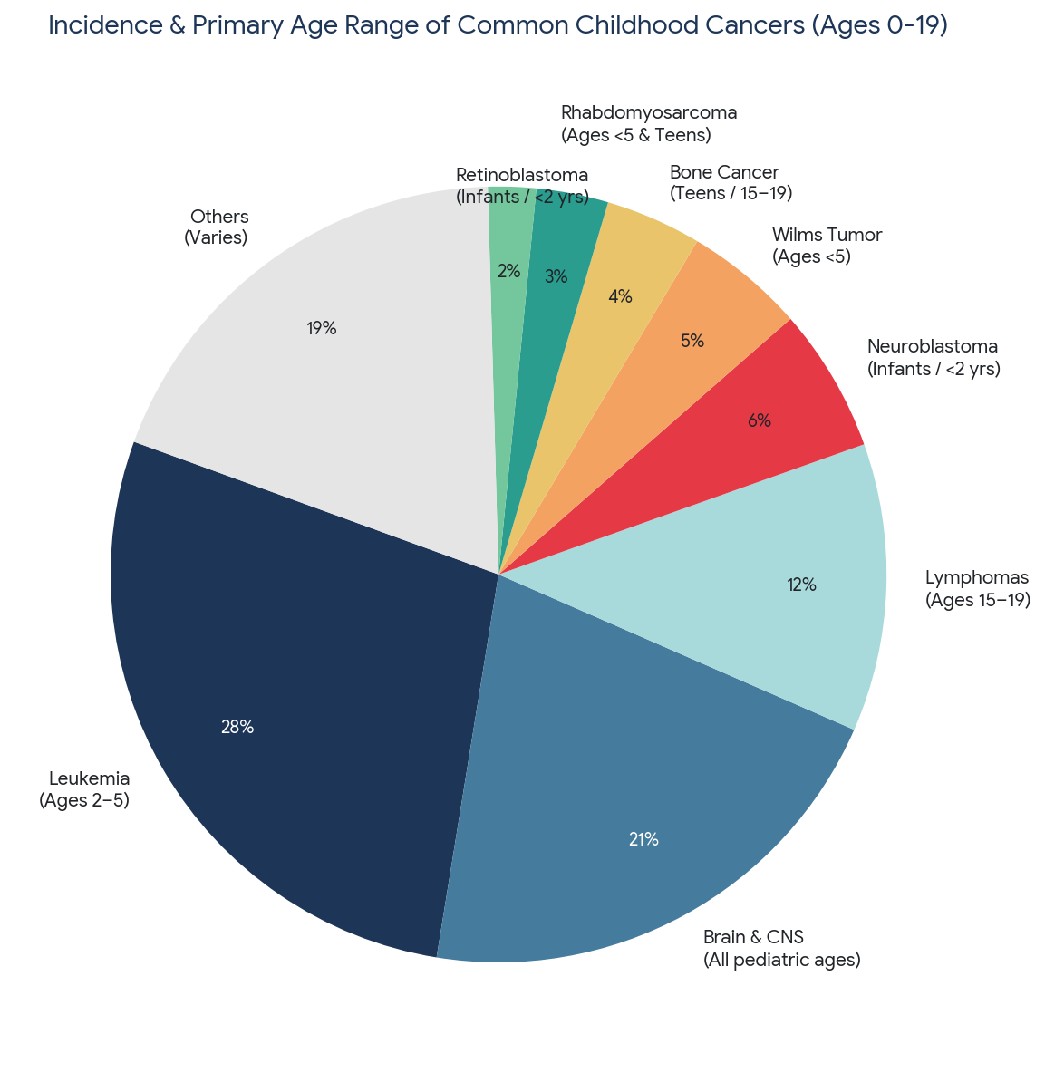
Types of Pediatric cancer
Leukemias (ALL, AML): The most common childhood cancers. Patients frequently require anesthesia for repeated bone marrow aspirations and intrathecal chemotherapy.
Central Nervous System Tumors: Require prolonged, complex general anesthesia, meticulous intracranial pressure management, and neuro-monitoring during resection.
Lymphomas (Hodgkin & Non-Hodgkin): Frequently present with large thoracic or mediastinal masses that severely compromise the airway and hemodynamics.
Solid Tumors (Neuroblastoma, Wilms Tumor, Osteosarcoma): Often present as massive abdominal or extremity tumors requiring major resections, carrying high risks for significant blood loss and complex postoperative pain.
* Based on NCI

Slide 5
Common procedures
Diagnostic & Staging: Lumbar punctures, bone marrow aspirations, and image-guided biopsies.
Therapeutic Interventions: Port-a-Cath or Hickman line placements, tumor resections, and limb-salvage or amputation surgeries.
Radiologic Procedures: Because young children cannot safely remain still, repeated anesthetics or deep sedation are routinely required for MRIs, CT scans, and daily radiation therapy sessions including proton beam therapy

Slide 6
Preop consideration
Pertinent patient history
Chemotherapy induced organ toxicity
Hematologic optimization
Psychological preparation

Slide 7
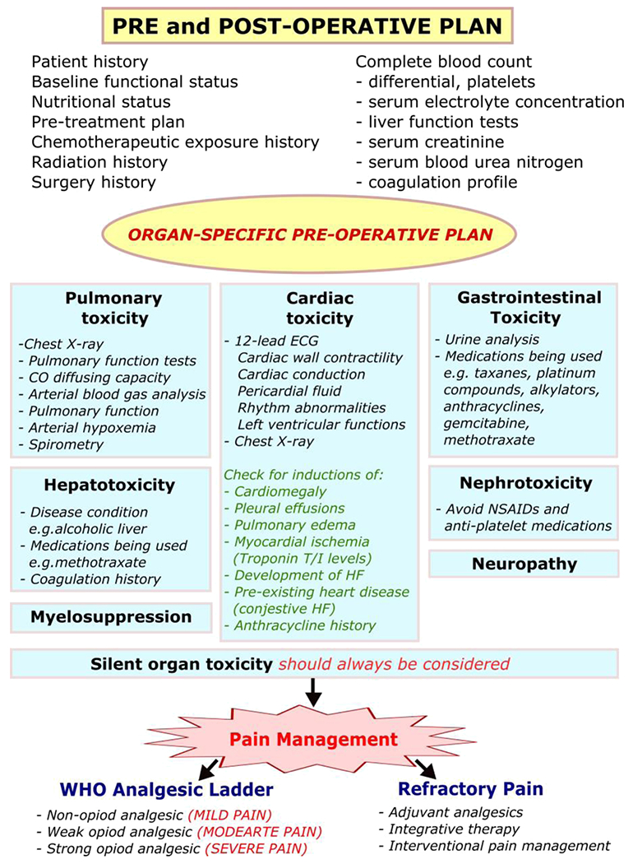
Preop Consideration

Slide 8
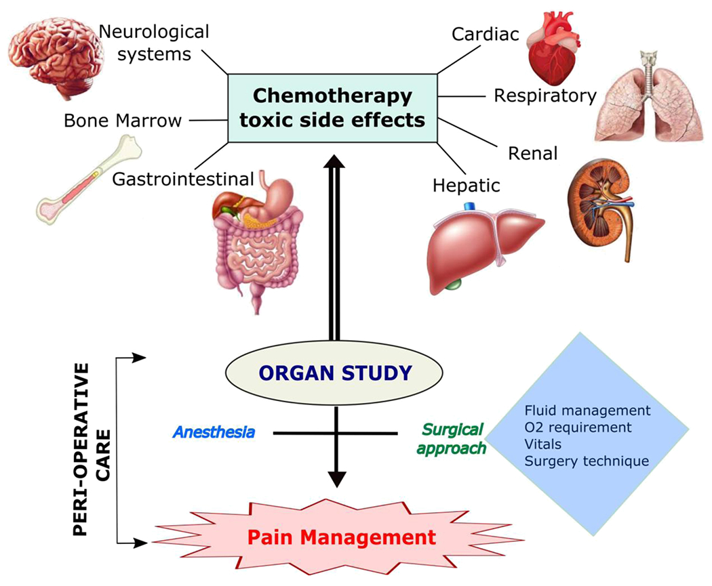

Slide 9
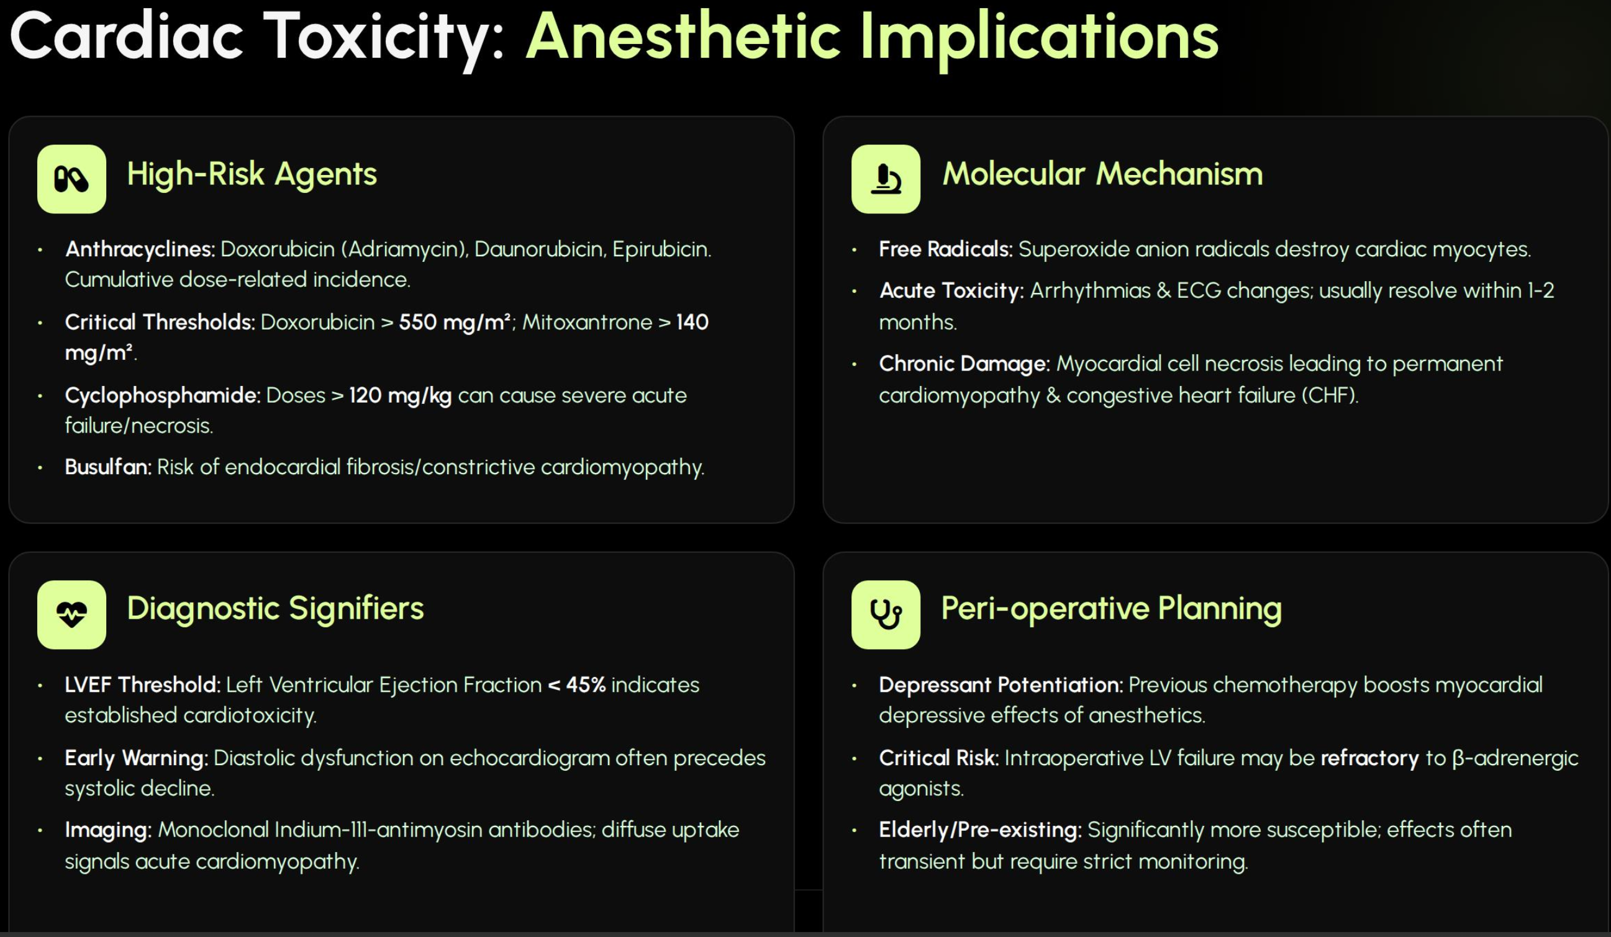

Slide 14

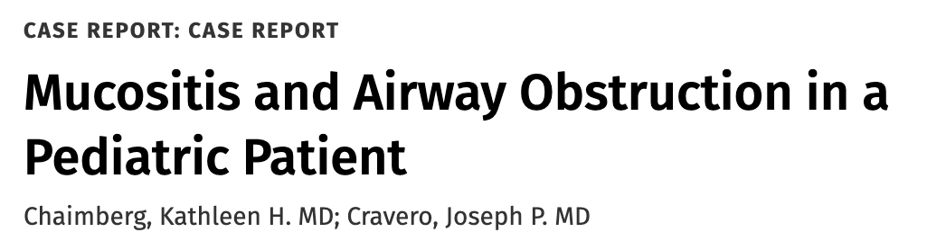
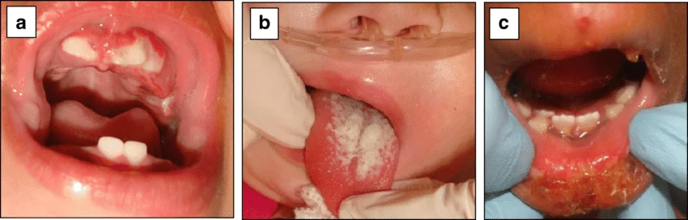
Patient: A 16-year-old undergoing chemotherapy developed severe oral mucositis.
Complication: Necrotic tissue and pseudo-membranes caused severe airway obstruction.
Intervention: Emergency intubation failed; the airway was eventually secured using a laryngeal mask airway (LMA) and fiberoptic bronchoscope.
Outcome: The patient required a tracheostomy to clear debris but died days later from organ failure.
Takeaway: Severe mucositis in oncology patients is a major red flag for difficult airways; early broncho-scopic evaluation is highly recommended.
Source: Ritwik, Priyanshi & Chrisentery-Singleton, Tammuella. (2020). Oral and dental considerations in pediatric cancers. Cancer and Metastasis Reviews. 39. 10.1007/s10555-020-09842-5.

Slide 16
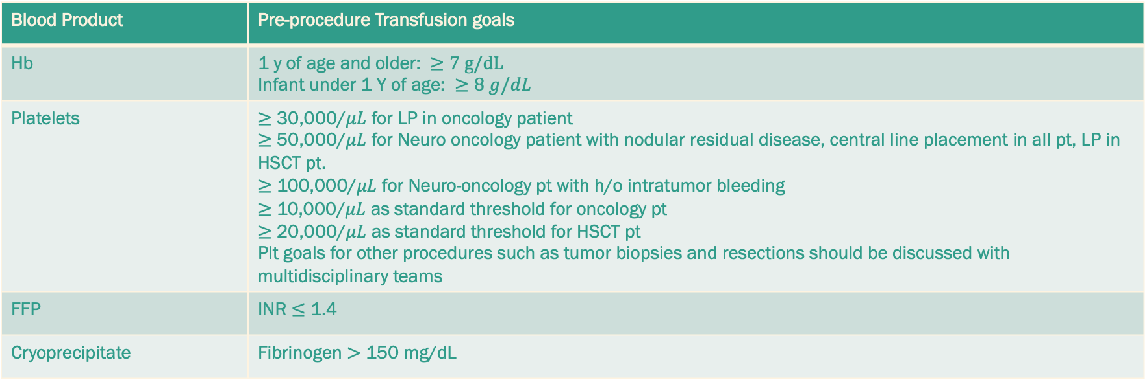
Hematologic Optimization: Assessing profound anemia, thrombocytopenia, and neutropenia; ensuring cross-matched blood products are available in the room prior to induction.
Blood Product | Pre-procedure Transfusion goals
Hb | 1 y of age and older: $≥7 g/dL$ Infant under 1 Y of age: $≥8 g/dL$
Platelets | $≥$ 30,000/$μL$ for LP in oncology patient $≥$ 50,000/$μL$ for Neuro oncology patient with nodular residual disease, central line placement in all pt, LP in HSCT pt. $≥$ 100,000/$μL$ for Neuro-oncology pt with h/o intratumor bleeding $≥$ 10,000/$μL$ as standard threshold for oncology pt $≥$ 20,000/$μL$ as standard threshold for HSCT pt Plt goals for other procedures such as tumor biopsies and resections should be discussed with multidisciplinary teams
FFP | INR $≤$ 1.4
Cryoprecipitate | Fibrinogen $>$ 150 mg/dL
Based on Children’s Oncology group supportive care Endorsed guidelines, American Society of Clinical Oncology Clinical Practice Update, Pediatric Critical care transfusion and anemia expertise initiative

Slide 17

Psychological Preparation:
Preoperative anxiety worsens surgical stress.
Structured, age-appropriate preoperative education programs like role playing and desensitization in younger children
Distraction and music therapy can help shift the attention away from procedure related pain
Placement of central access device early on treatment and topical anaesthetic cream
Peer engagement formal socialization and mentorship from another survivors in adolescent.
Lisa Dean Moseley Foundation institute for cancer and blood disorder- Cancer survivorship program
Notes:
CBT combined with deep breathing, imagery, distraction and positive coping self statement
Be specific about the procedure, what will occur, why and check for understanding and need for repetition
Describe sight, sounds, smell and feeling what child might experience
Offer choice and sense of control by deciding what toys they can bring or which finger thay want pulse oximeter
Parental information on what has worked in past
Use stuffed animal to localize the pain and interventions

Slide 18
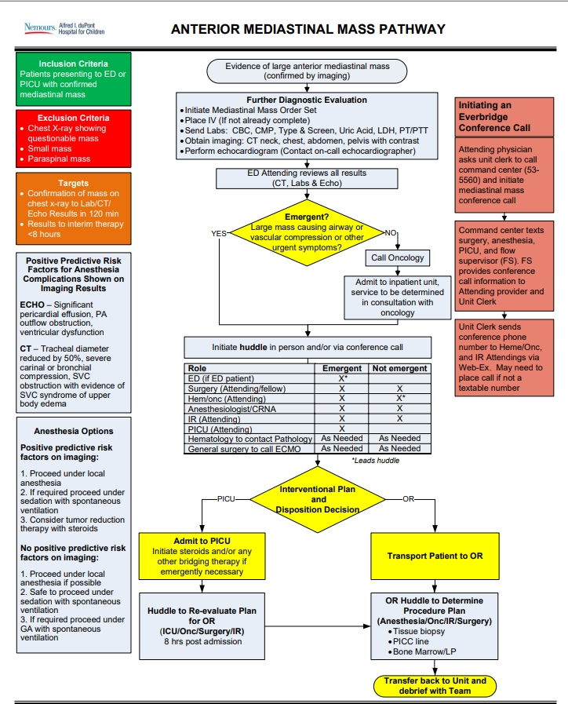
Anterior Mediastinal Mass

Slide 22
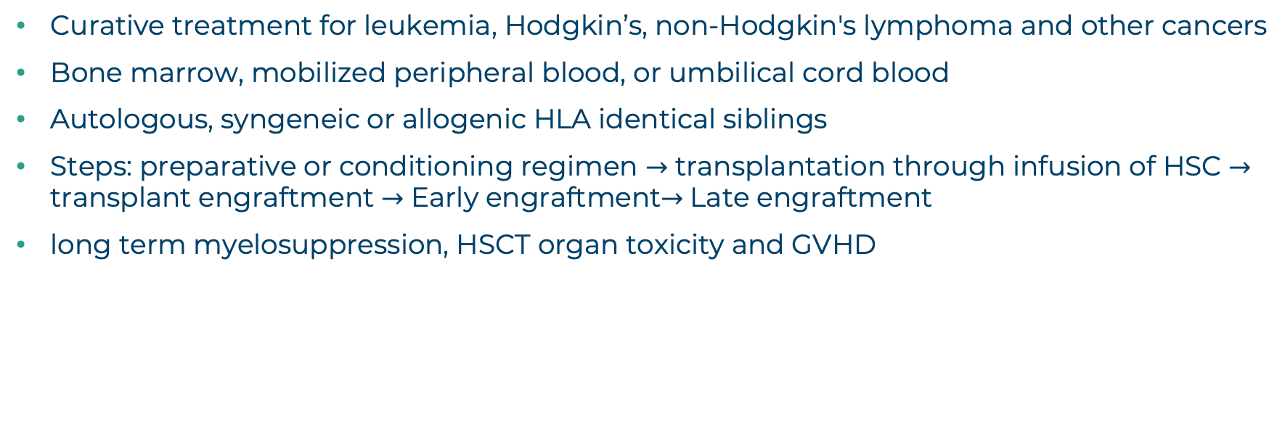
Hematopoietic stem cell transplantation (HSCT)
Curative treatment for leukemia, Hodgkin’s, non-Hodgkin's lymphoma and other cancers
Bone marrow, mobilized peripheral blood, or umbilical cord blood
Autologous, syngeneic or allogenic HLA identical siblings
Steps: preparative or conditioning regimen $→$ transplantation through infusion of HSC $→$ transplant engraftment $→$ Early engraftment$→$Late engraftment
long term myelosuppression, HSCT organ toxicity and GVHD

Slide 23
Preoperative | Intraoperative | Postoperative
Consultation with primary service | Attention to skin, teeth, eyes, and joints, careful positioning | Patient appropriate opioids and other analgesic
CBC, BMP, Echo, Chest radiograph | Sterile technique with central access | Observation of indicated isolation precaution
Transfusion specification: Cytomegalovirus Sero negativity, leukocyte reduction, irradiation | Full stomach precaution, appropriate hydration, and UOP management
History of acute and chronic pain medication | Difficult IV access due to repeated procedure and chemotherapy
Infection prophylaxis | Challenging airway due to mucositis, radiation
Avoidance of any marrow suppressive medication

Slide 24
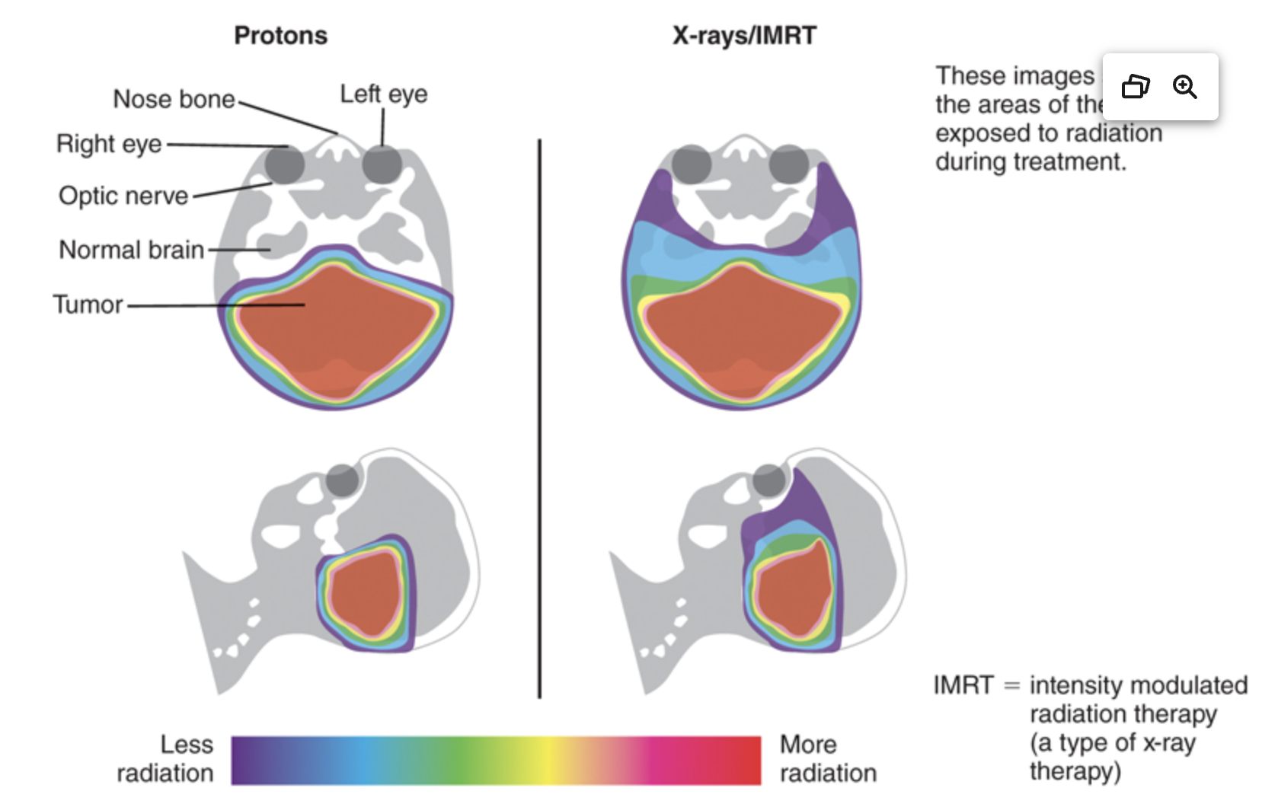
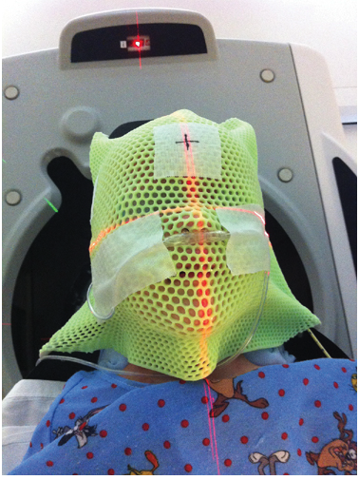
Radiation therapy
Treatment Duration: 5 days a week for 4-8 weeks.
Treatment Goal: Radiation of tumor while minimizing healthy tissue damage for pediatric brain tumor and extracranial solid tumor
Treatment Options: Convention photon or newer Proton beam therapy.
Treatment plan: Simulation run, CT scan, Custom mold/ mask made up of brass or acrylic
Anaesthesia plan: Possible standing consent, port access, risk vs benefit for respiratory issues, Immobility achieved with TIVA with either natural airway with end-tidal monitoring or LMA, Video monitoring during procedure.

Slide 25
Tumor Lysis Syndrome
ALL and non- Hodgkins Lymphoma (40%), non hematologic malignancy with rapid proliferation, large tumor burden, high sensitivity to chemotherapy
Seen on initiation of therapy (1-3 days) due to rapid destruction of tumor cells
Hyperuricemia, hyperkalemia, hyperphosphatemia, hypocalcemia and acid base imbalance
ARF, arrythmia, cardiac failure, multiorgan failure and death
Hydration, diuresis, Rasburicase (uric acid reducing agent) and allopurinol to prevent organ damage
Cytotoxic effect of dexamethasone with TLS prompt to use alternatives for antiemetics

Slide 26
Differentiation syndrome/ Retinoic acid syndrome
Commonly seen in Acute Promyelocytic Leukemia when started on All trans retinoic acid (ATRA) and arsenic trioxide (ATO)
Incidence: 2 to 37% in APML pt
Frequent and life threatening
Fever, dyspnea, hypotension, weight gain, pleural or pericardial effusions, and acute renal failure
Corticosteroid and cytoreductive therapy

Slide 27
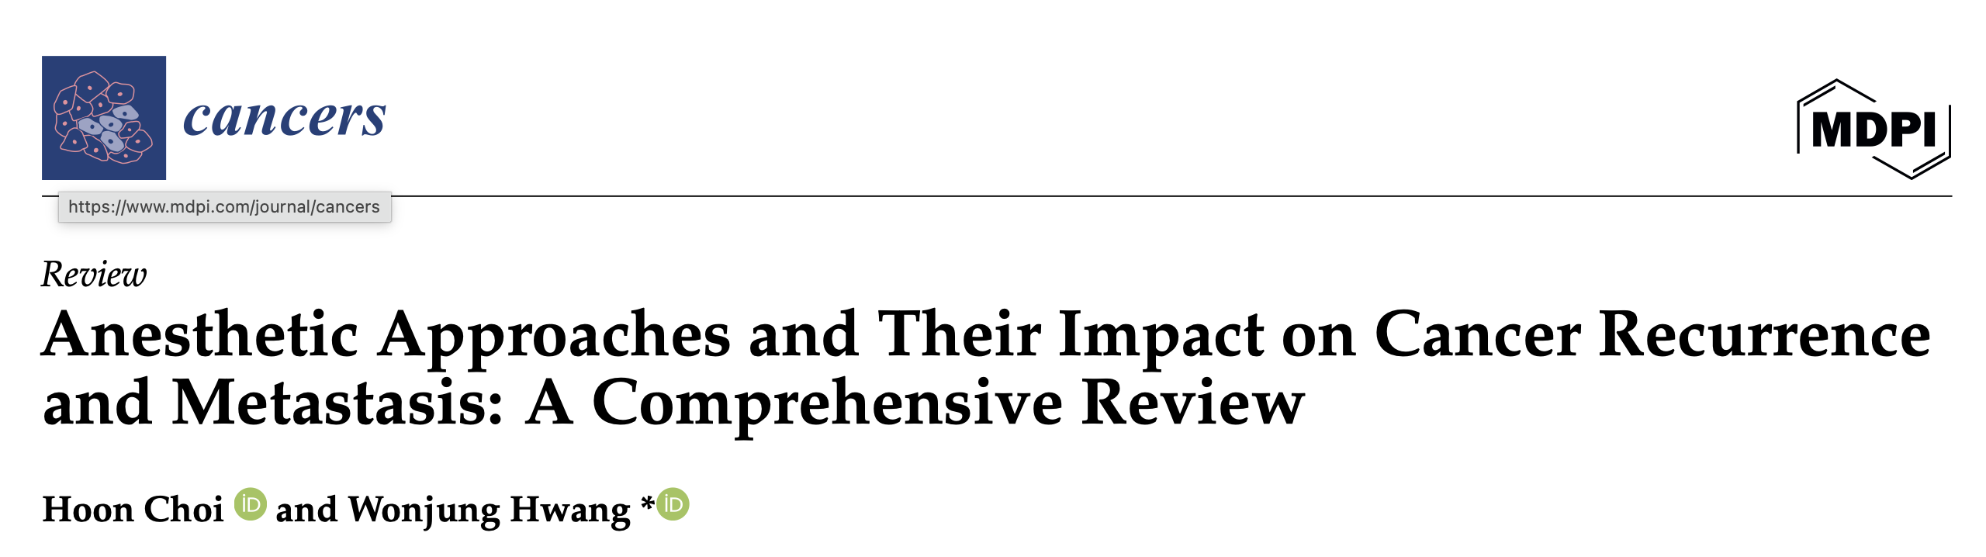
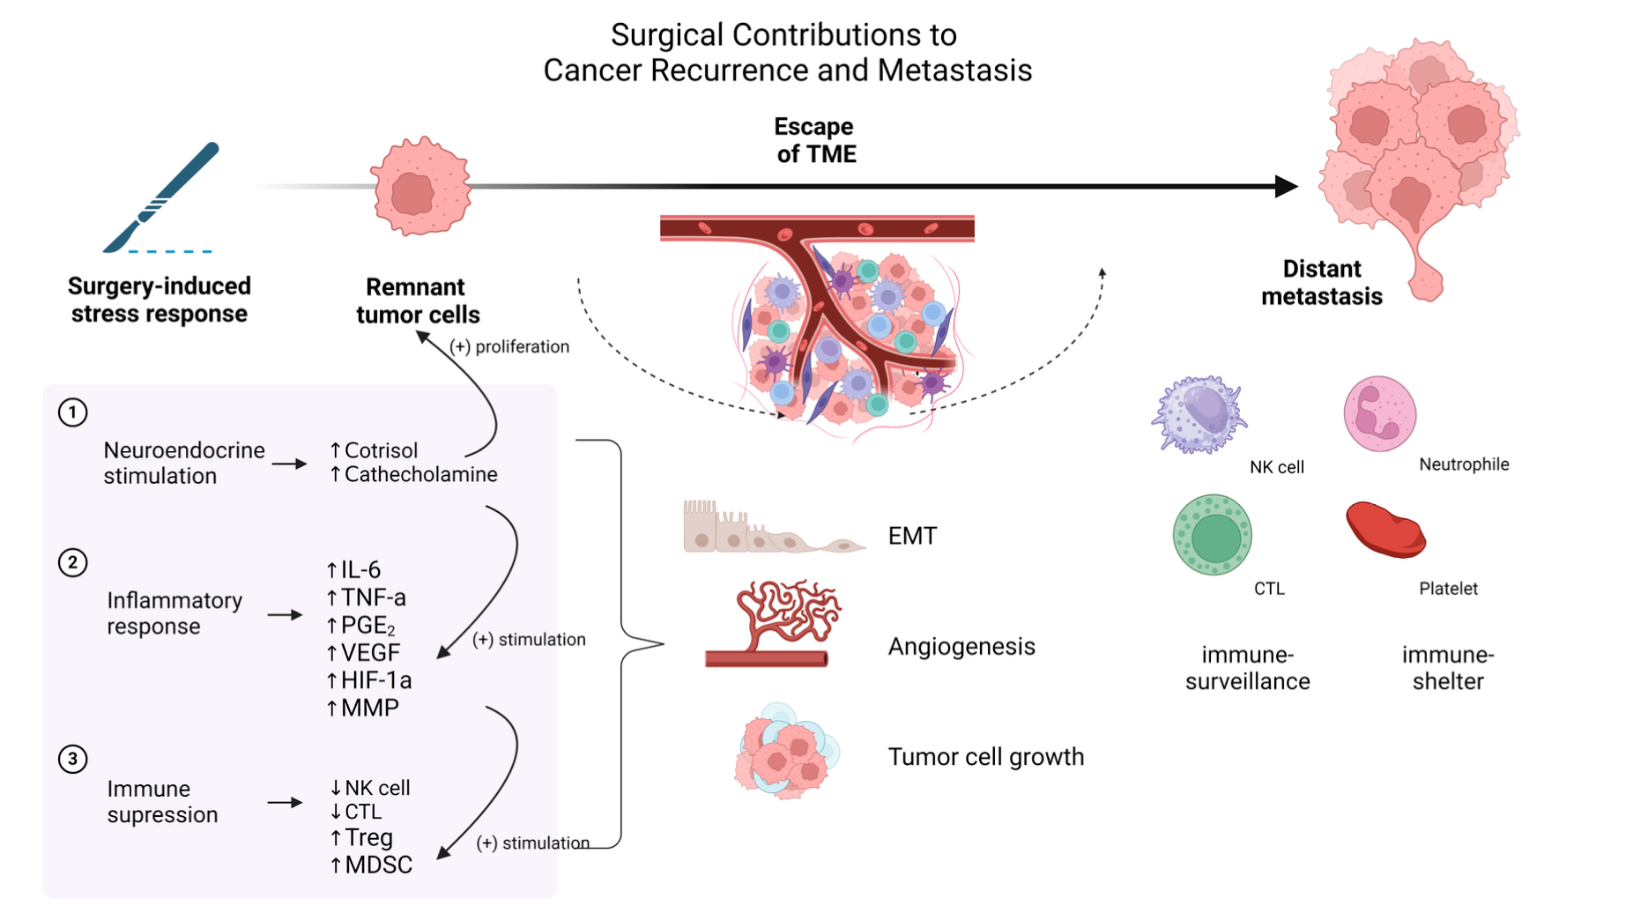
Anaesthesia and cancer recurrence
Review article
Mainly basic sciences study

Slide 28
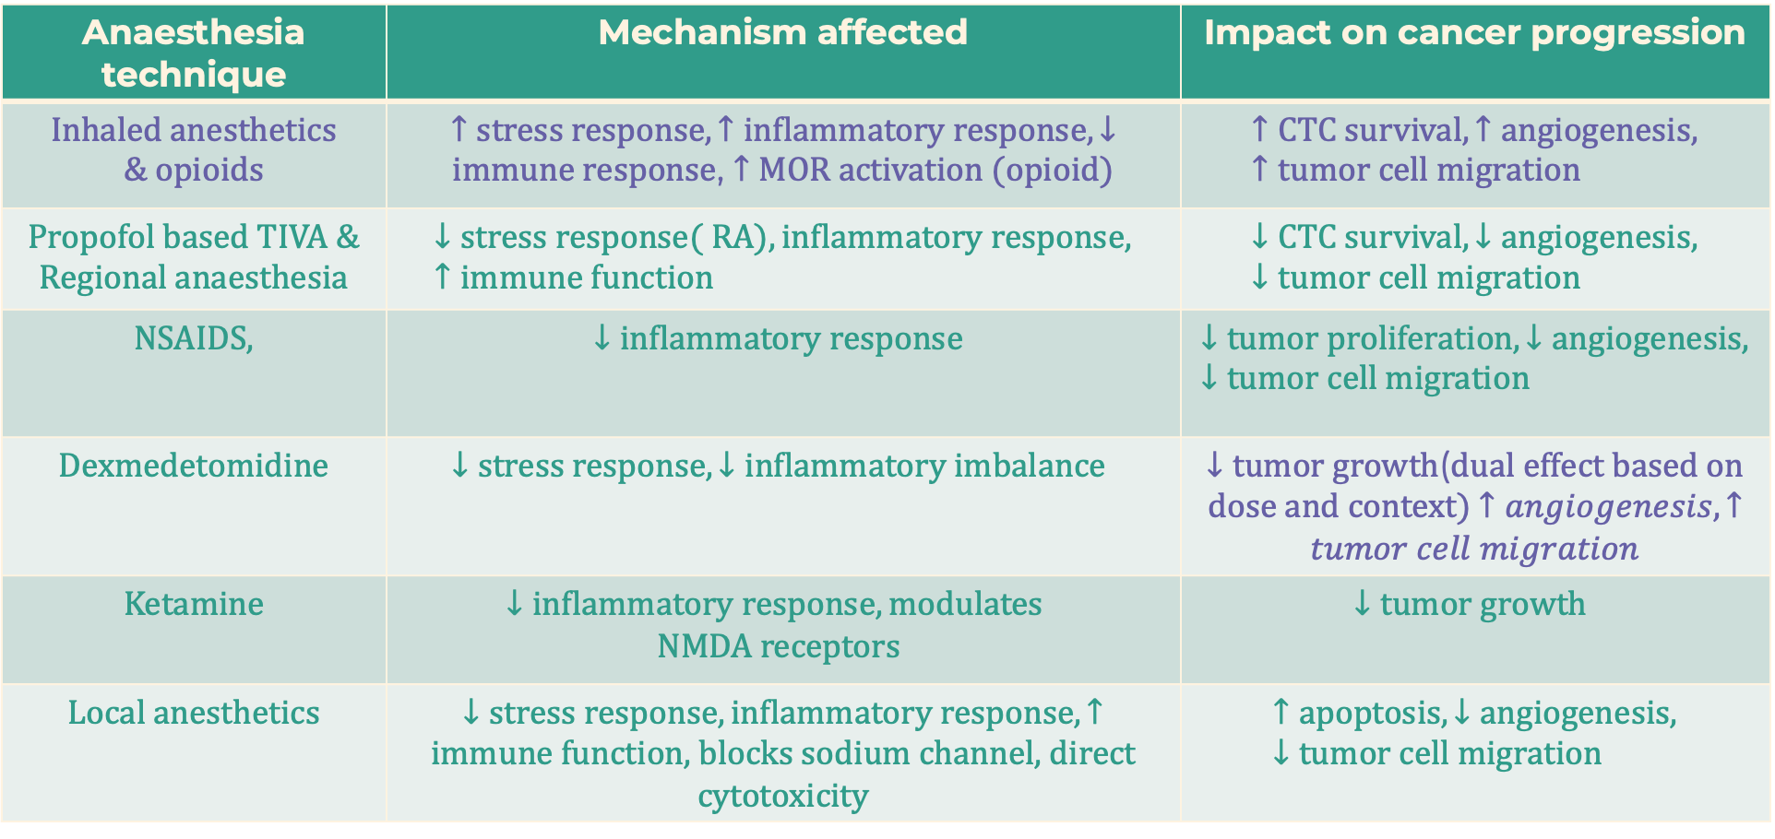
Anaesthesia technique | Mechanism affected | Impact on cancer progression
Inhaled anesthetics & opioids | $↑stress response, ↑inflammatory response, ↓immune response$, $↑MOR activation (opioid)$ | $$↑CTC survival, ↑angiogenesis, ↑tumor cell migration$$
Propofol based TIVA & Regional anaesthesia | $$↓stress response( RA), inflammatory response, ↑immune function$$ | $$↓CTC survival, ↓angiogenesis, ↓tumor cell migration$$
NSAIDS, | $$↓inflammatory response$$ | $$↓tumor proliferation, ↓angiogenesis, ↓tumor cell migration$$
Dexmedetomidine | $$↓stress response, ↓inflammatory imbalance$$ | $↓tumor growth$(dual effect based on dose and context) $↑angiogenesis, ↑tumor cell migration$
Ketamine | $$↓inflammatory response, modulates$$ $$NMDA receptors$$ | $$↓tumor growth$$
Local anesthetics | $↓stress response, inflammatory response, ↑immune function$, blocks sodium channel, direct cytotoxicity | $$↑apoptosis, ↓angiogenesis, ↓tumor cell migration$$

Slide 29
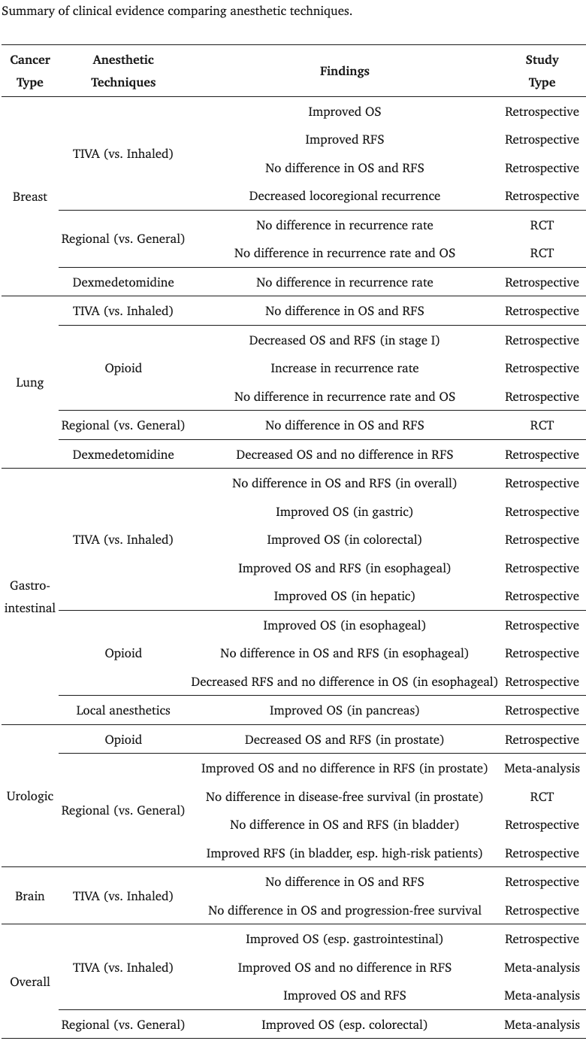

Slide 30
VAPOR-C Trial: terminated due to financial issues
GA- CARES trial: large pragmatic multicenter RCT for TIVA with propofol vs Volatile for all cause mortality showed use of propofol of anaesthesia maintenance is unlikely to improve cancer related outcome compared to volatile.
GAS-TIVA trial: 0n going multicenter trial for TIVA vs Volatile anesthetics in RFS in Non small cell lung cancer

Slide 31
Reference
Devine, K. J., Diorio, C., Richman, S. A., Henderson, A. A., Oranges, K., Armideo, E., Kolb, M. S., Freedman, J. L., Aplenc, R., Fisher, M. J., Minturn, J. E., Olson, T., Bagatell, R., Barakat, L., Croy, C., Mauro, J., Vitlip, L., Acord, M. R., Mattei, P., Johnson, V. K., … Reilly, A. F. (2022). Guideline for Children With Cancer Receiving General Anesthesia for Procedures and Imaging. Journal of pediatric hematology/oncology, 44(4), e859–e865. https://doi.org/10.1097/MPH.0000000000002430
Ehrhardt, M. J., Leerink, J. M., Mulder, R. L., Mavinkurve-Groothuis, A., Kok, W., Nohria, A., Nathan, P. C., Merkx, R., de Baat, E., Asogwa, O. A., Skinner, R., Wallace, H., Lieke Feijen, E. A. M., de Ville de Goyet, M., Prasad, M., Bárdi, E., Pavasovic, V., van der Pal, H., Fresneau, B., Demoor-Goldschmidt, C., … Armenian, S. H. (2023). Systematic review and updated recommendations for cardiomyopathy surveillance for survivors of childhood, adolescent, and young adult cancer from the International Late Effects of Childhood Cancer Guideline Harmonization Group. The Lancet. Oncology, 24(3), e108–e120. https://doi.org/10.1016/S1470-2045(23)00012-8
Zeien, J., Qiu, W., Triay, M., Dhaibar, H. A., Cruz-Topete, D., Cornett, E. M., Urits, I., Viswanath, O., & Kaye, A. D. (2022). Clinical implications of chemotherapeutic agent organ toxicity on perioperative care. Biomedicine & pharmacotherapy = Biomedecine & pharmacotherapie, 146, 112503. https://doi.org/10.1016/j.biopha.2021.112503
Coté, C. J. (2024). A Practice of Anesthesia for Infants and Children (7th ed.). Elsevier - OHCE. https://bookshelf.health.elsevier.com/books/9780323825627
Choi, H., & Hwang, W. (2024). Anesthetic Approaches and Their Impact on Cancer Recurrence and Metastasis: A Comprehensive Review. Cancers, 16(24), 4269. https://doi.org/10.3390/cancers16244269
Coté, C. J. (2024). A Practice of Anesthesia for Infants and Children (7th ed.). Elsevier - OHCE. https://bookshelf.health.elsevier.com/books/9780323825627

Slide 32


