Slide 1
Comparative Effectiveness of Antihypertensive Medications in Children With Chronic Kidney Disease
Caroline Gluck, MD, MTR
Assistant Professor
Nemours Children’s Health, Wilmington, DE

Slide 2
Disclosures
This research supported by:
Institute for Advanced Clinical Trials For Children (I-ACT for Children)
Bayer
NIH/NIDDK P50 for Pediatric Center of Excellence in Nephrology (PCEN)
The research reported in this presentation was conducted using PEDSnet, A National Pediatric Learning Health System, supported by PCORI® Award RI-CRN-2020-007
Preserving Kidney Function in Children with Chronic Kidney Disease Award RD-2020C2-20338, PCORI

Slide 3
Chronic Kidney Disease (CKD)
Affects approximately 16% of the U.S. population
Gaps in knowledge of CKD in children due to rarity of condition
Landmark studies by Chronic Kidney Disease in Children (CKiD) have identified factors associated with more rapid progression of CKD^{1,2}:
1) Glomerular Disease
2) Proteinuria
3) Hypertension
Previous studies have not included children with history of malignancy
1. Warady et al. Predictors of Rapid Progression of Glomerular and Non-Glomerular Kidney Disease in Children: The CKiD Cohort. Am J Kidney Dis. 2015 Jun; 65(6):878–888. [PubMed: 25799137]
2. Furth et al. Estimating Time to ESRD in Children with CKD. Am J Kidney Dis. 2018 Jun; 71(6): 783-792. [PubMed: 29653769]

Slide 4
Study goals: Use real world clinical EHR data to study kidney function decline in pediatric populations
Aim 1: Use EHR data to model chronic kidney disease progression, overall and by underlying etiology of kidney disease.
Aim 2: Examine the impact of hypertension and proteinuria on time course of kidney failure.

Slide 5
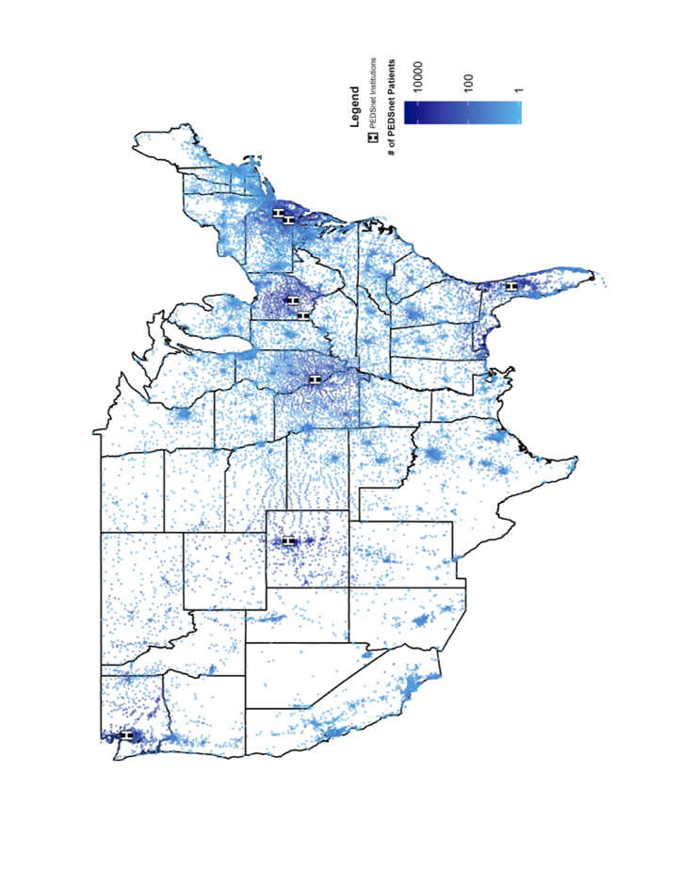
PEDSnet
A National Pediatric Learning Health System
Aggregated EHR data from 6 large pediatric health systems in the United States
Includes data from the following PEDSnet institutions:
The Children’s Hospital of Philadelphia Nemours/Alfred I. duPont Hospital for Children Nationwide Children’s Hospital Children’s Hospital Colorado Seattle Children’s Hospital St. Louis Children’s Hospital
Geographic distribution of PEDSnet’s Patients Data are from 2009-2020
2026 PEDSnet institutions: Anne & Robert H Lurie Children’s Hospital of Chicago; Children’s Hospital Colorado; Children’s Minnesota; Children’s National Hospital; Children’s Healthcare of Atlanta; Children’s Hospital of Philadelphia; Cincinnati Children’s Hospital Medical Center; Indiana University Riley’s Children’s Health; Nationwide Children’s Hospital; Nemours Children’s Health, Seattle Children’s Hospital; Stanford Children’s Health; Texas Children’s Hospital

Slide 6
Study Design: Retrospective Cohort
Study period: January 2009 to August 2020
Data source: PEDSnet
Cohort entrance date: date of first eGFR measurement < 90 mL/min/1.73m², conditional on a second 90 days or later and with a value of < 90 mL/min/1.73m² and no intervening value(s) ≥90 mL/min/1.73m²
Exclusion criteria
Age: age <12 months or ≥18 yrs
Chronic dialysis (prior to cohort entry)
Kidney transplant (prior to cohort entry)
No nephrologist visit
CKD Etiology Sub-Cohorts:
1) Malignancy
2) Glomerular CKD
3) Non-Glomerular CKD

Slide 7
Study Design: Retrospective Cohort
Composite Renal Outcomes (CRO):
eGFR ≥50% decline
eGFR <15 mL/min/1.73m²
Chronic dialysis (occurrence of two dialysis codes separated by at least 90 days)
Kidney transplant
Hypertension and Proteinuria:
Hypertension definition: HTN code during at least 2 visits within 2 years of cohort entrance
Proteinuria definition: at least 1 lab value with at least 1+ proteinuria within 2 years of cohort entrance

Slide 8
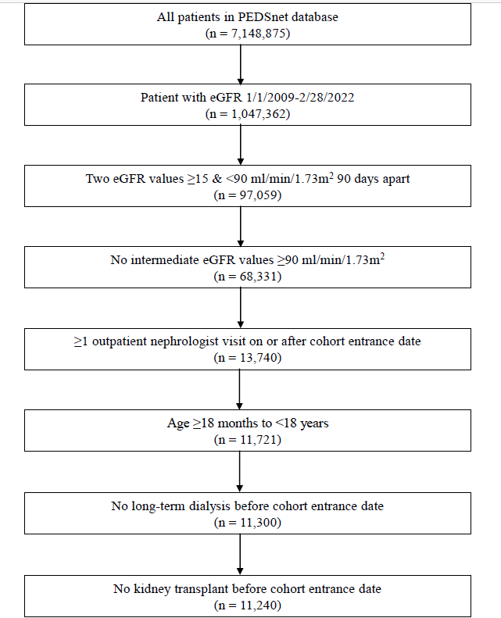
Cohort Derivation

Slide 9
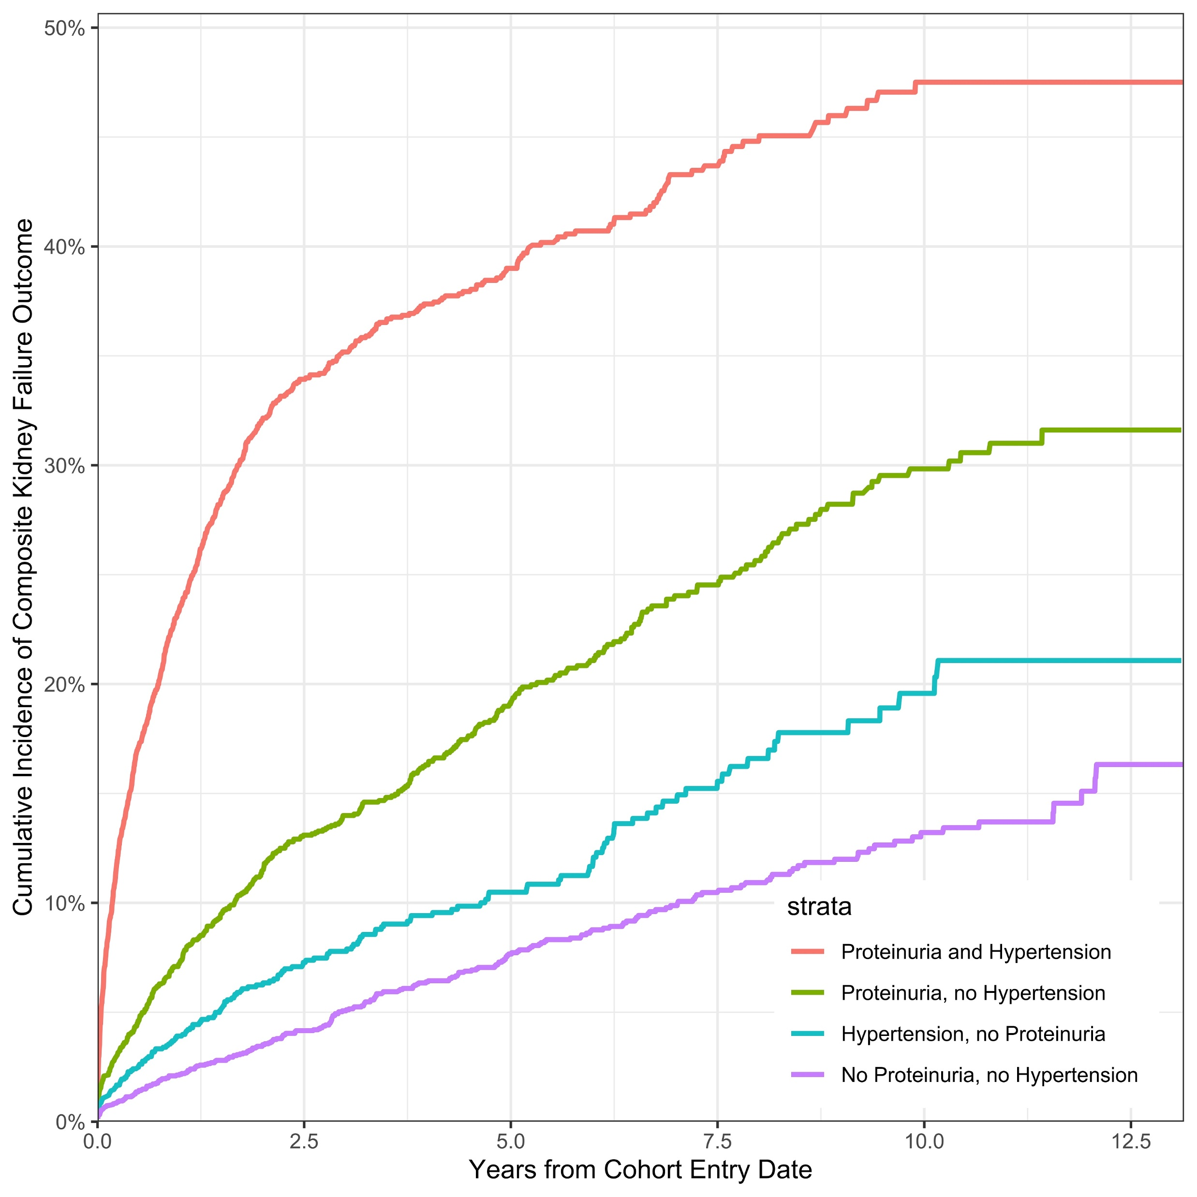
Cumulative Incidence of Composite Outcome by Proteinuria and Hypertension

Slide 10

What are the clinical risk factors associated with progression of kidney disease in children with CKD?
Retrospective
cohort study
PEDSnet EHR data
Clinical factors associated with CKD progression
(adjusted hazard ratio, 95% CI, p<0.001)
N=11,240
children with CKD
1.49
(1.22, 1.82)
Lower eGFR category at baseline
Hypertension
37% with proteinuria
Malignancy
1.79
(1.52, 2.11)
45 - 59 mL
1.44
(1.23, 1.69)
35% with hypertension
Glomerular disease
2.01
(1.78, 2.28)
30 - 44 mL
2.38
(2.02, 2.79)
50% female
Median follow-up
5.1 years
Proteinuria
2.23
(1.89, 2.62)
15 - 29 mL
5.75
(5.05, 6.55)
Conclusions: Disease etiology, proteinuria, hypertension, age, male sex, more advanced CKD, and greater medical complexity at start of follow-up were associated with more rapid decline in kidney function among children with CKD.
Caroline A. Gluck, Christopher B. Forrest, Amy Goodwin Davies, et al. Evaluating Kidney Function Decline in Children with Chronic Kidney Disease Using a Multi-institutional Electronic Health Record Database. CJASN doi: 10.2215/CJN.05700522. Visual Abstract by Corina-Gabriela Teodosiu, MD

Slide 11



PRESERVE Preserving Kidney Function in Children with CKD
Nephrologists
Informaticians
Parent & Youth Partners
Denburg MR, et al. Kidney Med 2023
Notes:
PRESERVE is funded by PCORI and is one of a few projects supported by a call for studies on rare disease.
The purpose of PRESERVE is to provide new knowledge to inform shared decision-making regarding BP management for pediatric CKD
PRESERVE includes 16 institutions in PCORnet®
PRESERVE is led by PEDSnet (pedsnet.org)
Additional 7 institutions (from four other PCORnet® networks) are participating
GLEAN rare disease – 10/11 centers represented in PRESERVE

Slide 12
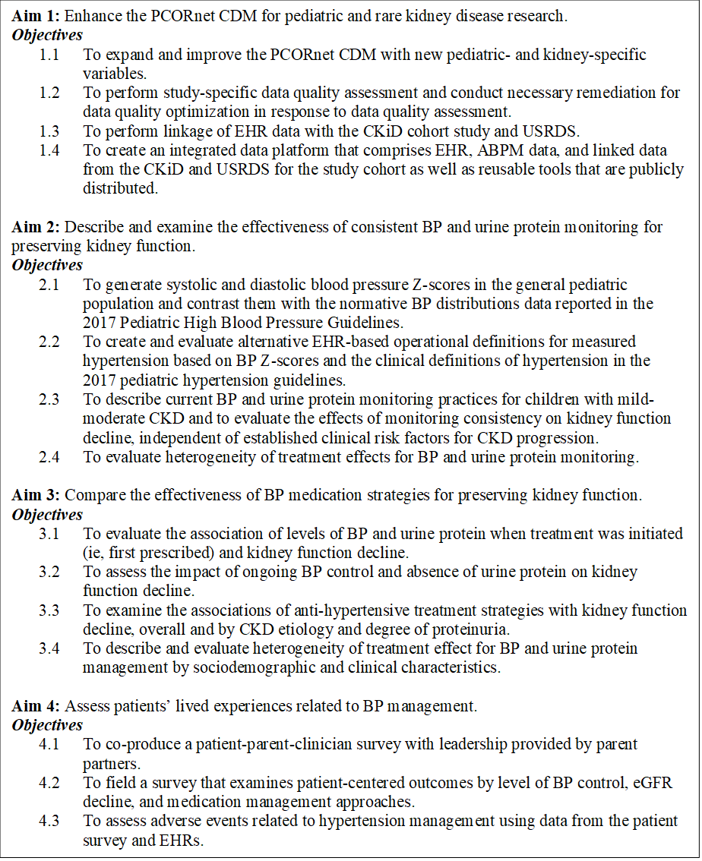
PRESERVE
Enhanced common data model for pediatric and rare kidney disease research.
Comparative effectiveness of BP medication strategies for preserving kidney function.
Assess patients’ lived experiences related to BP management.
Denburg MR, et al. Kidney Med 2023
Notes:
PRESERVE has four aims, each with objectives that guide their scope of work
Specifically, this project will:
Expand and improve the PCORnet common data model for research in children with kidney disease
new pediatric- and kidney-specific variables and linking patients’ EHR data to other kidney disease databases.
Compare the effectiveness of alternative strategies for monitoring and treating hypertension on preserving kidney function.
Assess the lived experiences of patients and caregivers related to BP management.

Slide 13
PRESERVE Sources of data
EHR
Structured EHR data (N >20,000)
Chart reviews (N = 1500)
Linked kidney disease databases
Surveys (N = 633)
Chart reviews
CKiD
PRESERVE Database
USRDS
Surveys

Slide 14
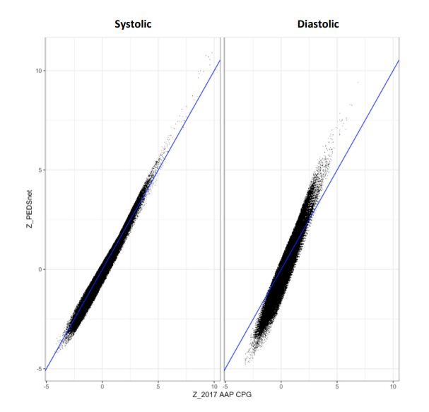
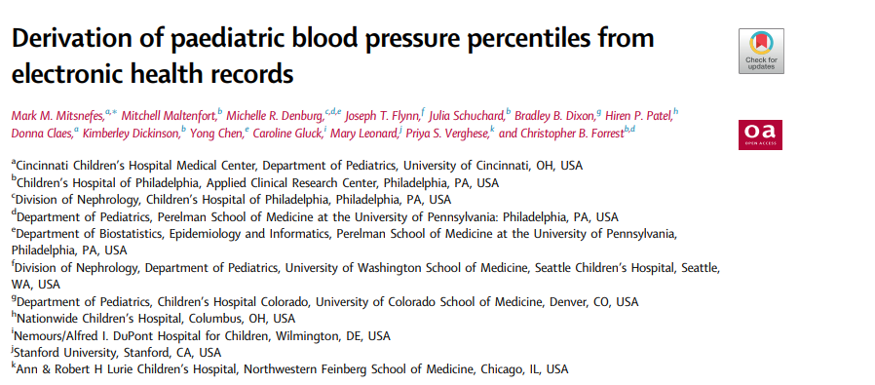
Blood pressure measurements derived from EHR records correlate well with 2017 American Academy of Paediatrics (AAP) Clinical Practise Guidelines (CPG)

Slide 15
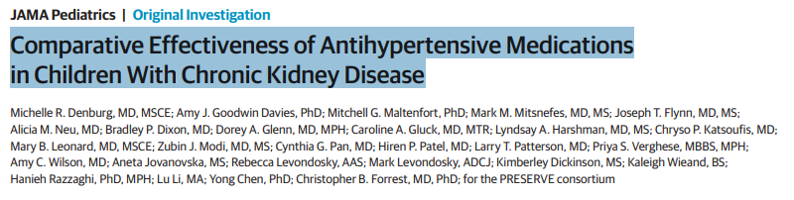
Does antihypertensive medication and BP target influence CKD progression?
Published online March 16, 2026

Slide 16
Study Design: Retrospective Cohort – Emulated Trial
Study period: January 2009 through December 2020
Data source: 13 institutions from 5 PCORnet Clinical Research Networks
Inclusion: Children 2 to 20.9 years with CKD stage 2-4 and systolic blood pressure higher than the 90th percentile or with a hypertension diagnosis who initiated treatment with RAASior CCB
Exclusion criteria: kidney replacement therapy, renal artery stenosis,Malignancy, pregnancy, previous antihypertensive therapy (in past 18 mo) or combination therapy
Exposure: Incident RAASi or CCB treatment
Randomization: emulated by propensity score weighting to balance groups on sociodemographic factors, institution, year, CKD etiology, proteinuria, CKD stage, obesity, health care use, medications, comorbidities, and blood pressure control (percentage of time at greater than the 90th percentile).

Slide 17
Study Design: Retrospective Cohort – Emulated Trial
Outcomes:
1) Kidney replacement therapy within 2 years of follow-up (ascertained through linkage with the United States Renal Data System)
2) Composite of kidney replacement therapy, 50% decline in estimated glomerular filtration rate, or estimated glomerular filtration rate less than 15 mL/min/1.73m2.
Analysis: Cox proportional hazards regression with propensity score stratification was used to estimate adjusted hazard ratios (aHRs) in the intention-to-treat analysis. Adjusted analyses also compared systolic blood pressure control within 2 years of follow-up.

Slide 18
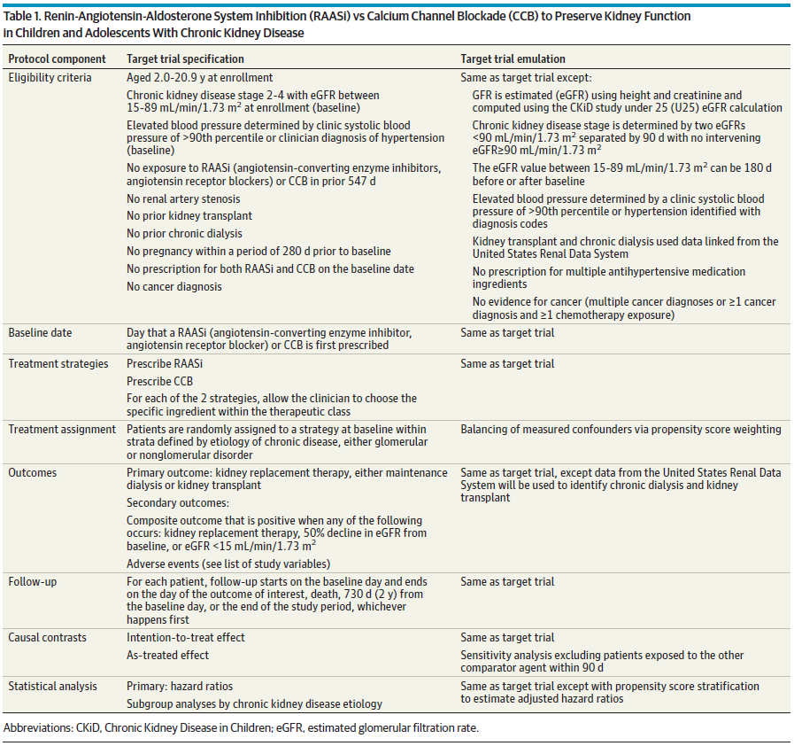

Slide 19
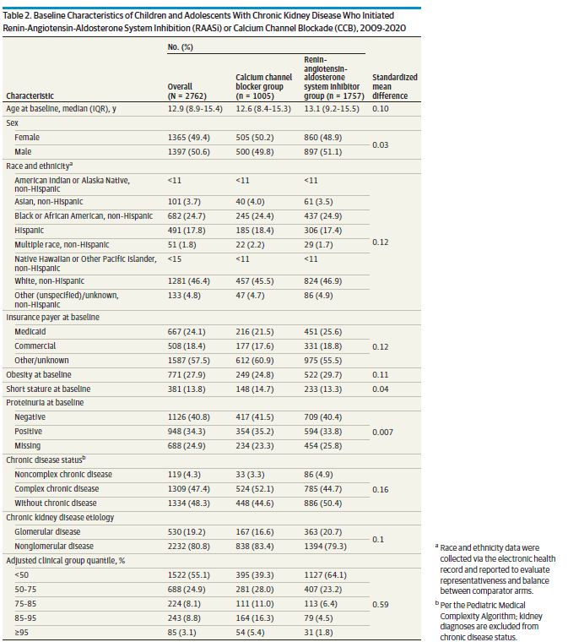

Slide 20
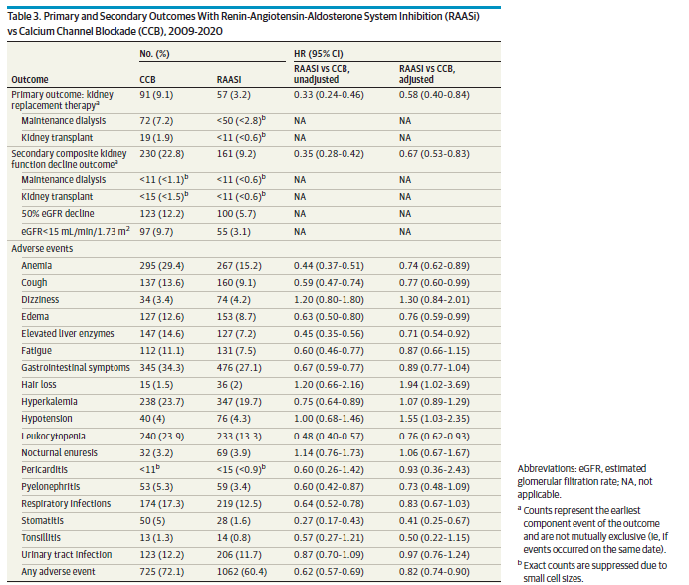

Slide 21
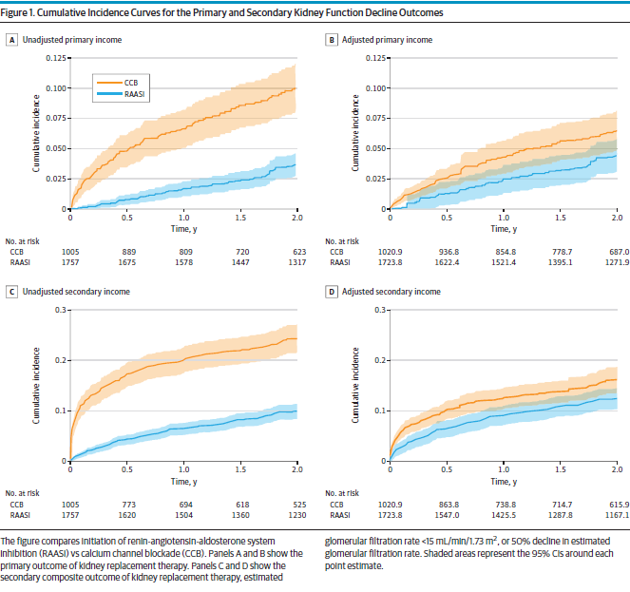

Slide 22
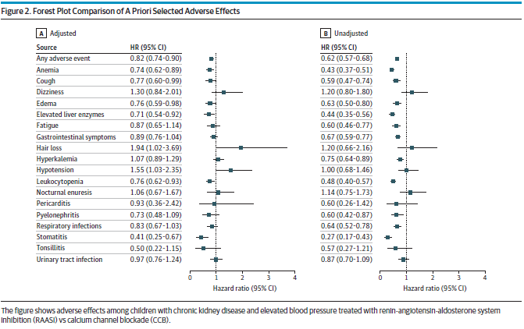

Slide 23
PRESERVE 2.0 grant awarded!
PCORI grant for collaborative pragmatic trial: “Alternative Approaches for Managing Blood Pressure in Children with Chronic Kidney Disease”.
Compares
1) conventional vs intensified blood pressure control
2) calcium channel blockers vs renin-angiotensin-aldosterone system inhibitors and assessing composite kidney function decline outcomes.
This is a 5year, $12M project; the total award to Nemours is $311,752 over 5 years and will start Oct 2026!

Slide 24
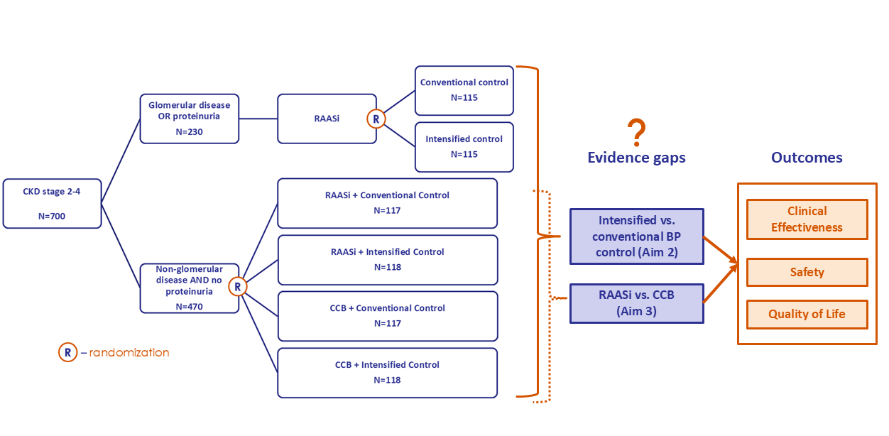
PRESERVE 2.0 Alternative Approaches for Managing Blood Pressure in Children with Chronic Kidney Disease
Notes:
30 centers

