Slide 1
Appendicitis Update
Diagnosis
Definitive Care

Slide 2
Introduction- Appendicitis
Most common surgical emergency in pediatrics
On of the most common pediatric surgical procedures in general
80,000 every year in United States
2.3 cases per 1000 children 10-19 years old
Uncommon less than 2 years old
(Think of Hirschsprung’s)
Cost almost one billion in US, per year
Uncomplicated- 6,000$, complicated -14,000$

Slide 3
Risk Factors
Fecalith
Western Diet
Genetic? (Shape and location of the appendix).

Slide 4
Pathophysiology
Luminal Obstruction
Fecalith
Catarrhal Inflammation
Invasive Bacteria
Genetic?
Shape of the appendix?

Slide 5
Appendicitis and Age
Rare under the age of 2
Younger children are more likely to be perforated and less likely to form an abscess
Adults do better with appendicitis?

Slide 6
Presentation for Appendicitis
Central abdominal pain that proceeds nausea and eventually migrates to the right lower quadrant
Anorexia
Low grade fever
Elevated WBC with left shift
Pain with movement
Fever with Tachycardia with complicated appendicitis

Slide 7
Physical Findings With Appendicitis
Right lower quadrant tenderness
Voluntary guarding, Involuntary guarding
Peritoneal signs
Rovsing’s sign
Psoas sign
Obturator

Slide 8
Risk Factors, Complicated Appendicitis
Less than five years of age?
Length of time with symptoms
Presence of a Fecalith
Hispanic and African Americans

Slide 9
Position of the Appendix
May have an effect on the presentation of appendicitis
RLQ pain and tenderness
Suprapubic pain and tenderness
Right flank pain and tenderness

Slide 10
Assessment
Vitals – HR and Temp
Labs – CBC with Diff
US?
CT?

Slide 11
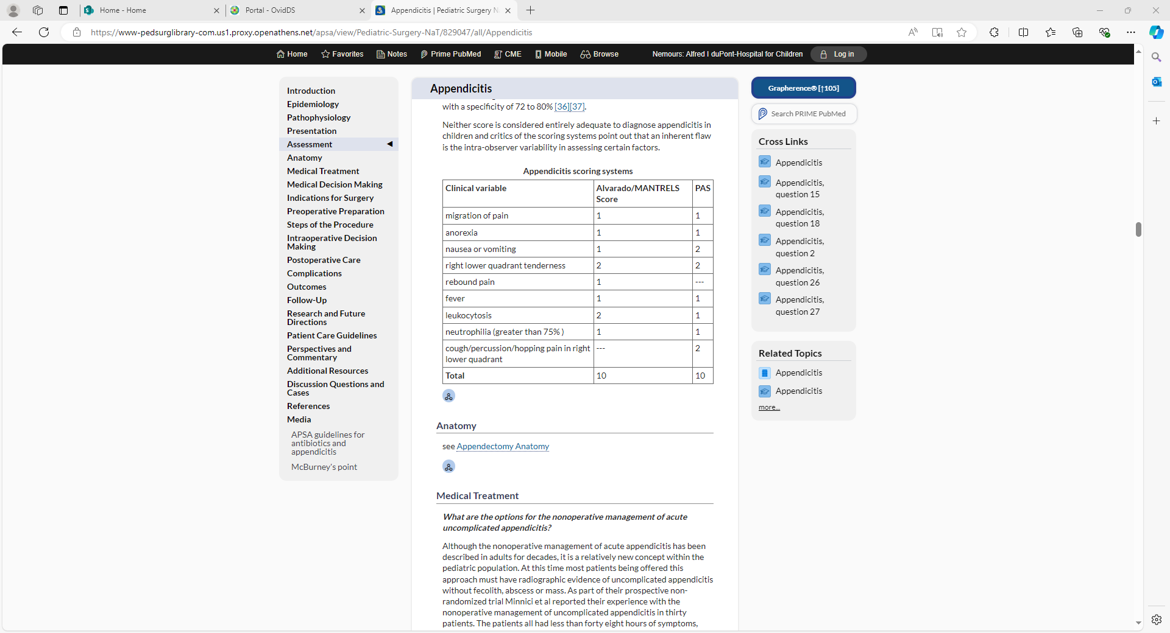
Appendicitis Score

Slide 12
Appendicitis Score Meaning
Low risk 0-3, need to look for other source
Intermediate 4-7, US, CT, CBC, CRP
High risk 8-10, Operate

Slide 13
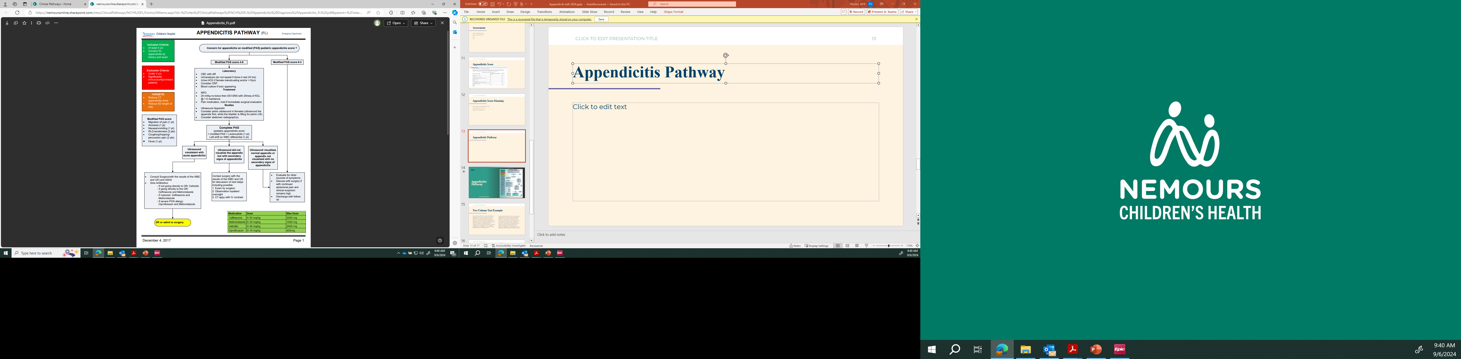
Appendicitis Pathway

Slide 14
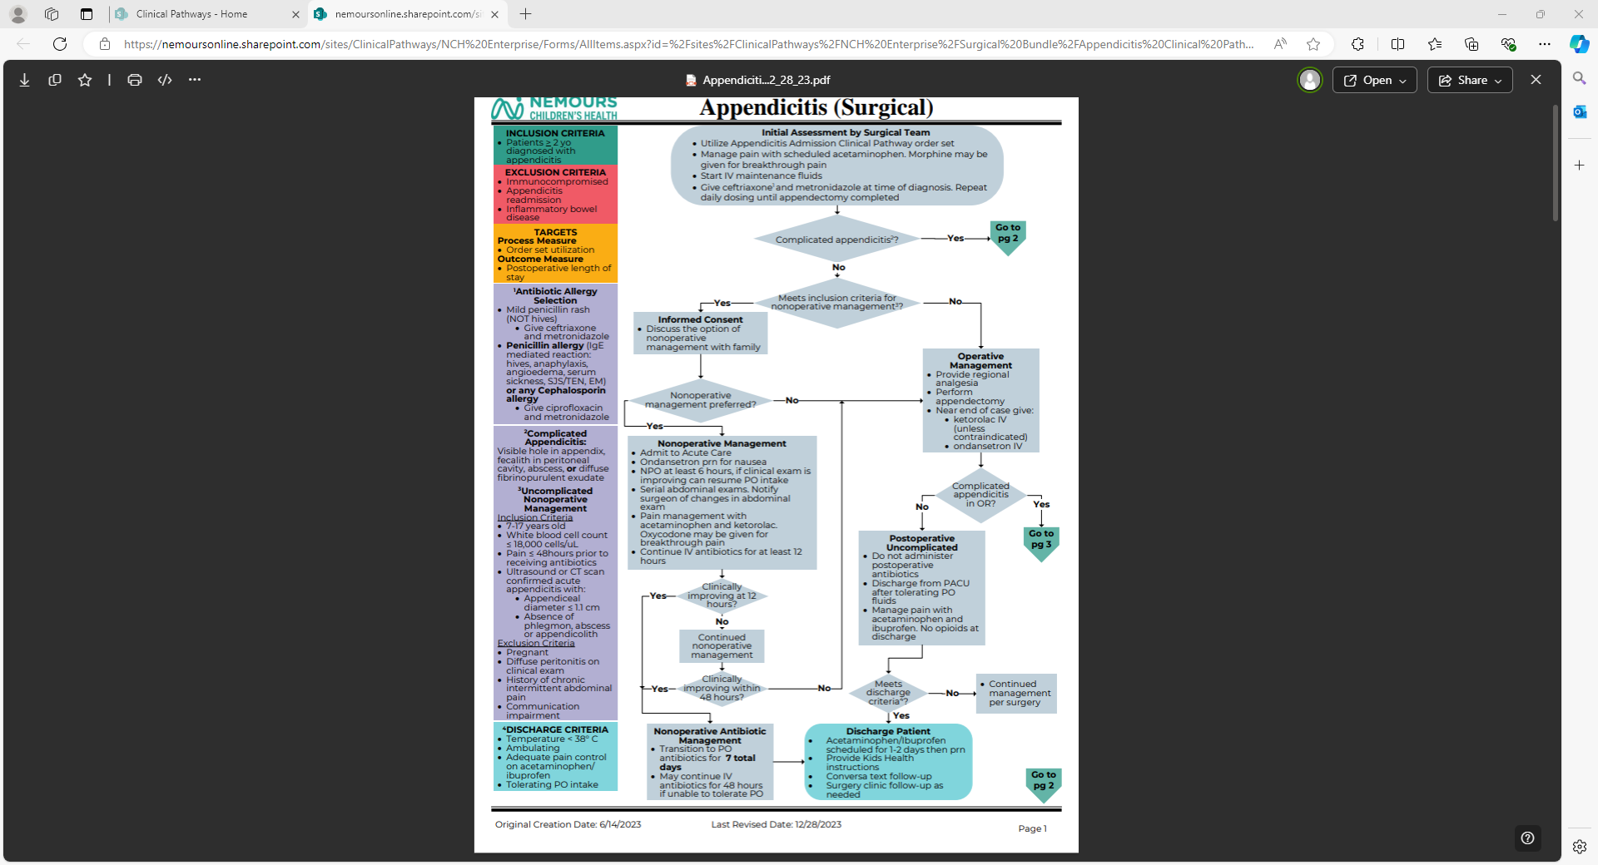
Appedicitis Pathway

Slide 15
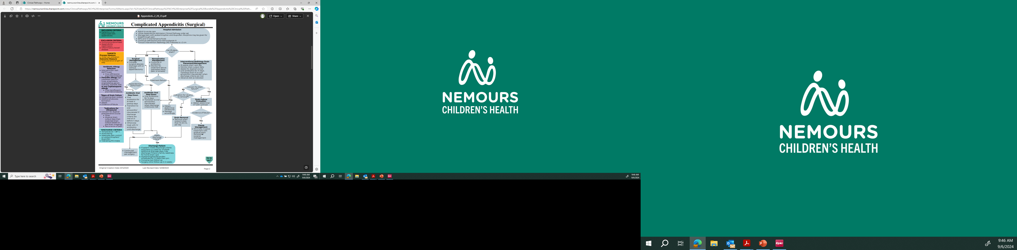
Appendicitis Pathway Complicated

Slide 16
Questions
?

