Slide 1


Skull fractures in children: when a fracture is more than just a fracture
Greg Olavarria MD
Nemours Hospital for Children, Neurosurgery
September 2024

Slide 2
Disclosure
No financial arrangements to disclose
No products discussed or endorsed
All relevant literature represents current standard and reasonable care

Slide 3
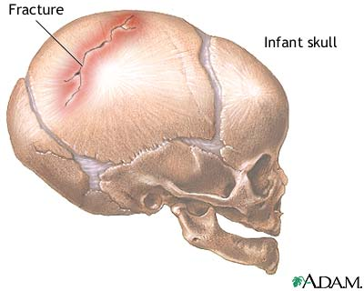
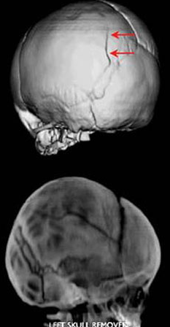

Skull fractures are common
PEDIATRIC NEUROSURGERY EMERGENCIES: Trauma brain and spine and hydrocephalus – related (acute vs shunt related), rare non trauma hemorrhage or tumor
More than 600,000 ED visits each year for TBI
#1 Cause death in children
Mechanism: usually falls
Fear of “talk and die” scenario

Slide 4
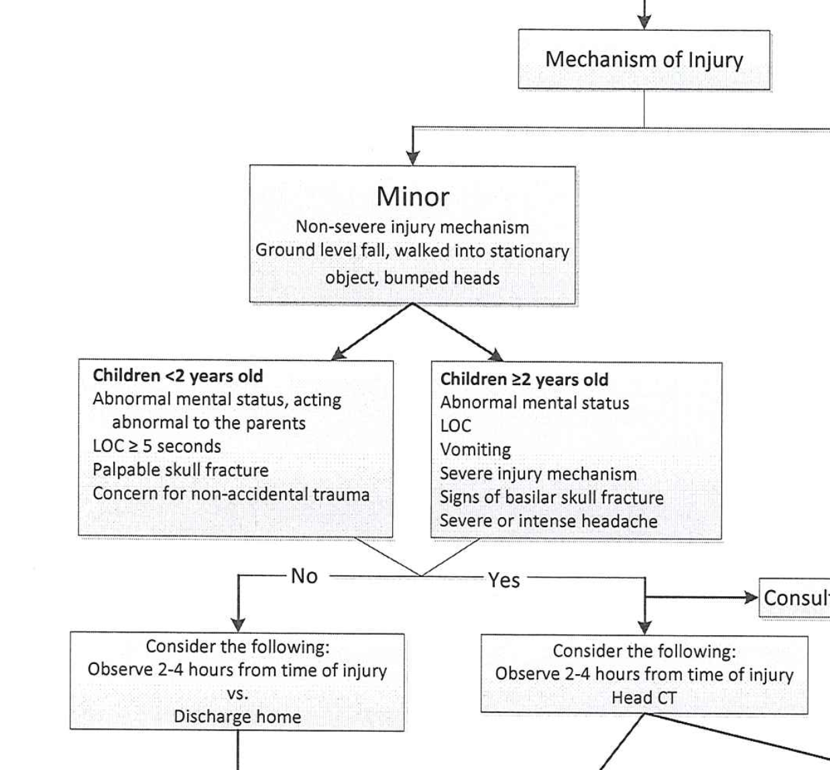

Slide 5
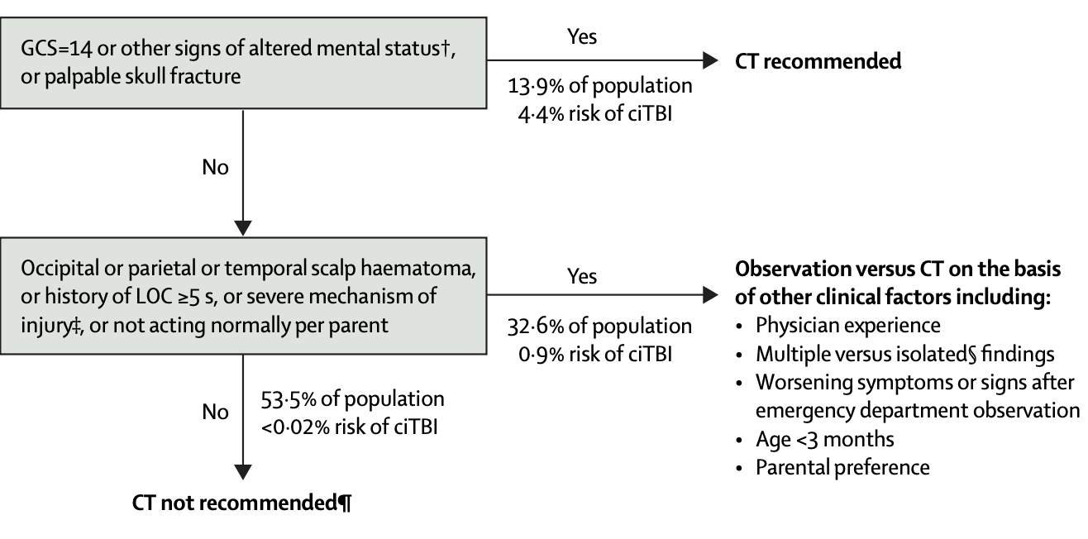
WHEN TO CT
From Kupperman, et al., 2009

Slide 6
Types of Fractures
Closed (simple) and open or compound
Diastatic at the sutures
90% vault
Basilar fractures: Raccoon eyes and Battle sign
Temporal bone fractures: transverse (terrible) and longitudinal – more common (less terrible)
”Growing” type: leptomeningeal cyst

Slide 7
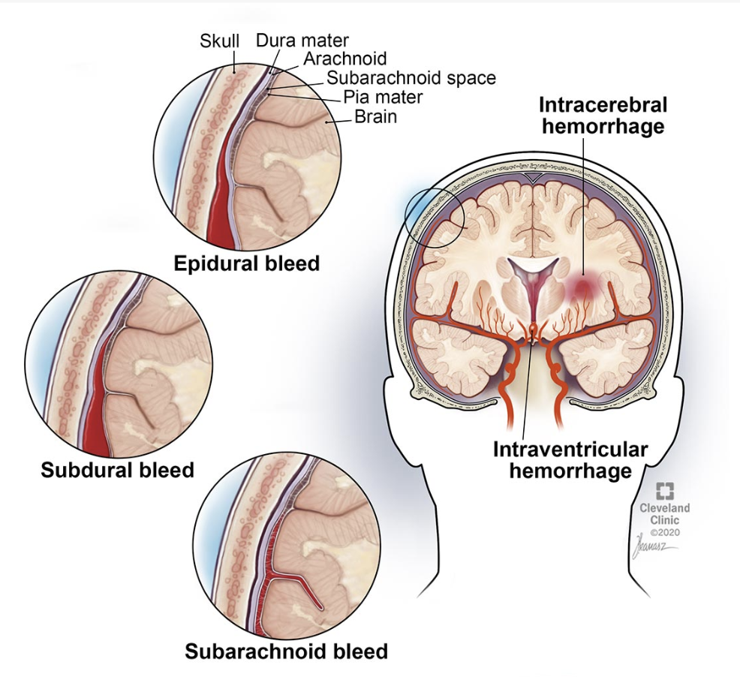
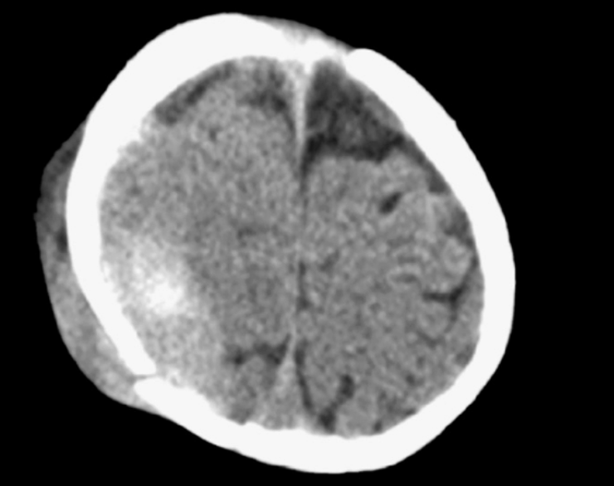

Slide 8
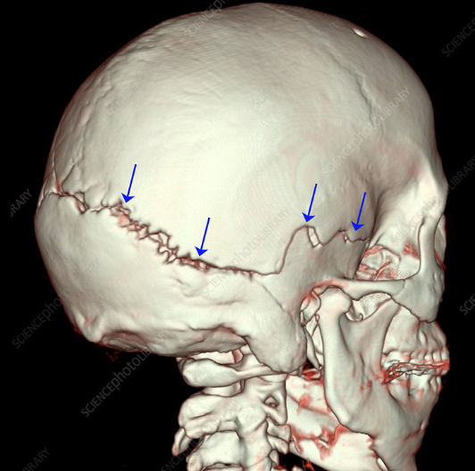
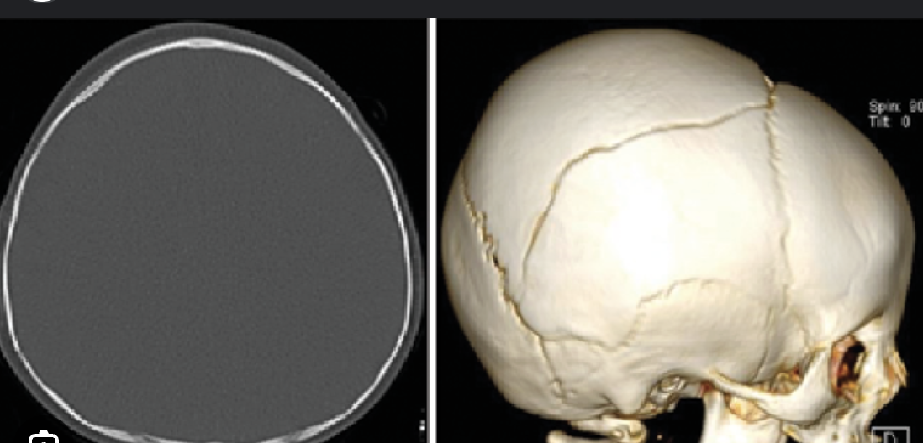
3 D RECONSTRUCTION OF SKULL

Slide 9
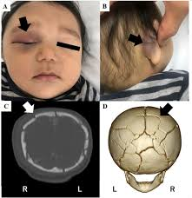
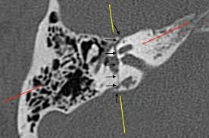

Slide 10
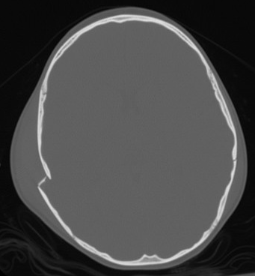
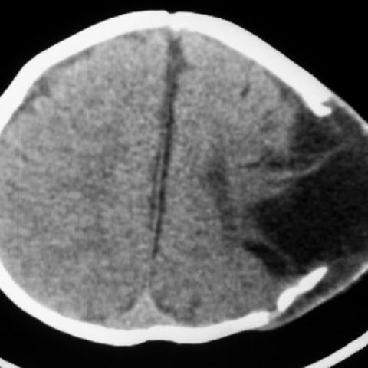
Depressed fracture
Growing skull fracture

Slide 11
Indications for surgery
Depressed fractures NOT near a venous sinus
Depressed greater than thickness of skull
Open fracture with csf leak
Hematoma evacuation
Frontal sinus involved
Cosmetic deformity
Level III evidence

Slide 12
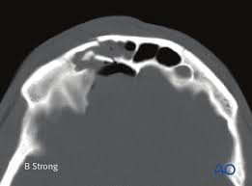
Complex or worrisome fractures
Older child: forces greater
Frontal sinus involved
CSF leak with dural tear
Near venous sinuses
Transverse temporal bone
Caution with NG tube and basilar skull fractures

Slide 13
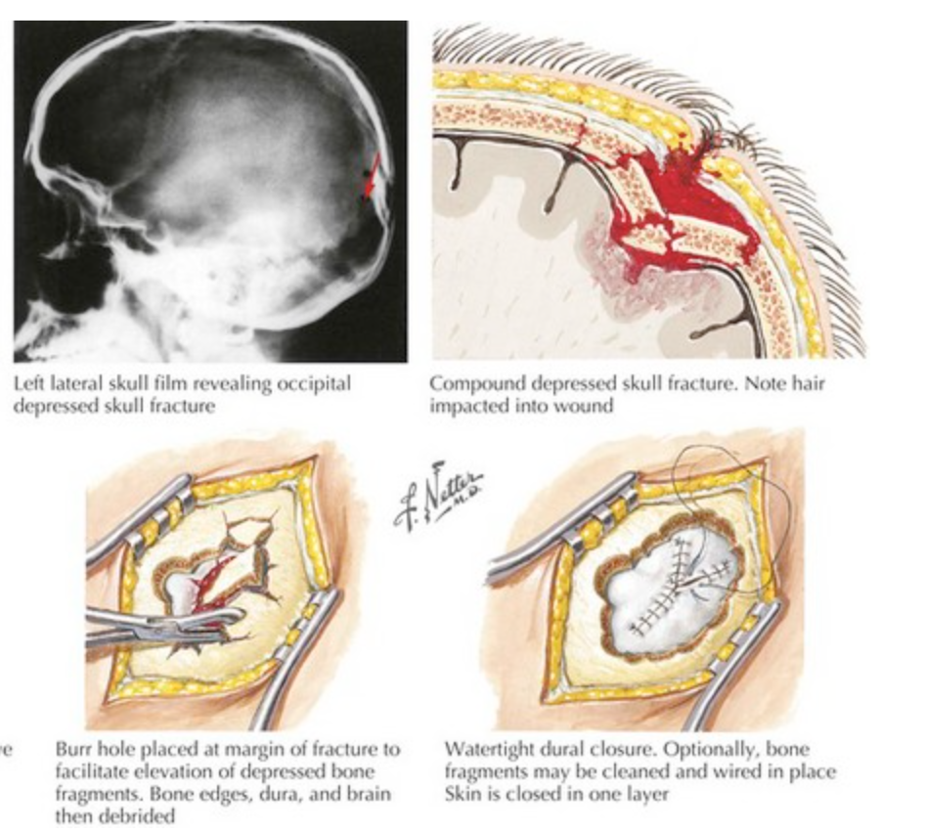
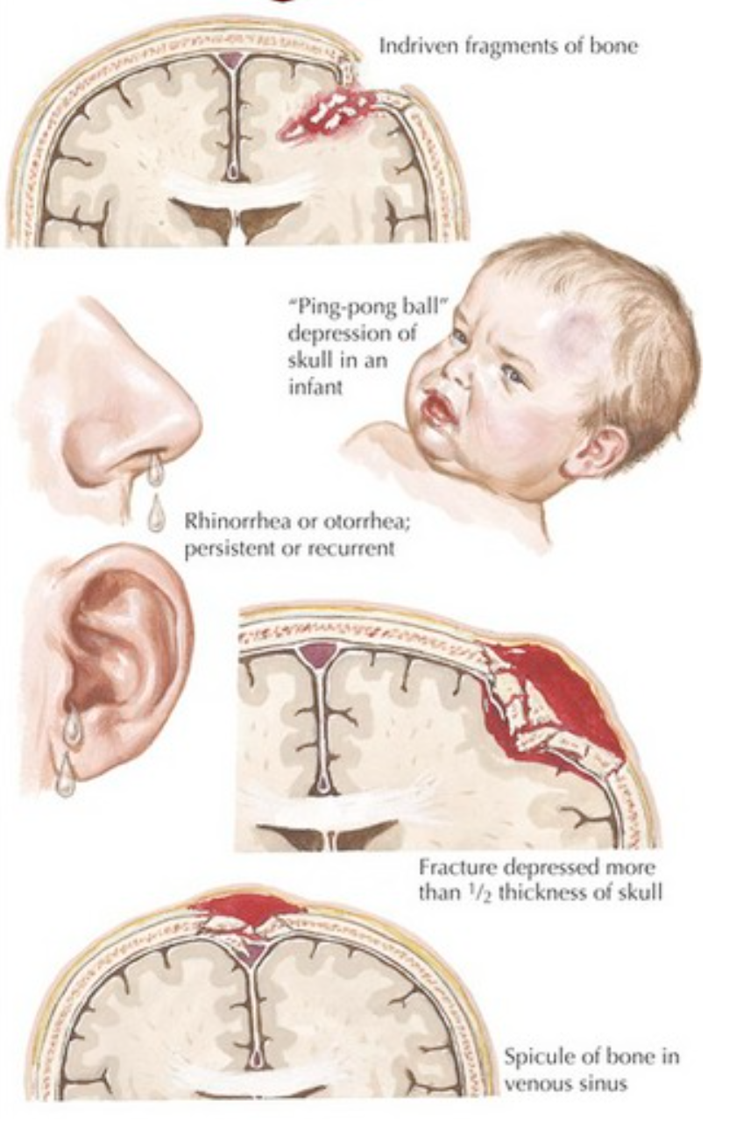

Slide 14
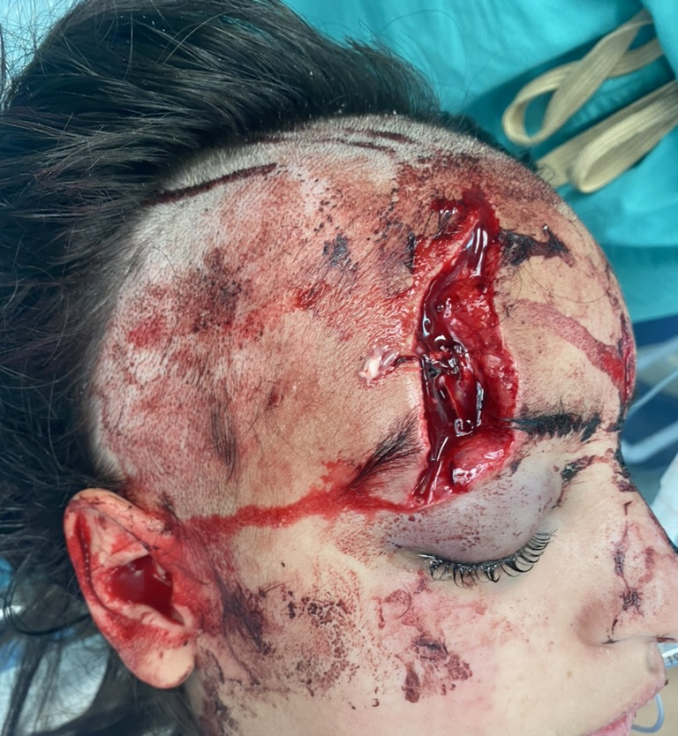
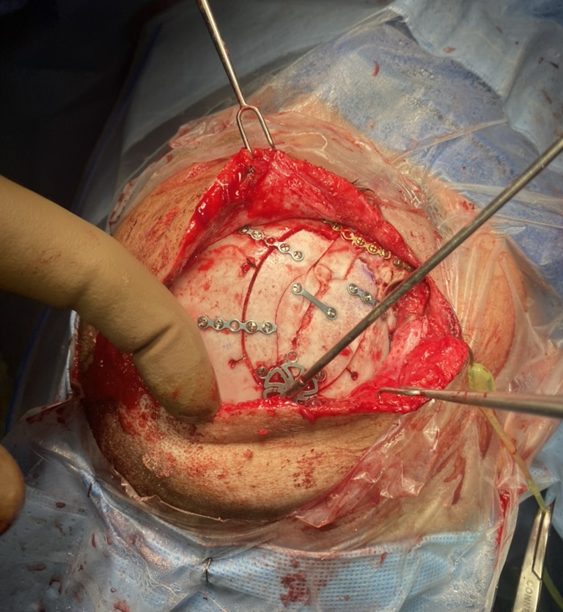

Slide 15
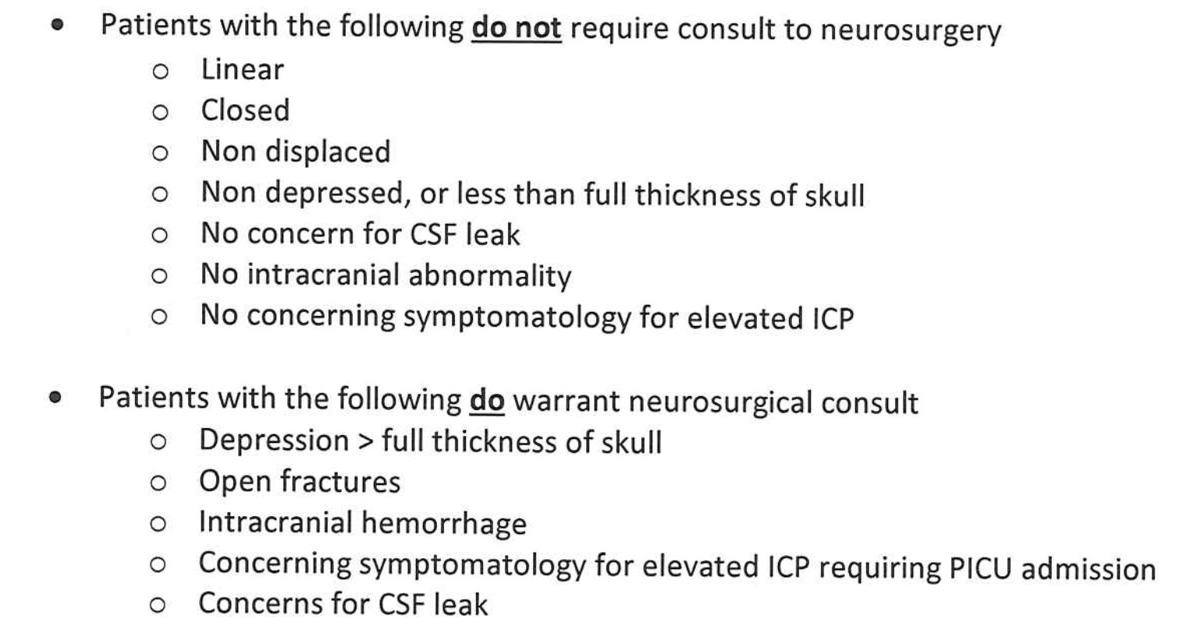

Slide 16
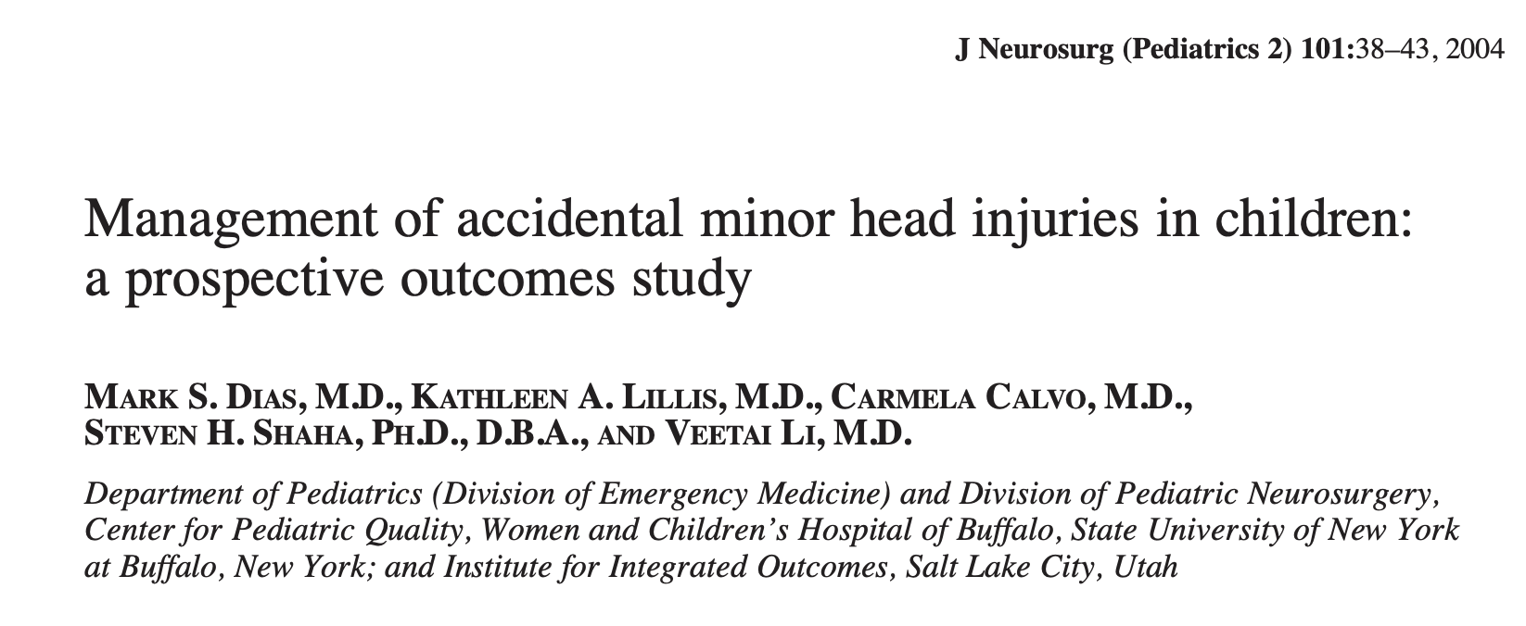
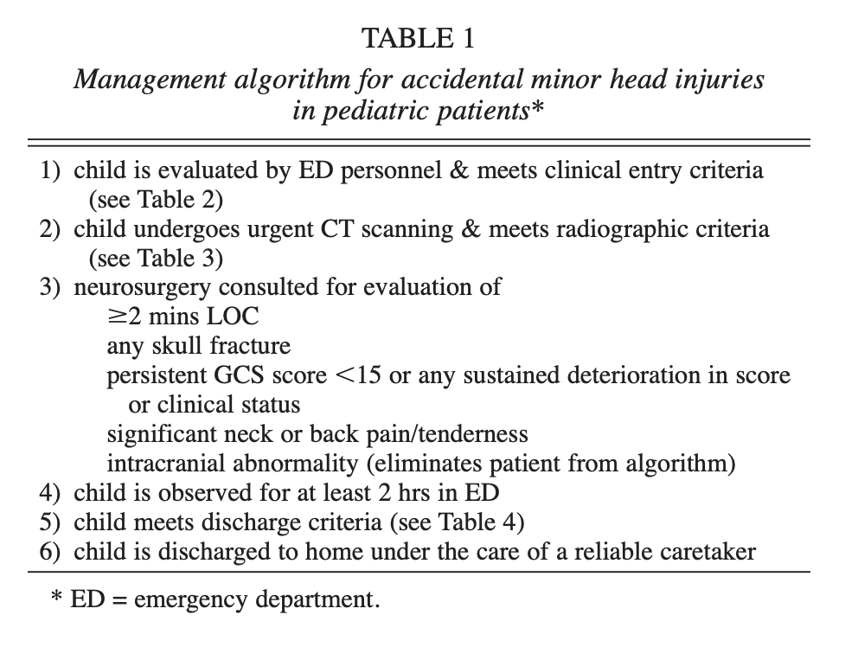
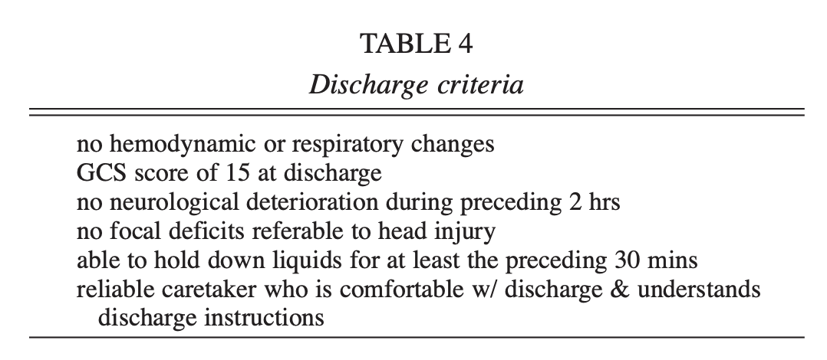

Slide 17
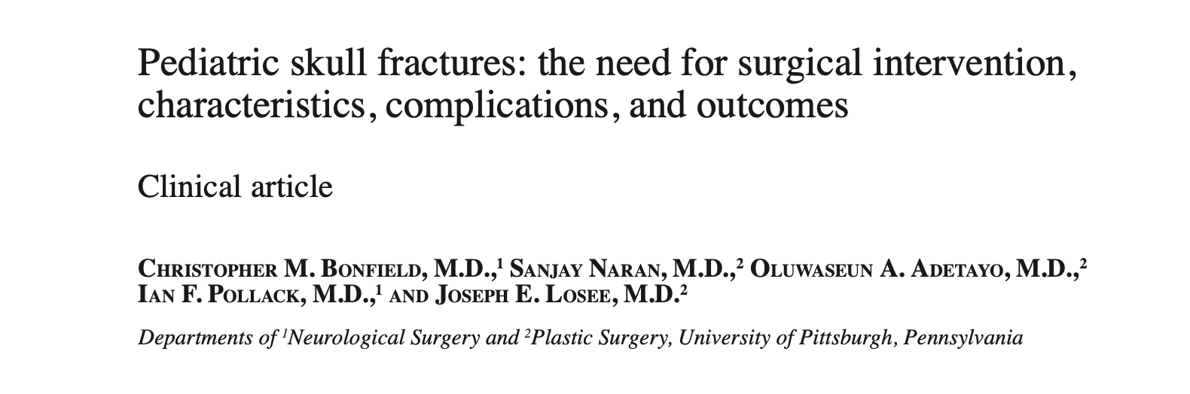
897 children:
86% non operative
More likely surgical: Hit with object or MVC
Frontal more likely surgical

Slide 18
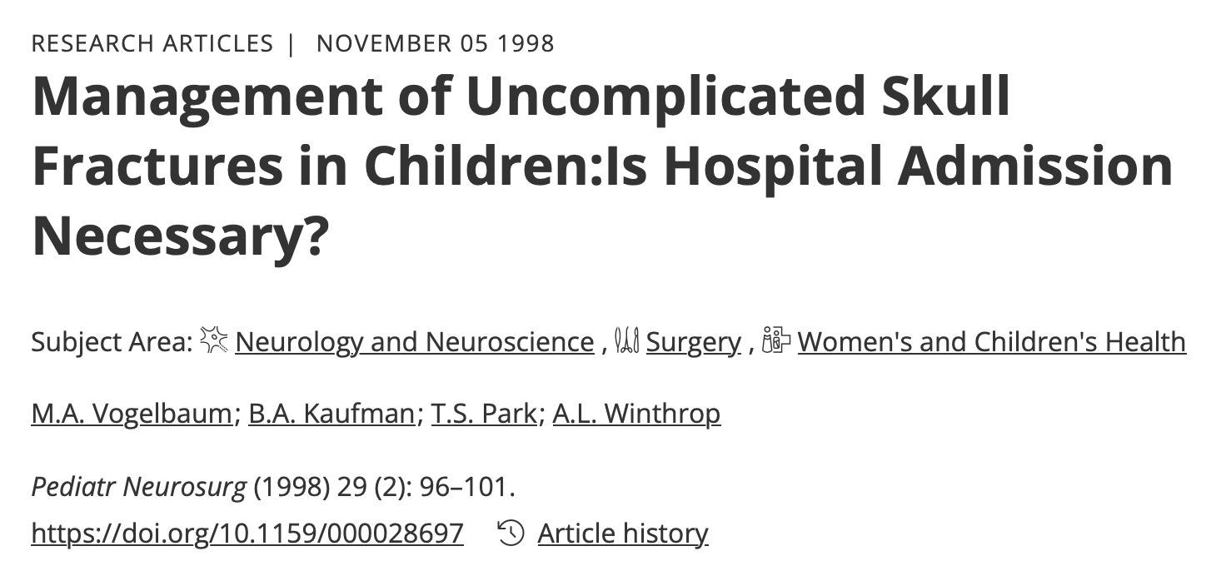
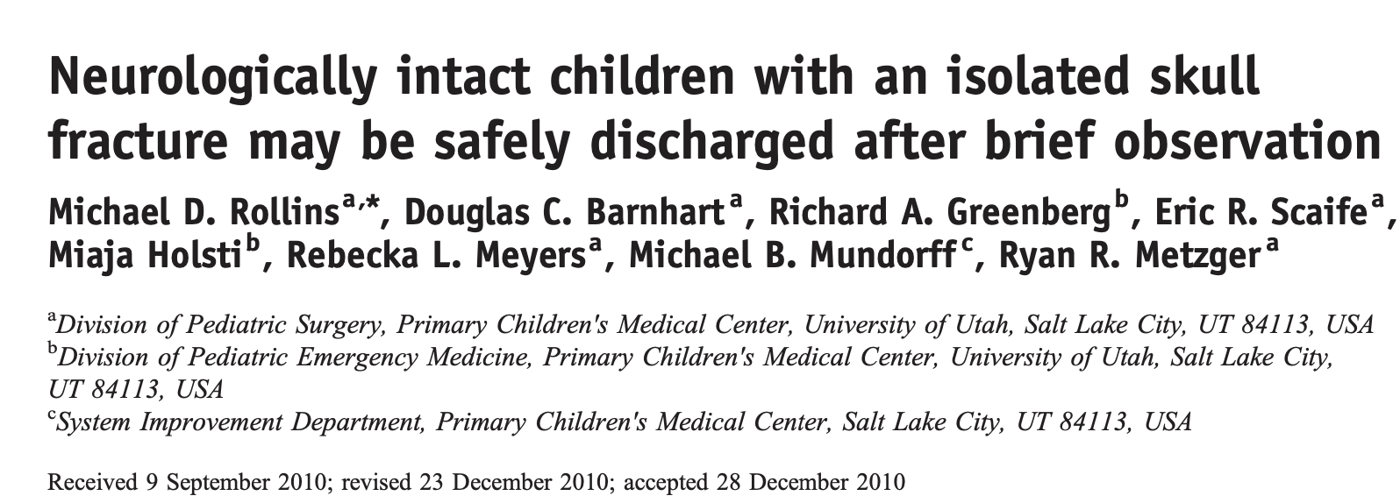
With protocol, admissions dropped
Transfers more likely to be admitted
No discharged patient returned
44 pts, all admitted with fracture
Average length of stay: 18-36 hrs
No complications related to injury

Slide 19
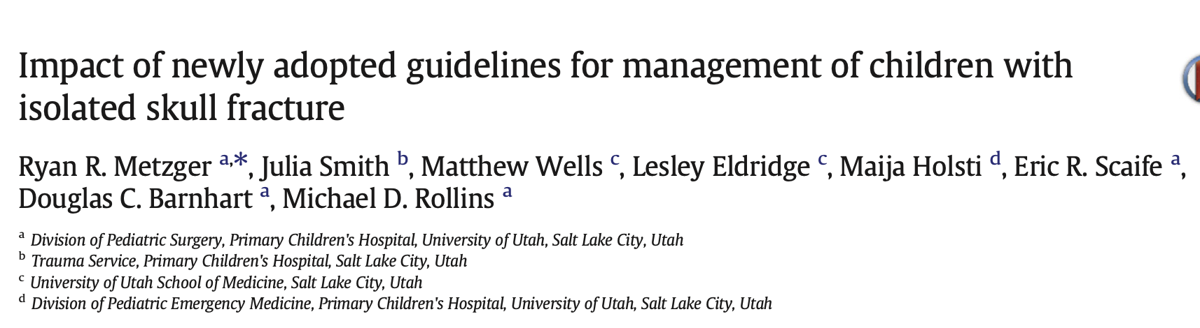
Protocol
Reduced admissions and cost without associated complications

Slide 20
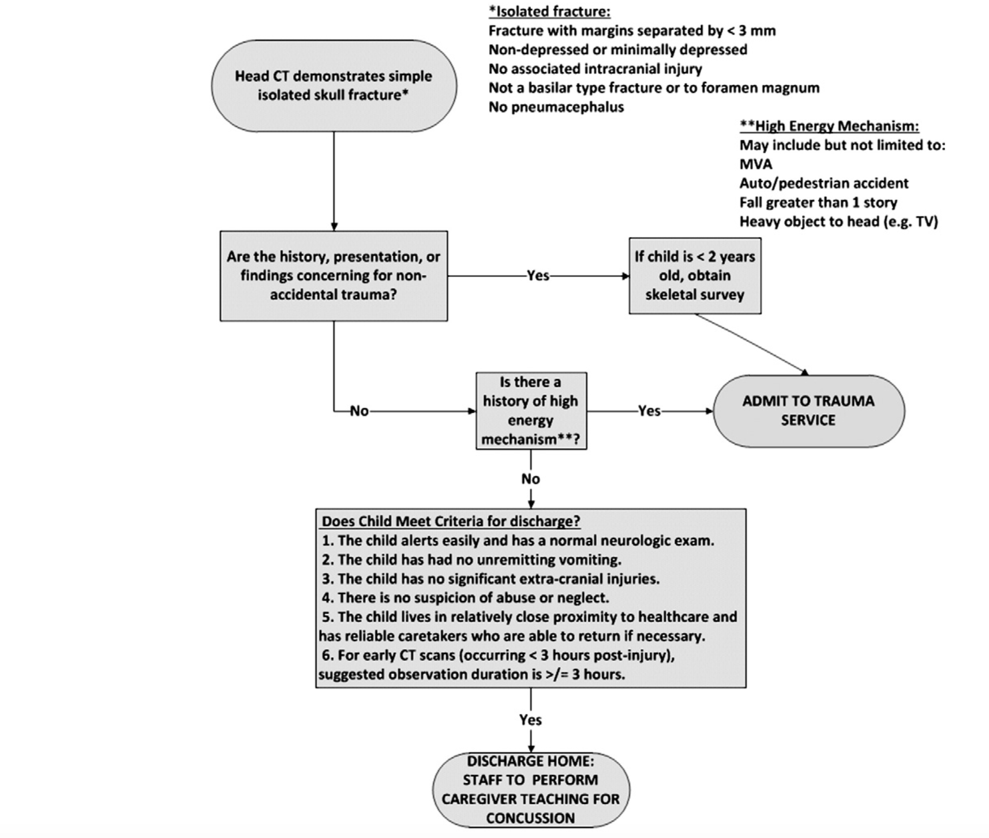

Slide 21
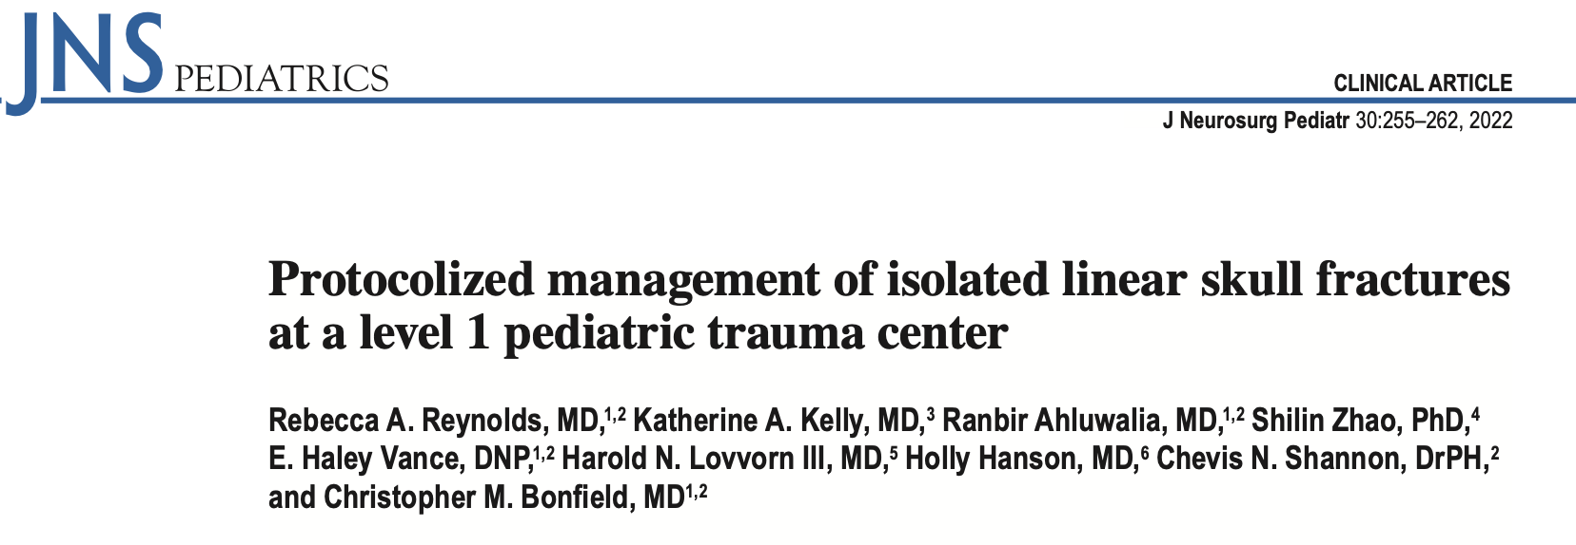
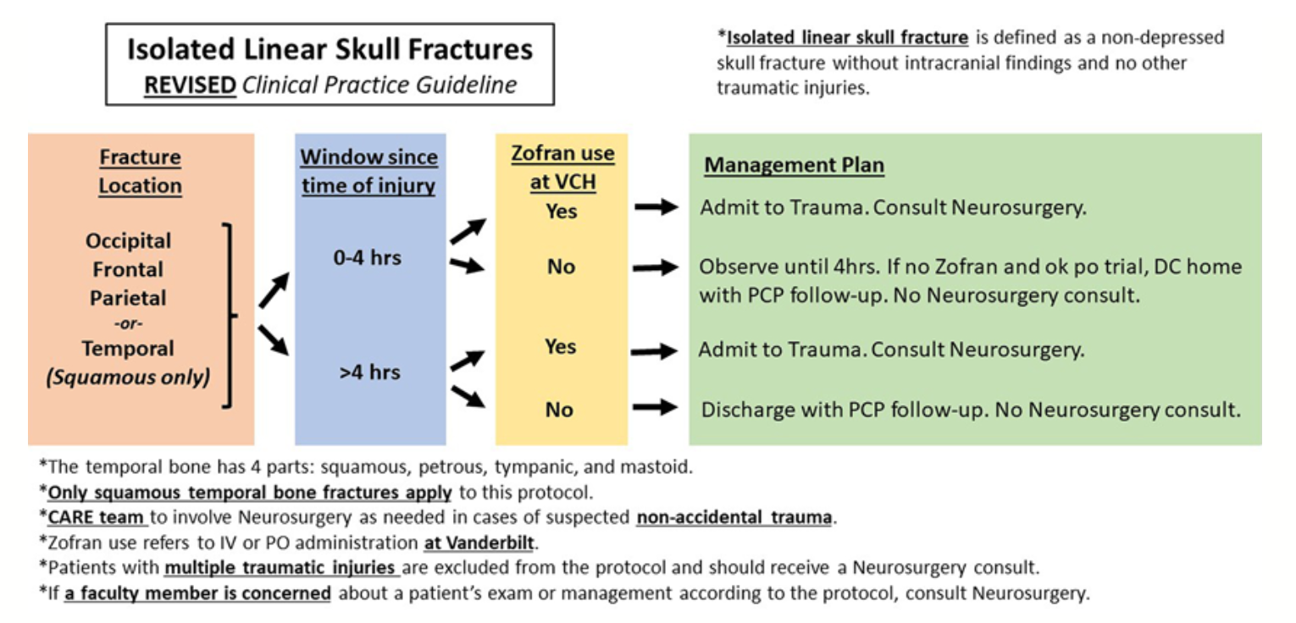
Compared admission and discharge home
Reduced neurosurgical consultation and admissions
Cost savings
Screenshot 2024-08-02 at 10.33.18 PM

Slide 22
Simple fractures and discharge
NO extracranial trauma
NO worry for home environment, abuse
NO vomiting: PO challenge in ED
IF normal exam and child alerts normally

Slide 23
Conclusions
Skull fractures are common
Most treat and street
Transfer and admit certain complex fractures or if child symptomatic or neglect/abuse suspected
Next ED session: triage of the shunted child

Slide 24


