Slide 1
Headache Highway: Roadmap to Primary Management & Referral
Janet Leon, DO, MS
Pediatric Neurology

Slide 2
Disclosure
No disclosures to report

Slide 3
Objectives
Headaches v. Migraine?
How to treat migraine?
Who to image?
When to refer?

Slide 4
Tension Headache
Dull, pressure-like (not throbbing)
A tight band around the head
All over (not just in one point or one side)
Worse in the scalp, temples, or back of the neck, and possibly in the shoulders

Slide 5
7 yo with 5 prior episodes of severe headache…
Location – Bifrontal
Character – Throbbing
Duration – 2-4 hours
Associated Symptoms – Phonophobia, photophobia, vomiting
Alleviating Factor – Ibuprofen
Exacerbating Factors – Activity
Family history of migraine

Slide 6
Does she meet the criteria for the diagnosis of migraine?

Slide 7
ICHD-3: Adult Migraine without aura
Previously used terms: Common migraine; hemicrania simplex.
Diagnostic criteria:
A. At least five attacks¹ fulfilling criteria B-D
B. Headache attacks lasting 4-72 hr (untreated or unsuccessfully treated)^{2;3}
C. Headache has at least two of the following four characteristics:
unilateral location
pulsating quality
moderate or severe pain intensity
aggravation by or causing avoidance of routine physical activity (eg, walking or climbing stairs)
D. During headache at least one of the following:
nausea and/or vomiting
photophobia and phonophobia
E. Not better accounted for by another ICHD-3 diagnosis.

Slide 8
ICHD-3 Criteria Modified for Children
Duration of at least 1-2 hours
Bifrontal or bitemporal
Description of “pounding” and severity is difficult (can use face scale)
Photophobia/Phonophobia/Nausea – sometimes inferred from their behavior

Slide 9
Migraine Statistics
~ 82 % of adolescents report having a headache < 15 yrs
~6% of adolescents have migraine yearly
Prevalence 10% in the population
Migraine cause 13,000 school days missed every 2 weeks
3 million bed ridden days
Total costs 70% higher for family with child with migraine

Slide 10
Migraines Pathogenesis
Genetic
CACNA1A, ATP1A2 and SCN1A
Environmental
Hormonal

Slide 11
Pathophysiology

Slide 12
Back To Our Case
Coke → 3 cans/day
Sleep usually ~ Midnight to 6 am
Skips breakfast
8 oz water/day
Anxious

Slide 13
Management:
Hydration
Sleep
Meal Patterns
Caffeine
Mood

Slide 14
Hydration
Ages 1-3 35 oz +
Ages 4-8 46 oz +
Girls Ages 9-13 57 oz +
Boys Ages 9-13 64 oz +

Slide 15
Sleep
Artificial Light Reduction
Reduces stimulation to the sensitive occipital cortex
Reduces the suppressive effect light has on sleep signaling and circuitry
Encourage Relaxation Before Bed
Bath
Self-massage
Reading
Light conversation
Journaling

Slide 16
Meal Patterns
Consistent Meal Patters
Avoids unpredictable adrenal output
Cravings
Weight
Healthy diet

Slide 17
Relaxation/Mood
Stress-reduction techniques into their daily routine
Encourage the patient to
go for a walk
meditate
perform stretches every day

Slide 18
Acute Treatment

Slide 19
Acute Treatment

Slide 20
Acute Treatment - Triptans
Rizatriptan is the only FDA approved triptan for all children ages 6-17
20-39 kg - 5mg
> 40 kg 10 mg
Sumatriptan–naproxen is a single tablet that is a combined triptan/naproxen
FDA approved for 12-17 year olds
Sumatriptan is often prescribed in children
(Not FDA Approved)
Almotriptan
FDA approved for children 12-17
Zolmitriptan nasal spray
FDA approved for children 12 and olde
Contraindications to Triptans / side effects
CAD
CVA
PAD
Chronically uncontrolled high blood pressure

Slide 21
Key Management Points:
Acute medications usage > 10 days/month
Preventive Rx if > migraine >1/week or SE

Slide 22
Medication Overuse Headache
Pathophysiology:
Overuse → CNS functional and structural change
→ Hippocampal periaqueductal gray area, posterior cingulate cortex, thalamus, cerebellum, orbitofrontal cortex (OFC), and the mesocorticolimbic reward system

Slide 23
Medication Associated with Overuse headache
Medication Overuse Headache by Drug Class and Duration of Headache
Ergotamine-->10 days/month for over 3 months
Triptan-->9 days/month for over 3 months
ASA-->15 days/month for over 3 months
NSAIDs-->15 days/month for >3 months
Acetaminophen/paracetamol-->15 days/month for over 3 months
Opioids-->10 days/month for over 3 months
Combination analgesics-->10 days/month for over 3 months
Multiple drug classes-->10 days/month for over 3 months

Slide 24
Preventive Treatment
Nutraceuticals
Magnesium
Riboflavin
CoQ 10
Prescription
Antiepileptic
TCA

Slide 25
Magnesium (Mg)
Co-Factor for ATP-synthase necessary for generation of ATP
It also regulates neuronal excitability P
lays an important role in the regulation of vascular tone

Slide 26
Vitamin B2 (riboflavin)
Pre-cursor in electron transport chain essential for energy stores

Slide 27
Coenzyme Q10
Vital role in sustaining mitochondrial energy store. Recently, it is seen that coenzyme Q10 administered to migraine patients results in a decrease of CGRP, which is an important vasoactive peptide involved in the pathogenesis of migraine

Slide 28
Migraine Nutraceuticals

Slide 29
Preventive Treatment
Lifestyle modifications, vitamin supplementation
Lifestyle modifications, vitamin supplementation, daily preventive
Topamax
Amitriptyline

Slide 31
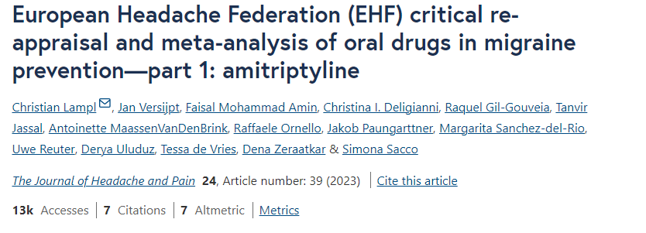
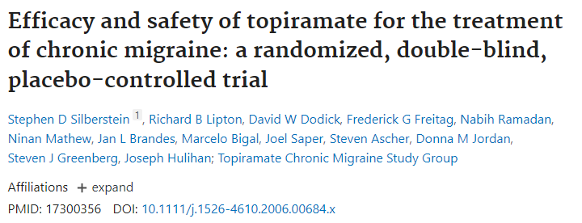
In the first clinical trial, published by Gomersall and Stuart in 1973, amitriptyline (10–60 mg per day) reduced the number of migraine attacks by 42% (p < 0.001), in about half of the subjects by > 50%.

Slide 32
Preventive treatment
Topamax
2 mg/kg/day
Start at 25 mg daily
Max daily dose 200 mg
Amitriptyline
1 mg/kg/day
Start at 10 mg daily
Max dose 100 mg/day

Slide 33
Preventive Treatment – Off Label
Cyproheptadine
among the more commonly prescribed daily preventive medications for children under age 12 years
Sedation
Not FDA-approved
Dose: .2-.4 mg/kg/day (max 8 mg a day)
Toldo et, al 2012
Okuma et al, 2013

Slide 34
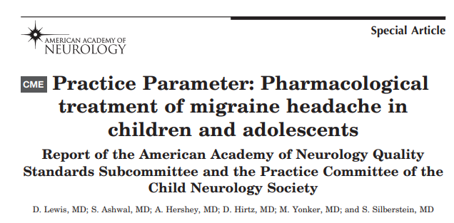

Slide 35
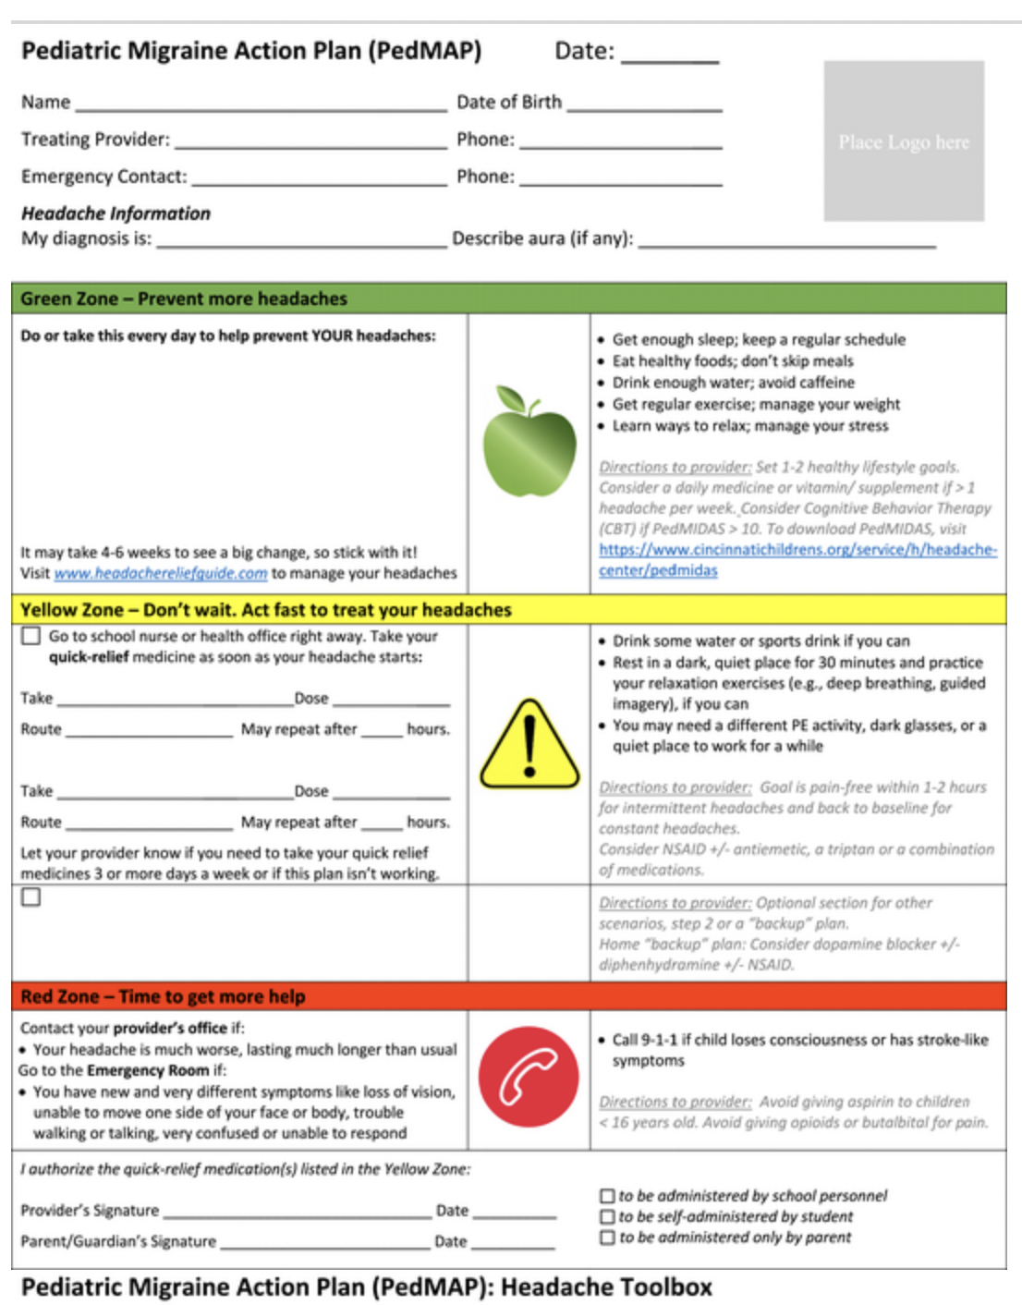
Pediatric Migraine Action Plan

Slide 36
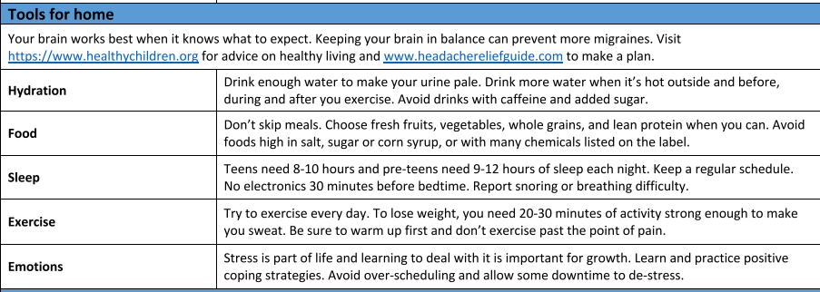

Slide 37
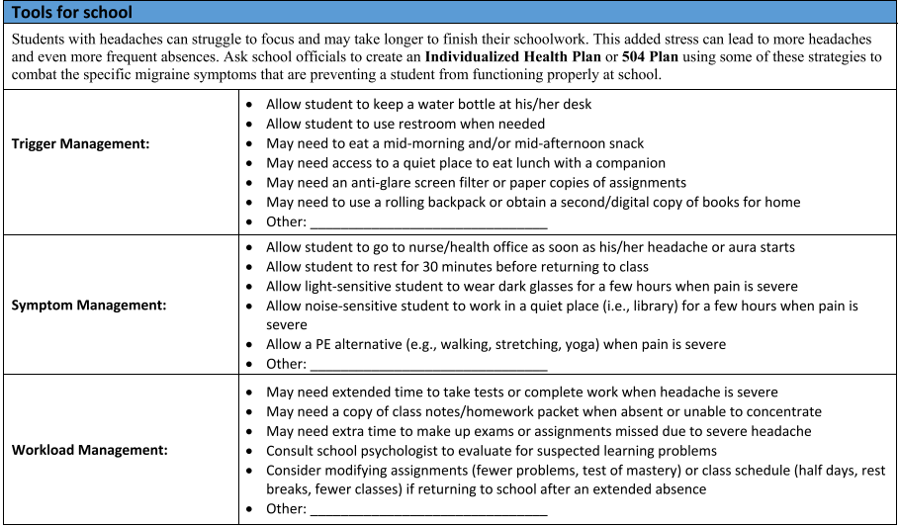

Slide 38
Set Expectations

Slide 39
Imaging Appropriateness

Slide 40
Imaging
Yilmaz et al 449 children with headache
approximately 55% of children had migraine
30% tension-type
10% secondary
5% were unspecified
21% of imaged children had abnormalities identified, largely incidental findings,
<1% having relevant findings to explain the headaches, namely, tumor with hydrocephalus.
Martens et al found that even though some neurologic signs were present in a substantial number of children with primary headaches, mostly migraines, the yield of brain MRI scans was still low.
Therefore, the yield of brain MRI is not contributory to the diagnostic and therapeutic approach in children with primary headaches.

Slide 41
Red Flags
Increasing frequency and/or severity over several weeks (under 4 months) in a child under age 12 but more importantly a child under 6
CHANGE of headache patters in young children
Fever
Occipital Headaches
Wake up from sleep
Positional
Thunderclap headache
Worsening with Valsalva
Headaches that present with seizures
Altered sensorium

Slide 42
When to Refer?
Have not responded to a trial of adequate sleep, regular diet and good hydration
Are causing disability despite adequate trials of abortive medications such as ibuprofen or acetaminophen
If you are not comfortable managing prescription preventive treatment
When headaches do not meet the typical migraine diagnosis criteria

Slide 43
Future of Pediatric Migraine

Slide 44
References
https://practicalneurology.com/articles/2023-may-june/migraine-in-children-andadolescents#:~:text=Pharmaceuticals%20for%20prevention%20of%20pediatric,aged%2012%20to%2017%20years
Kaur K, Hernandez V, Al Hajaj SW, Ebrahim AM, Razack M, ElSharief MW, Dragas D. The Efficacy of Herbal Supplements and Nutraceuticals for Prevention of Migraine: Can They Help? Cureus. 2021 May 6;13(5):e14868. doi: 10.7759/cureus.14868. PMID: 33972917; PMCID: PMC8105190
https://doi.org/10.1212/01.WNL.0000147332.41993.90
Preventive effect of cyproheptadine hydrochloride in refractory patients with frequent migraine - PubMed (nih.gov)
Sakai F. Oral triptans in children and adolescents: an update. Curr Pain Headache Rep. 2015 Mar;19(3):8. doi: 10.1007/s11916-015-0478-z. PMID: 25754598
Fischer MA, Jan A. Medication-Overuse Headache. [Updated 2023 Aug 22]. In: StatPearls [Internet]. Treasure Island (FL): StatPearls Publishing; 2024 Jan-. Available from: https://www.ncbi.nlm.nih.gov/books/NBK538150/
https://headachejournal.onlinelibrary.wiley.com/doi/10.1111/head.13681
https://headachejournal.onlinelibrary.wiley.com/doi/pdf/10.1111/head.13091#:~:text=Triptans%2C%20specifically%20formulated%20for%20treatment,all%20children%20ages%206%2D17
https://americanheadachesociety.org/wp-content/uploads/2018/05/John_Rothrock_and_Deborah_Friedman_-_Triptans.pdf
https://www.ncbi.nlm.nih.gov/pmc/articles/PMC8105190/
Kaur K, Hernandez V, Al Hajaj SW, Ebrahim AM, Razack M, ElSharief MW, Dragas D. The Efficacy of Herbal Supplements and Nutraceuticals for Prevention of Migraine: Can They Help? Cureus. 2021 May 6;13(5):e14868. doi: 10.7759/cureus.14868. PMID: 33972917; PMCID: PMC8105190.
Silberstein SD, Lipton RB, Dodick DW, Freitag FG, Ramadan N, Mathew N, Brandes JL, Bigal M, Saper J, Ascher S, Jordan DM, Greenberg SJ, Hulihan J; Topiramate Chronic Migraine Study Group. Efficacy and safety of topiramate for the treatment of chronic migraine: a randomized, double-blind, placebo-controlled trial. Headache. 2007 Feb;47(2):170-80. doi: 10.1111/j.1526-4610.2006.00684.x. PMID: 17300356.
Dodick DW, Freitag F, Banks J, Saper J, Xiang J, Rupnow M, Biondi D, Greenberg SJ, Hulihan J; CAPSS-277 Investigator Group. Topiramate versus amitriptyline in migraine prevention: a 26-week, multicenter, randomized, double-blind, double-dummy, parallel-group noninferiority trial in adult migraineurs. Clin Ther. 2009 Mar;31(3):542-59. doi: 10.1016/j.clinthera.2009.03.020. PMID: 19393844.

