Slide 1
Malignant and Benign Hematology from the Hematologist to the Primary Care Provider
Anderson Collier MD
Chief Pediatric Hematology-Oncology
Nemours Children’s Health Jacksonville
Anderson.collier@nemours.org

Slide 3
Objectives
Discuss the etiologies of neutropenia
Review diagnosis of leukemia
Evaluate the work-up of bleeding disorders
Describe some novel therapies in Hematology and Oncology

Slide 4
Case 1
14 y.o. AA male who recently moved to Jacksonville who is establishing care with you
RSV at years old
Myringotomy tubes at 4 y.o.
Normal PE
Neutrophils 36%→ANC 1008
Lymphocytes 58%→ALC 1624
Monocytes 6%→AMC 168
MCV 85
14.3
2.8
239

Slide 5
Case 1: Neutropenia
Repeat CBC in 3 weeks.
More in depth questioning
No recurrent fever
No recurrent antibiotics
No history of invasive bacterial infections
On PE, no rash, normal gums
Neutrophils 36%→ANC 972
Lymphocytes 59%→ALC 1593
Monocytes 5%→AMC 135
MCV 86
14.5
2.7
252

Slide 6
Case 1: Considerations
Google says:
Cyclic neutropenia
Viral suppression
Bone marrow failure
Autoimmune
Normal variant

Slide 7
“Benign Ethic Neutropenia”
Merz LE and Achebe M. “When non-Whiteness becomes a condition.” Blood 2021:137(1);13-15.
“BEN describes the phenotype of having an absolute neutrophil count (ANC) <1500 cells/mcl with no increased risk of infection.”
Caused by a SNP in promoter region of the Duffy antigen receptor for chemokines (DARC) gene
Duffy null RBC phenotype
<1% of European or Asian ancestry
90-100% of sub-Saharan Africa
Due to the slave trade, Caribbean ancestry also affected
50-70% of Arabic peninsula.
Merz LE. Blood 2021:137;13-15.

Slide 8
What to do for our patient?
Reported ANC reference ranges
1050-4080
910-4720
500-5400
Re-assure mother
Educate on the problem
Merz LE. Blood 2021:137;13-15.

Slide 9
Case 2
8 yo WF presents with 3 days fever
Cough, congestion and anterior cervical adenopathy
Remainder of PE is normal
What do you think and what do you do?
Neutrophils 17%→ANC 1564
Lymphocytes 78%→ALC 7176
Monocytes 1%→AMC 92
MCV 98
10.9
9.2
167

Slide 10
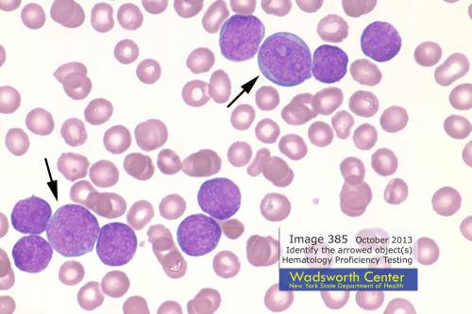
Presenting signs & symptoms of ALL (%)
http://www.medical-labs.net/blasts-from-acute-lymphocytic-leukemia-all-patient-138/

Slide 11
Childhood cancers

Slide 12
Risk factors for developing leukemia
Down syndrome
After 1 yo, ALL more common than AML
Li-Fraumeni syndrome
Inactivating mutations in TP53
Identical twin with leukemia
Severe congenital neutropenia
Radiation exposure
Chemotherapy

Slide 13
B-ALL Survival (AALL0932 and 1131)
Standard Risk
High risk
5-yr EFS: 92%
5-yr OS: 96.8%
5-yr EFS: 91.9%
5-yr OS: 96.5%
Angiolillo AL. JCO 2021:39;1437-47
Salzer WL. JCO 202:38;2628-38.

Slide 14
B-ALL Relapse (AALL0932 and 1131)
Standard Risk, by treatment arm
High risk, isolated BM relapse
Angiolillo AL. JCO 2021:39;1437-47
Salzer WL. JCO 202:38;2628-38.

Slide 15
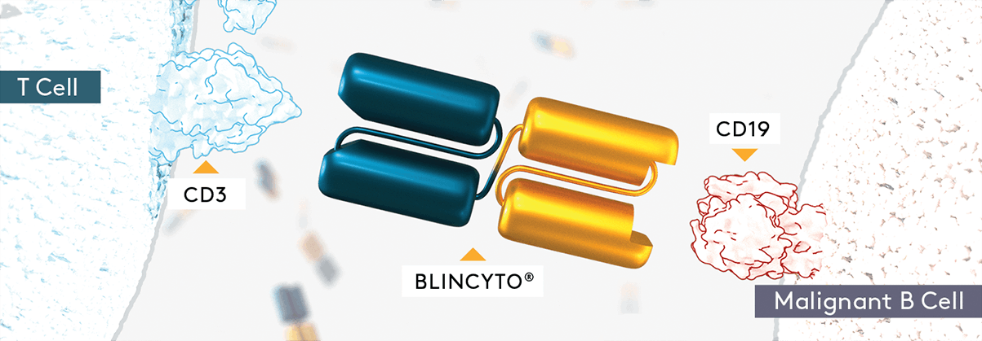
Current and future directions for ALL
Targeted therapies
Blinatumomab
https://www.blincytohcp.com/mechanism-of-action.

Slide 16
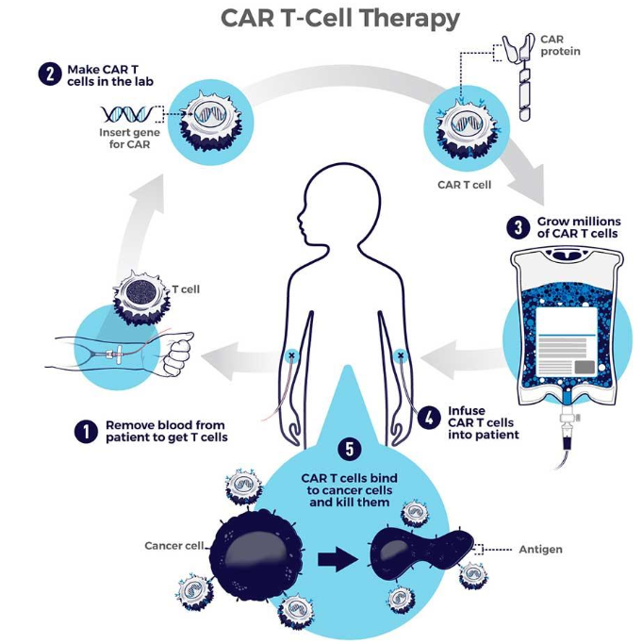
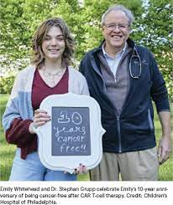
Current and future directions: ALL & beyond
Immunotherapy
CAR-T (Chimeric Antigen Receptor)
https://www.cancer.gov/about-cancer/treatment/research/car-t-cells

Slide 17
CAR-T
Completed 2nd
pt in JAX
https://www.cancer.gov/about-cancer/treatment/research/car-t-cells

Slide 18
Case 3 #1
14 y.o. Lantinx male who you have been following for frequent nosebleeds presents for prolonged episode
Cauterization twice
No problems with circumcision
PE
Petechiae all over, few bruises
What do you think?
Neutrophils 46%→ANC 3128
Lymphocytes 45%→ALC 3060
Monocytes 8%→AMC 544
MCV 85
13.3
6.8
9

Slide 19
Case 3 #2
14 y.o. Lantinx male who you have been following for frequent nosebleeds presents with a cut on his arm that keeps oozing
Cauterization twice
Circumcision oozed for 20 minutes but stopped with pressure
PE
Normal
What do you think?
Neutrophils 46%→ANC 3128
Lymphocytes 45%→ALC 3060
Monocytes 8%→AMC 544
MCV 85
PT 10.2
PTT 65.4
13.3
6.8
319

Slide 20
Case 3 #3
14 y.o. Lantinx female who you have been following for frequent nosebleeds
Cauterization twice
Periods last 10 days with 5 heavy days
PE
Normal
What do you think?
Neutrophils 46%→ANC 3128
Lymphocytes 45%→ALC 3060
Monocytes 8%→AMC 544
MCV 65
PT 11.1
PTT 35.4
10.3
6.8
319

Slide 21
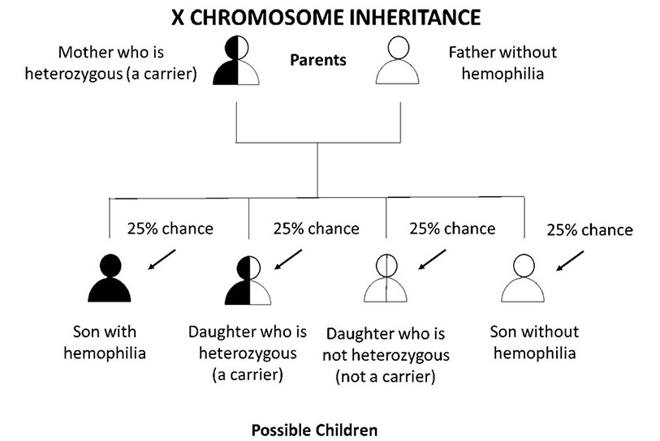
Evaluation of bleeding
Sex of patient
https://www.cdc.gov/ncbddd/hemophilia/inheritance-pattern.html.

Slide 22
Evaluation of bleeding
Sex of patient
Type of bleeding
Mucosal, soft tissue, trauma, combined
Family History
https://www.hemophilia.org/bleeding-disorders-a-z/overview/fast-facts.

Slide 23
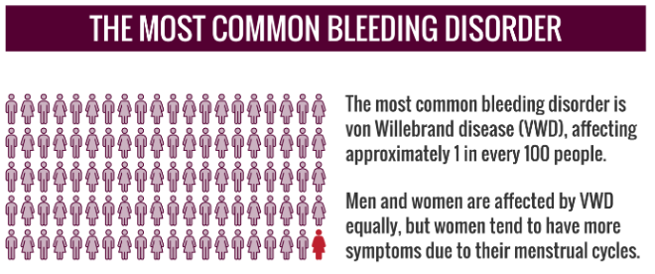
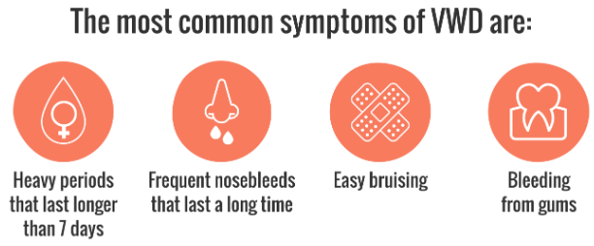
Case 3 #3: Von Willebrand disease
Von Willebrand studies
Levels are affected by:
Blood type
OCP
Symptoms vary by disease severity
Often times takes many years for diagnosis
Common to be diagnosed in teenage years
https://www.hemophilia.org/bleeding-disorders-a-z/overview/fast-facts.

Slide 24
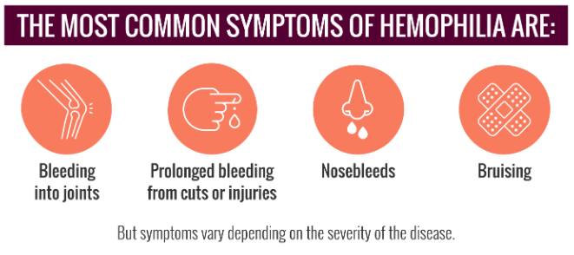
Case 3 #2: Hemophilia
The royal family disease
The Talmud identified hemophilia
A male baby should not be circumcised if 2 brothers had died from bleeding from circumcision
~30,000 people with hemophilia in the US
60% severe
15% moderate
25% mild
https://www.hemophilia.org/bleeding-disorders-a-z/overview/fast-facts.

Slide 25
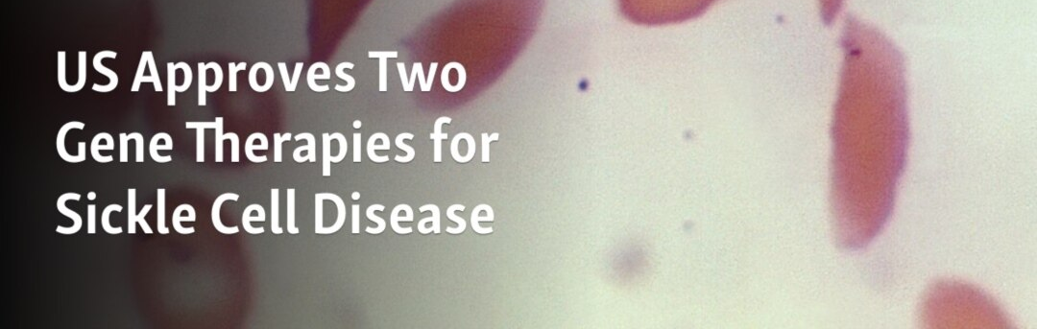
Gene therapy
Hemophilia A and B
Viral vector
Modifies stem cells to produce factor VIII or factor IX
CRISPR –Cas9
Approved for 12 years and up
Edits beta globin gene in stem cells
Increases production of hemoglobin F
Lentivirus vector transfection
Approved for 12 years and up
Stem cells modified to produce hemoglobin A

Slide 26
Thank you & Questions
Please reach out with any patient issues.
Happy to help triage
Anderson.collier@nemours.org
904-319-4844

