Slide 1
The Orthopedic Knee Exam
Stephanie S. Pearce. MD
Orthopaedic Sports Surgeon
Director of Sports Medicine
Nemours Children’s Health – Jacksonville
April 10th, 2024

Slide 2
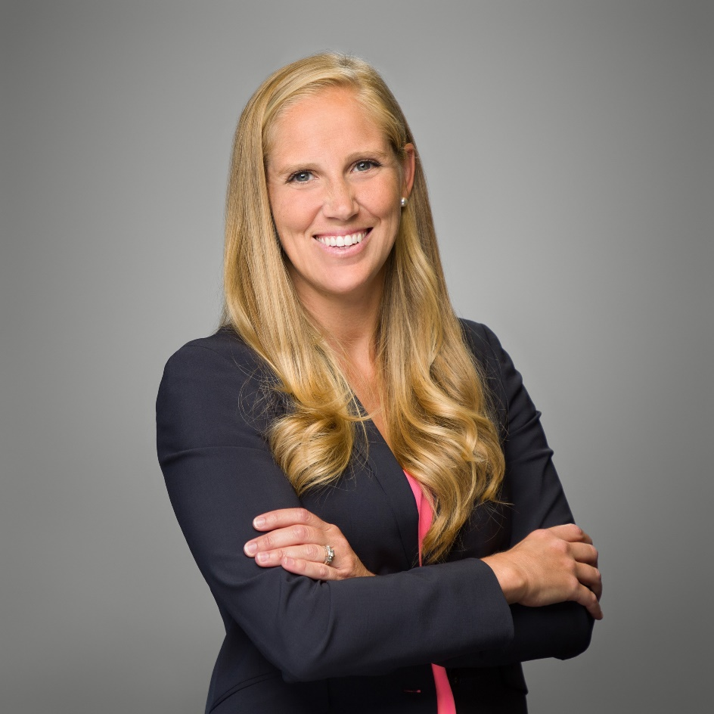
Education & Training
Orthopedics & Sports Medicine
Human Nutrition and Sports Medicine, BS - University of Florida
Doctorate of Medicine - University of South Alabama
Residency: Orthopaedic Surgery - University of South Alabama
Fellowship: Pediatric Orthopaedic Surgery - Children’s Hospital Colorado; Denver, CO
Fellowship: Sports Medicine Orthopaedic Surgery - The Steadman Clinic; Vail, CO
Stephanie S. Pearce, MD
Orthopedics Sports Surgeon
Director of Sports Medicine

Slide 3
Areas of Expertise
Orthopedics & Sports Medicine
Complex Knee ligamentous injuries
Meniscal pathology
Cartilage restoration
Arthroscopic management of OCDs in the Elbow, Knee, & Ankle
Elbow injuries, throwers and non-throwers
Shoulder instability
Hip preservation/arthroscopic management of FAI & labral tears
Sports medicine injuries & treatment of the whole athlete
Stephanie S. Pearce, MD
Orthopedics Sports Surgeon
Director of Sports Medicine

Slide 4
Team Physician & Event Coverage
Orthopedics & Sports Medicine
US Ski & Snowboard
US Snowboard, US FreeSki
FIS National & World Championships
Land Rover US Grand Prix
Jacksonville FC // Clay County Soccer Club
Jacksonville Sports Medicine Program
FASMed
Previously served with
Premier Lacrosse League
University of South Alabama
University of West Florida
Norfolk Academy // Princess Anne High School
Battle Mountain High School
Stephanie S. Pearce, MD
Orthopedics Sports Surgeon
Director of Sports Medicine

Slide 5
Nemours Sports Medicine - 4 Locations
Orthopedics & Sports Medicine
Downtown
Jacksonville
Fleming
Island
Jacksonville
South
Nocatee
Courtesy Google Images

Slide 6
Disclosures
Orthopedics and Sports Medicine
Arthrex Consultant
AOSSM BOLD Leadership Playmaker
AANA Faculty
PRiSM Knee Ligament RIG Chair
RJOS Scientific Committee
POSNA Public Education and Media Relations Committee
Arthrex Research Grant Awardee
Recent JAAOS Unplugged Podcast Host

Slide 7
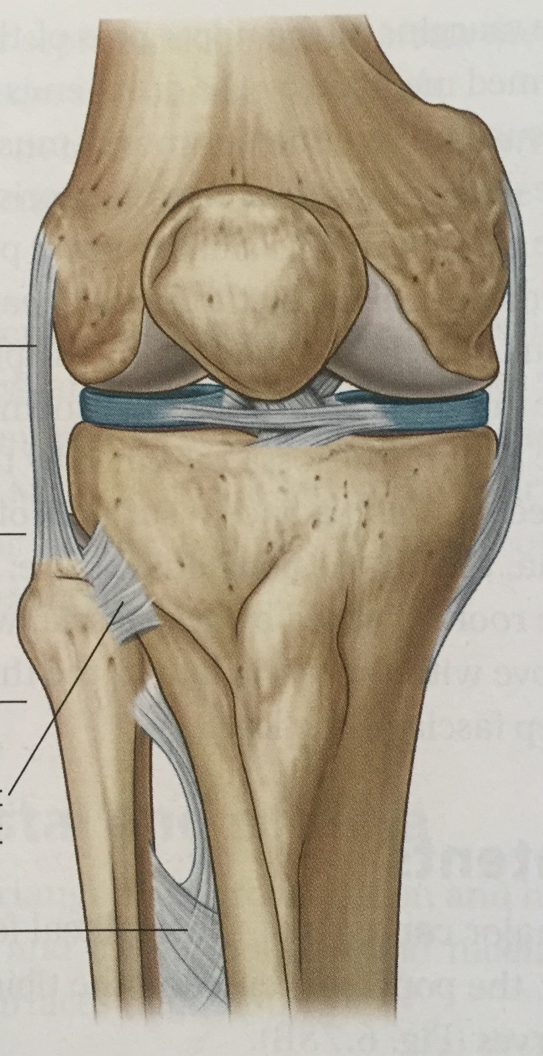
The Knee Exam
Orthopedics & Sports Medicine

Slide 8
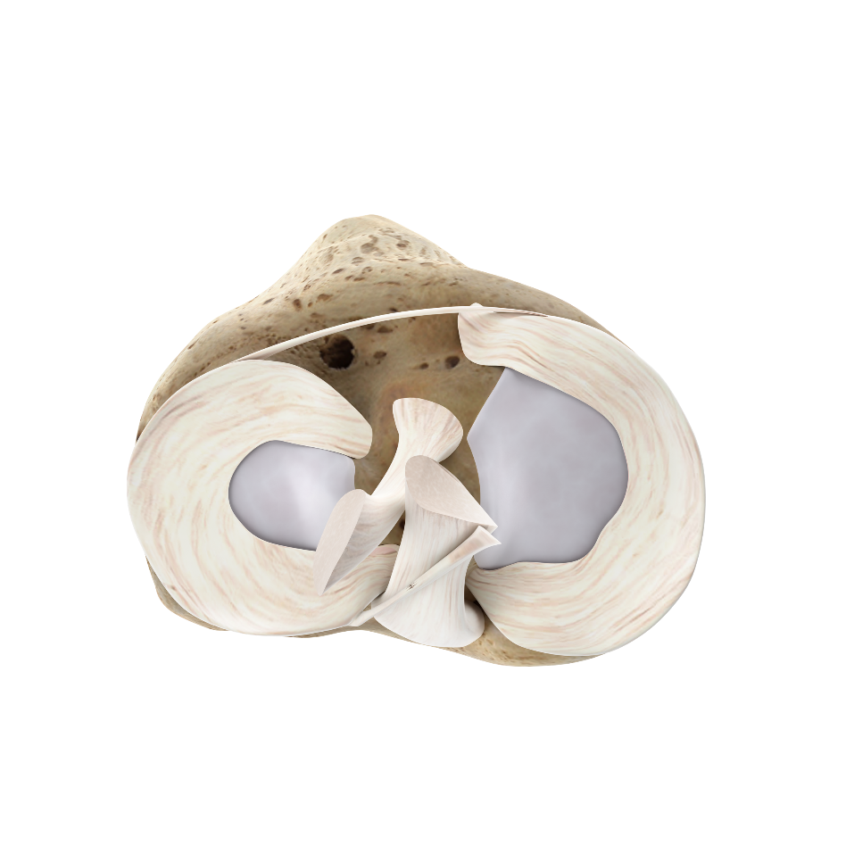
The Knee Exam
Identify
Cause of pain, locking, or symptoms
Red Flags
Red Flags Warrant
Need for further imaging (Xray)
Need for advanced imaging (MRI)
Referral to ED

Slide 9
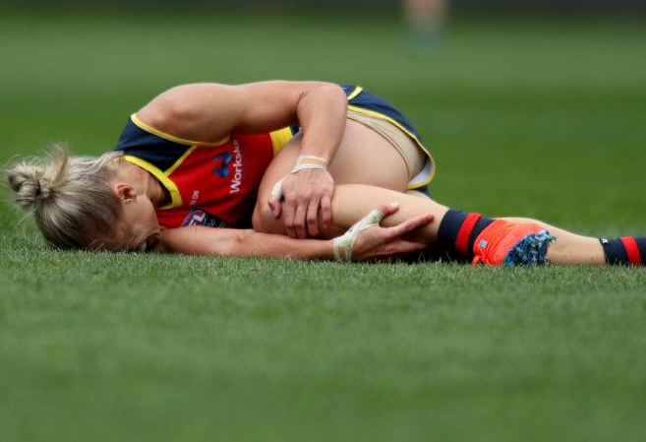
The Knee Exam
Red Flags
Knee Effusion
Locking
Inability to bear weight
Range of motion loss/difference
Positive Testing
Red Flags Warrant
Need for further imaging (Xray)
Need for advanced imaging (MRI)
Referral to ED

Slide 10
Main Tests
Knee Effusion
Milking & Patellar Ballotment
Locking
History and ROM exam
Inability to bear weight
Gait
Range of motion loss/difference
Knee extension to flexion
Positive Testing
…

Slide 11
Positive Testing
Ligament Laxity
ACL – Lachman’s, Anterior drawer, Pivot
PCL – Posterior drawer, PCL Sag
MCL – Valgus at 0 & 30
LCL/PLC – Varus at 0 & 30
Meniscus
Medial & Lateral
McMurray’s
Apley’s
Duck walk

Slide 12
Less Concerning Findings
TTP +/- swelling
Patellar tendinitis
Osgood Schlatter's (Tib Tubercle)
Sidney Larsen Johansen (distal patellar pole)
Quad tendinitis
Pes Anserine Bursitis
Hamstring tendinitis
Gerty’s Tubercle Bursitis/IT Band tendinitis

Slide 13
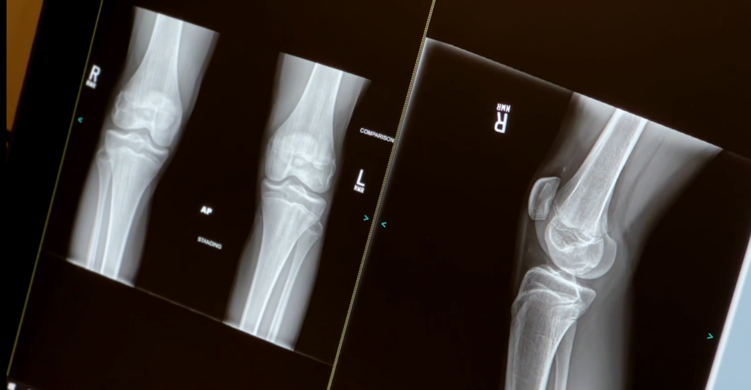
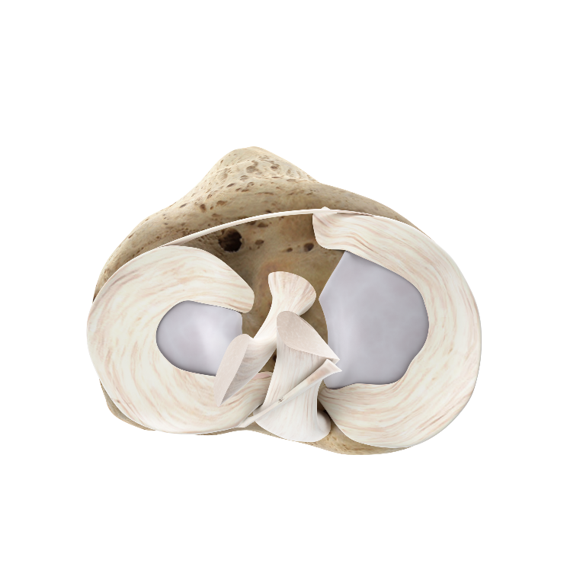
The Knee Exam
Orthopedics & Sports Medicine

Slide 14
Questions?

Slide 15
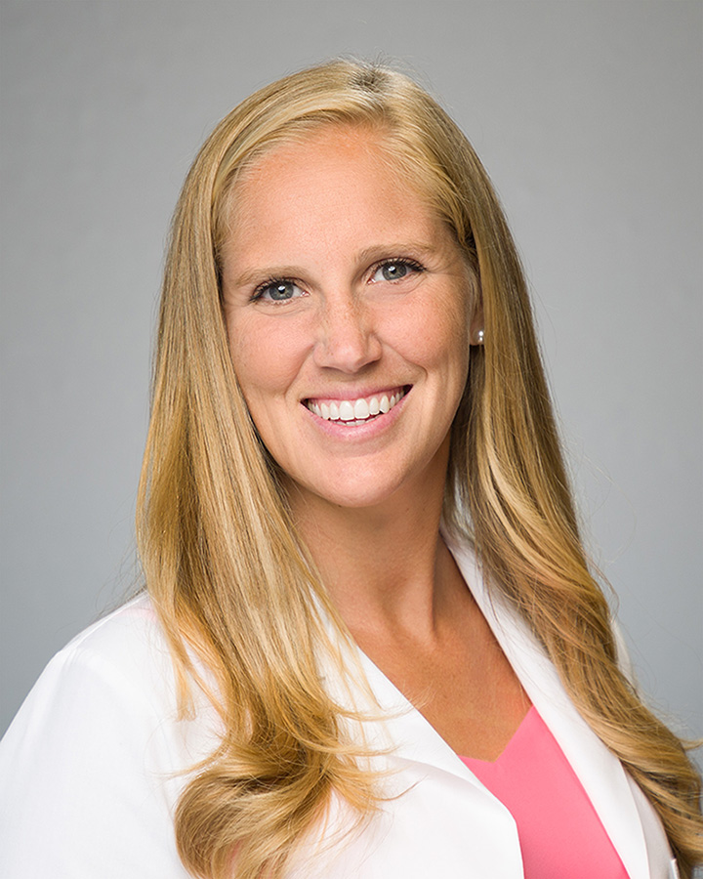
Thank You!!!
Stephanie S. Pearce, MD
Director of Sports Medicine
Orthopedic Surgery & Sports Medicine
Nemours Children’s Health – Jacksonville
Stephanie.Pearce@Nemours.org
904-697-3600 | Fax 904-697-3927 | Visit Nemours.org/NemoursLink

