Slide 1
Skin Champions
Improving Patient Outcomes
October 10, 2024
Presented by:
Marie Haddock BSN, RN, CWCON
Melissa Romeo BSN, RN, CWOCN, CPN
Lauren Stracuzzi MSN, RNC,-NIC, ACCNS-P

Slide 2
Welcome & Introductions
Name
Practice Area
Why are you interested in being a skin champion?
What previous experience do you have with pressure injury prevention/skin champion experience?

Slide 3
Objectives
Describe the expectations to fulfill the role of the unit-based Skin Champion
Describe pressure injury prevention strategies
Identify patients at high risk for development of pressure injury using risk assessment tools (i.e., Braden QD)
Identify and stage pressure injuries
Document and escalate pressure injuries utilizing Epic documentation, RL submission, and notification of the appropriate specialist (CWOCN vs. surgeon)
Recommend interventions when a pressure injury is identified
Identify available resources (people, equipment, dressings, specialty beds)

Slide 4
Unit-Based Skin Care Champions Responsibilities:
Act as a resource for your unit to identify patients at high risk for developing hospital acquired pressure injuries
Utilize Standards of Care to recommend pressure injury prevention strategies for patients in your unit
Assist with escalating level of care
Ensure completion of incident report when a pressure injury is identified
Participate in event reviews to identify opportunities for improvement
Assist bedside nurse with staging pressure injury
Review interventions of high-risk patients during unit huddles.
NDNQI quarterly assessments

Slide 5
NDNQI:
The National Database of Nursing Quality Indicators
Quarterly Survey to provide national data on nursing care and the relationship of the care to patient outcomes
Compares data to other hospitals and to units
Second Tuesday every 3 months
Must assess the patient's skin from head to toe, including under devices
Eventually, the nurses helping with the surveys will be required to become Skin Champions

Slide 6
Pressure Injuries
•What are they &
•Who is at risk?

Slide 7
Pressure Injury Defined
Localized damage to the skin and underlying soft tissue, usually over a bony prominence or related to a medical (or other) device
The injury can present as intact skin or an open ulcer and may be painful
Occurs as a result of intense and/or prolonged pressure, or pressure in combination with shear
The tolerance of soft tissue for pressure and shear may be affected by microclimate, nutrition, perfusion, co-morbidities and condition of the soft tissue

Slide 8
National Pressure Injury Advisory Panel
The National Pressure Injury Advisory Panel (NPIAP) serves as the authoritative voice for improved patient outcomes in pressure injury prevention and treatment through public policy, education and research (NPIAP, 2019).
In 2016 NPIAP redefined the definition of pressure injuries during the Staging Consensus Conference
Resources & education available by visiting NPIAP.com

Slide 9
Why focus on prevention of pressure injuries?
An estimated 60,000 patients die from pressure injuries each year, making it the 8th leading cause of death (NPIAP, 2022)
Since 2008, CMS no longer pays the costs associated with treating hospital-acquired pressure injuries
For each patient with a stage 3, 4, or unstageable pressure injury, the average cost to the hospital is $75,000 to $150,000, while the cost of prevention is $50-$100 per day (NPIAP, 2022)
Pressure injuries may lead to permanent scarring or altered function
Potentially expose the patient to the need for additional surgery, sedation, etc. for treatment of the injury
Potential for increased length of stay and/or mortality
High incidence of litigation

Slide 10
Special Population Considerations
Patients at increased risk of developing a pressure injury include:
Impaired mobility
Critically ill patients​
Medical devices​
Poor nutrition/are NPO​
Moisture​
Dehydration​
Diabetes​
Obesity​
Prolonged Surgery​
Poor Oxygenation ​
Poor Circulation​
Vasopressor Use​
Devices​
Studies indicate that 8.5-66% of patients undergoing surgery longer than 3 hours sustain pressure injuries, depending on population and length of surgery (Yılmaz & Başlı, 2021)

Slide 11
Pressure Injury Prevention (PIP) Taskforce
Formulated in 2016- formerly known as PUP
Inter-professional team:
Clinical Nurses
Wound Care Nurse
Clinical Nurse Specialists
APNs
Physicians
Respiratory Therapists
Quality and Safety
Risk Management
ECMO Specialist

Slide 12
PIP Journey
2016
Taskforce initiated
Partnership with EBP fellow
2017
Bundle Development/Roll-Out
Transition of taskforce leadership
Clinical Practice Guideline Development
2018
Focus on incidence data
Epic documentation updates
Initiation of SWARMS
NPIC
2019​
First skin champion class offered​
Move to stand-up huddles​
New Wound Care RN hired​
2020​
Camera access for RNs using Voalte
Data available on injury trends
Development of standard prophylaxis for injury prevention
2022
Second Wound Care RN Hired​
Implemented Braden QD
Updated EPIC to reflect Pressure Injuries separate from Wounds
Prophylaxis
2023
2 Skin Champion Classes
Collaboration with Ortho to improve Pressure Injury rates
Implementing PIV padding
PIP audits

Slide 13
Pressure Injury Staging

Slide 14
Stages
•Stage 1
•Stage 2
•Stage 3
•Stage 4
•Unstageable
•Deep Tissue Pressure Injury
•Mucosal Pressure Injury

Slide 15
Stage 1 Pressure Injury: Non-blanchable erythema of intact skin
Intact skin with an area of non-blanchable erythema. Appears differently in darkly pigmented skin. Blanchable erythema or changes in sensation, temperature, or firmness may be noted before non-blanching erythema occurs. Area will appear red, not purple or maroon. Purple or maroon skin can indicate a deep tissue pressure injury.

Slide 18
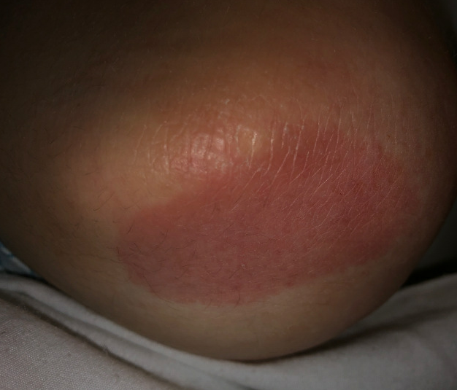
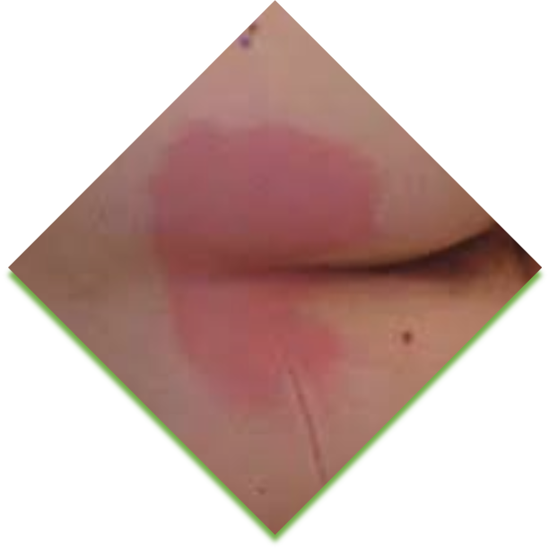
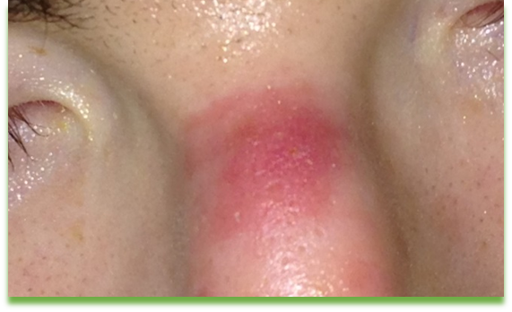
Stage 1: Intact, Red, Does Not Blanch

Slide 19
Stage 2 Pressure Injury: Partial-thickness loss of skin with exposed dermis
There are 2 presentations possible. A partial thickness wound with a pink/red, moist wound bed or an intact or ruptured serum-filled blister. Epidermis and/or dermis only are injured. There will be no Adipose (fat), granulation tissue, slough or eschar in the wound bed. These commonly result from moisture and/or shear over a bony prominence. A stage 2 should not be used to describe moisture associated skin damage or traumatic wounds such as skin tears, burns, or abrasions.

Slide 20
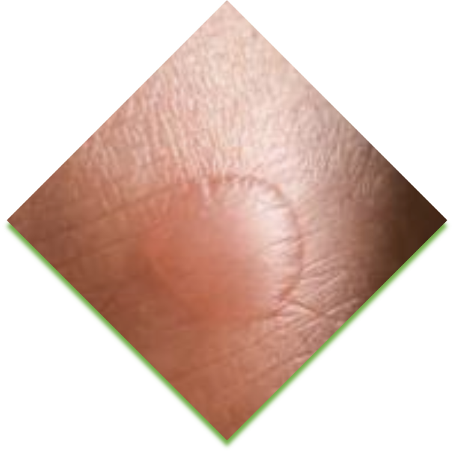
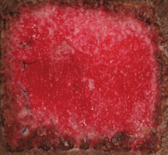
Stage 2 Pressure Injury: Partial-thickness loss of skin with exposed dermis

Slide 21
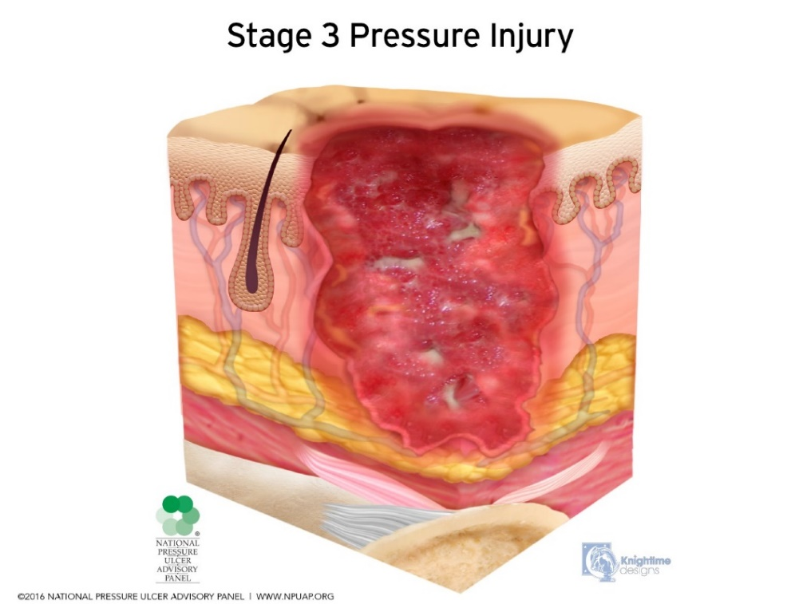
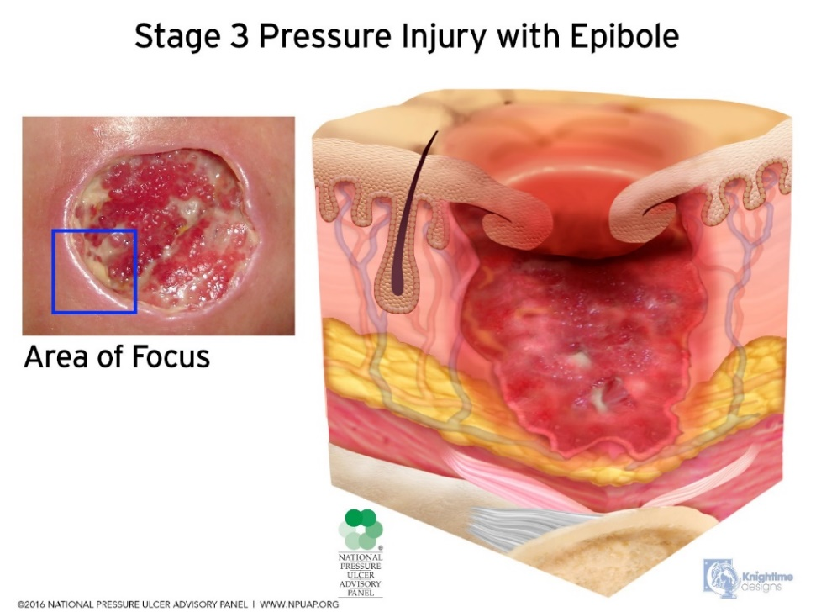
Stage 3 Pressure Injury: Full-thickness skin loss
Full-thickness loss of skin and underlying tissue. Adipose (fat) or granulation tissue might be visible and epibole (rolled wound edges) could be present. Slough and/or eschar may be visible. The depth of tissue damage varies. Undermining and tunneling may occur. Fascia, muscle, tendon, ligament, cartilage and/or bone are not exposed.

Slide 22
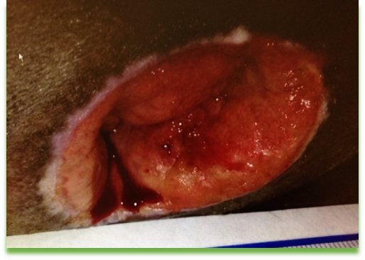
Stage 3: Full thickness
No structures in the wound bed; might have slough, eschar or undermining

Slide 23
Stage 4 Pressure Injury: Full-thickness skin and tissue loss
Full-thickness skin and tissue loss with exposed or directly palpable fascia, muscle, tendon, ligament, cartilage or bone in the ulcer. Slough and/or eschar could be visible. Epibole (rolled edges), undermining and/or tunneling often occur. Depth varies by anatomical location.

Slide 24
Stage 4: Muscle, Tendon, Ligament, Bone, Hardware

Slide 25
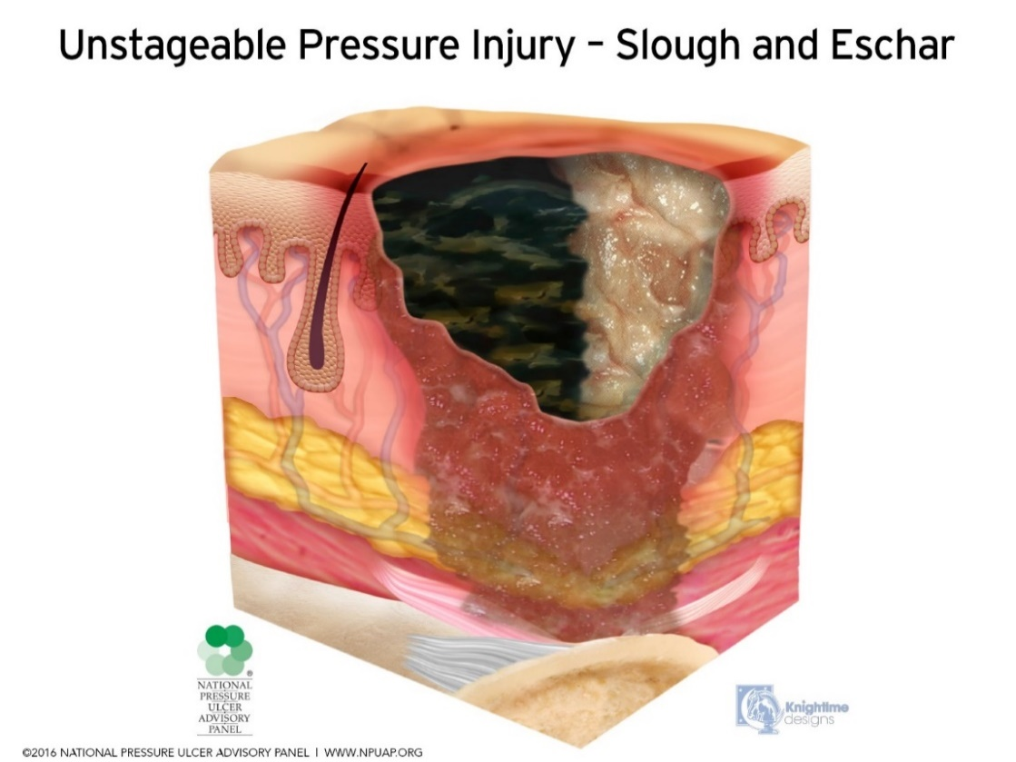
Unstageable Pressure Injury: Obscured full-thickness skin and tissue loss
Full-thickness skin and tissue loss in which the extent of tissue damage within the ulcer cannot be confirmed because it is obscured by slough or eschar. If slough or eschar is removed, a Stage 3 or Stage 4 pressure injury will be revealed. Stable eschar (i.e. dry, adherent, intact without erythema or fluctuance) on the heel or ischemic limb

Slide 26
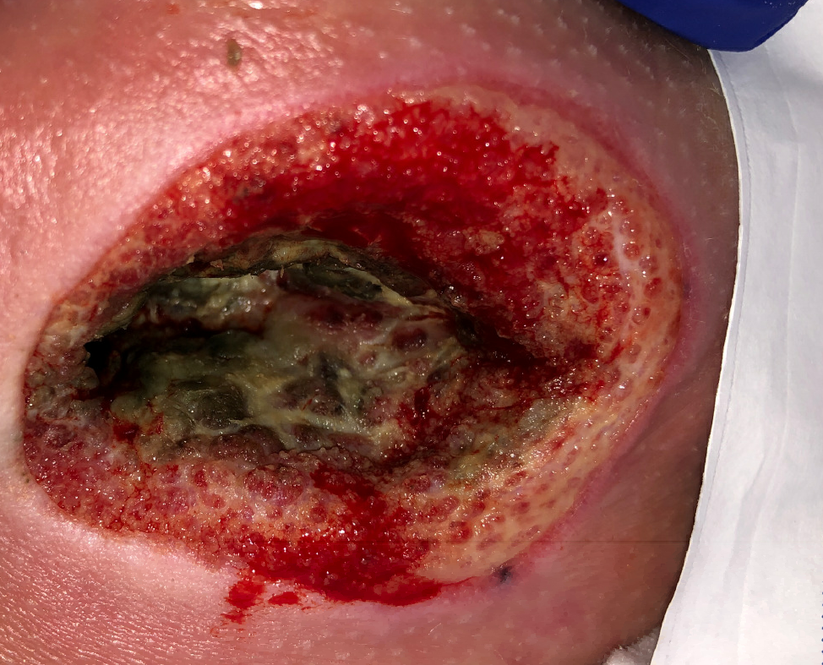
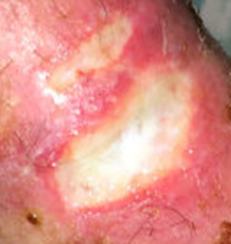
Unstageable: Base of Wound Obscured by Slough or Eschar

Slide 27
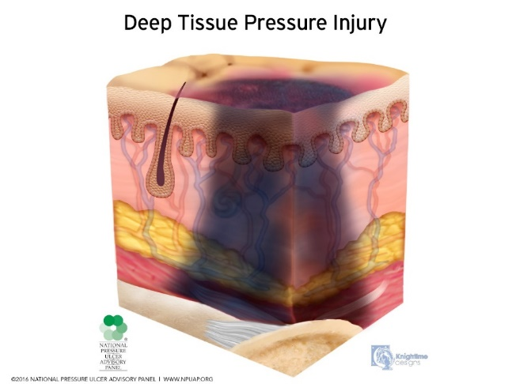
Deep Tissue Pressure Injury: Persistent non-blanchable deep red, maroon or purple discoloration
This has 2 presentations. It could present as intact or non-intact skin with an area of persistent deep red, maroon, purple/dark discoloration or as a dark wound bed or blood-filled blister.
Pain and temperature change often precede skin color changes. Discoloration may appear differently in darkly pigmented skin. DTPIs result from intense and/or prolonged pressure and shear forces at the bone-muscle interface. Since this injury occurs at the bone level, the exterior manifestations might not show up until after 5-7 days of the actual injury.

Slide 28
Deep Tissue Pressure Injury Progression: Evolve or Resolve
The wound may evolve rapidly to reveal the actual extent of tissue injury, or may resolve without tissue loss, similar to the way ecchymosis resolves.
If necrotic tissue, subcutaneous tissue, granulation tissue, fascia, muscle or other underlying structures are visible, this indicates a full thickness pressure injury (Unstageable, Stage 3 or Stage 4).
Do not stage unless the wound bed is visible. You can continue to document as a deep tissue pressure injury until it evolves completely.
Do not use DTPI to describe vascular, traumatic, neuropathic, or dermatologic conditions.

Slide 29
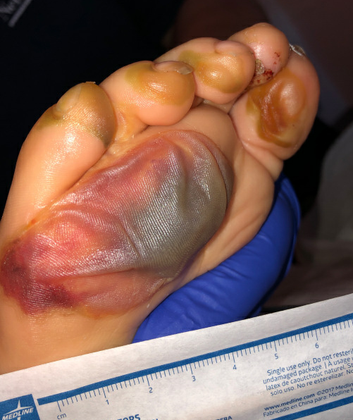
Deep Tissue Pressure Injury Presenting as a Blood-filled Bulla (blister)

Slide 30
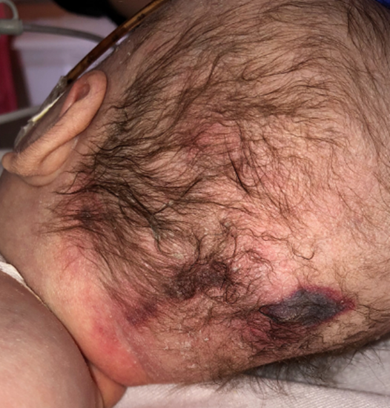
Deep Tissue Pressure Injury

Slide 31
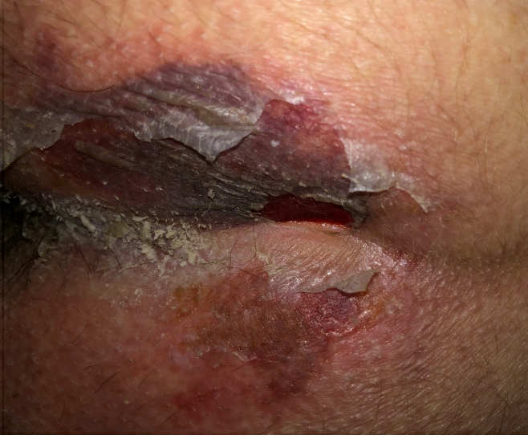
Evolution of a Deep Tissue Pressure Injury

Slide 32
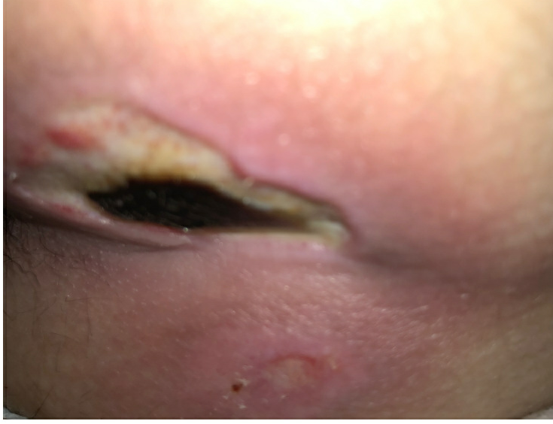
Evolution of a Deep Tissue Pressure Injury (continued)

Slide 33
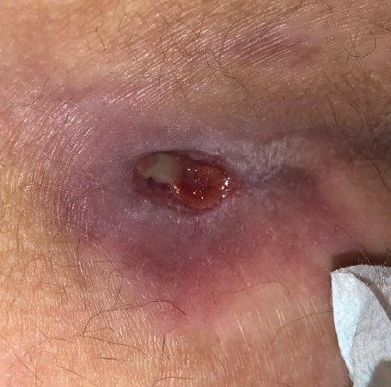
Evolution of a Deep Tissue Pressure Injury (continued)

Slide 34
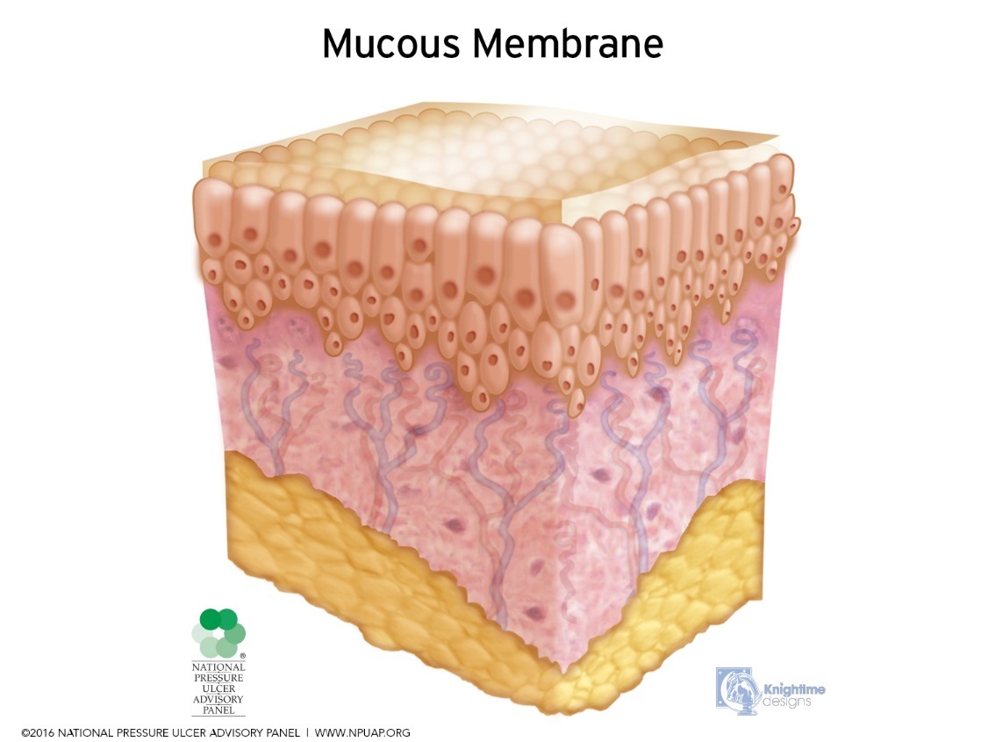
Mucosal Membrane Pressure Injury:
Found on mucous membranes usually with a history of a medical device in use at the location of the injury. Due to the anatomy of the tissue these ulcers cannot be staged.

Slide 35
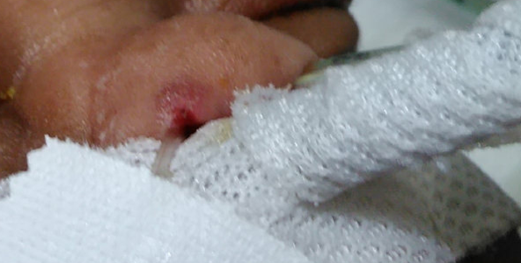
Sites of Mucosal Pressure Injuries
Vagina
Penile Meatus
Anus
Mouth
Nares

Slide 36
Pressure Injury Prevention

Slide 37
PIP Bundle – Skin Assessment
Admitted patients – skin assessment to be completed and documented upon admission, at each shift change and every 4 hours for patients with poor perfusion
Perioperative patients – skin assessment will be completed and documented pre-operatively, in the OR at the conclusion of the procedure, upon admission and prior to discharge from PACU
Patients undergoing procedure or sedation – skin assessment to be completed and documented pre-procedure and prior to discharge
Skin assessment includes:
Head to toe skin utilizing approved skin risk assessment tool (aka Braden)
Assessment of areas under and surrounding devices
Pulse ox probe site, skin temperature probe site, and blood pressure cuffs every 8 hours
Respiratory mask/device every 4 hours
Tracheostomy and tracheostomy ties every 24 hours
C-collar every 24 hours
Gastrostomy tube stomas with each skin assessment
EEG Leads

Slide 38
PIP Bundle – Device Rotation
Rotate devices every 8 hours unless otherwise specified
Be sure to document device rotation in Epic!
Devices include, but are not limited to:
Blood Pressure cuffs
Skin Temperature probe
Pulse oximetry probes
Splints and orthotics as ordered
Special note about continuous EEG leads
Unable to be rotated—EEG tech should place Mepilex Lite under leads
Partnered daily assessment with EEG tech/nursing. Unwrap the patient’s head and assess skin for redness under EEG leads

Slide 39
PIP Bundle – Positioning & Appropriate Bed Surface
Patients with impaired mobility should be repositioned at least every 2 hours, unless clinically contraindicated
Maintain head of bed (HOB) less than or equal to 30 degrees unless clinically contraindicated
If HOB is elevated, flex and elevate knees to prevent shearing and friction unless clinically contraindicated
Promote early mobilization of patients
Evaluate need for specialty bed based on skin risk assessment
Use pressure reduction devices to cushion bony prominences
Bony prominences include ear, occiput, cervical spine, elbow, sacrum/coccyx, iliac crest/hip, heel
Avoid multiple linen layers…do you really need multiple absorbent pads?

Slide 40
PIP Bundle – Skin Protection/Moisture Management
Barrier cream for incontinent/diapered patients
Keep skin clean and dry
Maintain adequate hydration
Offer bedpan/urinal at frequent intervals, i.e. after meals and before bed
Protective dressings when indicated
Absorbent self-adherent bordered foam dressing (a.k.a. Mepilex Border Sacrum)
Minimize risk of shear and friction
Use patient transfer/positioning device
Use draw sheet when repositioning to minimize shear/friction

Slide 41
Prophylactic Dressing Use
Level of risk determined by the total Braden QD score.
A score of 13 or greater indicates patients at risk
Minimize or eliminate friction and shear
Minimize linen layers between patient and pressure relieving mattress/surface
Minimize pressure
Place on an appropriate therapeutic mattress or bed (does not require physician order)
Place prophylactic dressing or device (i.e., mepilex, gel pillows) under bony prominences (occiput, sacrum, heels), when indicated
Apply Mepilex Border to the occiput and/or sacrum to the following admitted patients:
o Patients on ECMO
o Any patient unable to be turned (or self-reposition) every 2 hours (including infants)
o Generalized/weeping edema
o Patients who have experienced a cardiac arrest during hospitalization
o History of pressure injury
o Patients >1 year:
▪ Mobility subscore ≥1
▪ Receiving mechanical ventilation
▪ Altered sensation, including quadriplegia/paraplegia
o For any other patients believed to be at risk for skin breakdown

Slide 42
Prophylactic Dressing Use
For patients undergoing test/procedure/surgery:
o For any test/procedure/surgery lasting longer than 2 hours, patients will have prophylactic Mepilex Border dressings applied.
o For supine positioning, apply dressing to sacrum, occiput (if possible) and heels (if unable to be floated).
o For prone positioning, apply dressings to knees, hips, chest, and any other areas of potential sustained pressure.
Change prophylactic dressing every 3 days, or sooner if loose/soiled. Assess under dressing each shift by peeling edge of dressing to visualize skin. The same dressing can be re-adhered after assessment.

Slide 43
How Can You Help?
Promote the PIP bundle on your unit
Device rotation
Promote rotation of devices at least at the required intervals
Document location of pulse ox probe and BP cuff
Positioning/Pressure off-loading
Encourage patients to reposition frequently
For patients with impaired mobility, turn at least q2h
Float heels off bed by placing pillows under the calves
Gel pads for bony prominences
Frequent repositioning for patients in wheelchairs
Promote the use of Prophylactic dressings

Slide 44
How Can You Help?
Our Hospital Beds
Pressure Redistribution
Stryker (text “Bed Request”)
Low Air Loss
Alternating Air
Microclimate
Scale
Turn Assist
P-500 (text “Equip Tech”)
Low Air Loss
Alternating Air
Microclimate
Dolphin Mattress Air Immersion – No pressure (text “Equip Tech”)
Specialty beds are never a substitute for turning patients
Continue turn schedule

Slide 45
Treatment Options

Slide 46
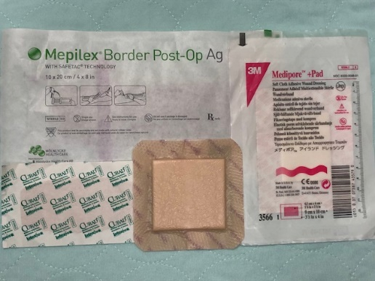
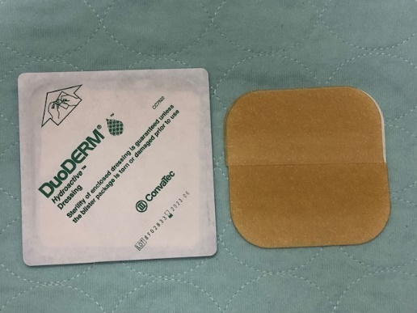
Wound Dressings
Hydrofiber: Designed to absorb moderate to large amount of drainage. Moldable, absorptive available with silver.
Ex., Aquacel, Aquacel Ag
Composites: Combination of 2 or more physically distinct products manufactured as a single dressing.
Ex. Mepilex Border, Medipore dressing, Bandaid
Hydrocolloids: Contain hydrophilic colloidal particles in an adhesive compound laminated onto a flexible water-resistant outer layer.
Ex. Duoderm and Duoderm Extra Thin

Slide 47
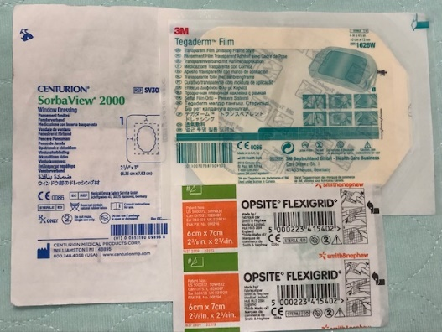
Wound Dressings
Hydrogel: Most of these dressings contain 90% water in a gel base. They are available in gel form. Provides moisture to a dry wound bed to promote autolytic debridement and facilitates wound repair.
Ex. Skintegrity Gel and Normlgel Ag
Transparent Films: these are transparent sheets of polyurethane coated with an adhesive. They are moisture vapor permeable, but non-absorpative. Visualize wound base.
Ex. Tegaderm, Op-site, Sorb-View
Collagenase Santyl –Enzymatic (chemical) debriding
ointment which liquifies necrotic tissue

Slide 48
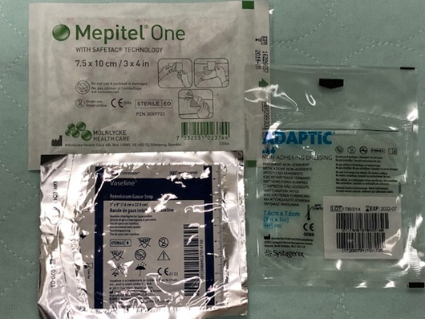
Wound Dressings
Gauze Dressings: Woven and nonwoven fibers of cotton, rayon, polyester or a combination. They are moderately absorptive, cost-effective and easily available.
Non-adherent Dressings: Dressings that will not stick to or traumatize the wound bed, sometimes impregnated with medications/antimicrobials.
Ex. Adaptic, Telfa, Xeroform, Mepitel

Slide 49
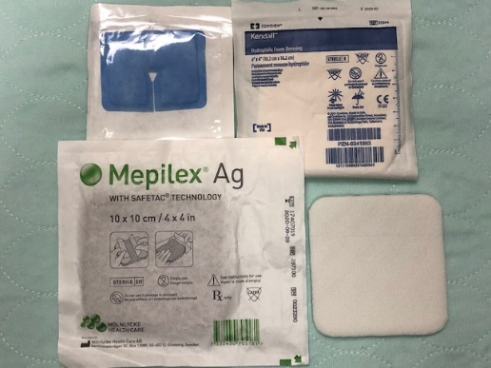
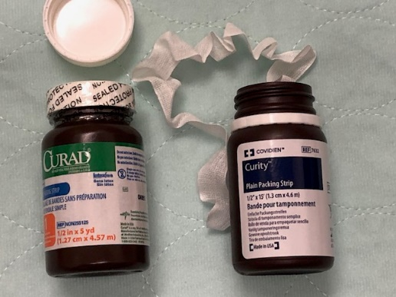
Wound Dressings
Skin Sealants: Liquid skin protectors provide a plastic type film over the skin that protects the skin from moisture and from medical tape.
Ex. Cavilon No Sting Barrier Film, Skin Prep, Marathon
Foam Dressing: Semi-permeable polyurethane dressing, non-adherent or semi-adherent contact layer, hydrophobic or waterproof outer layer.
Ex. Mepilex 4x4 foam dressing, Mepilex Border, Kendall Foam, Mepilex Lite, Mepilex Ag
Packing – Gauze ribbon used to pack wound cavities. Acts as a wick to draw exudate from wound cavity, removable. Available in various diameters, ¼, ½, and1 inch. Available in plain gauze or treated with anti-microbial Iodoform. Plain packing or Iodoform

Slide 50
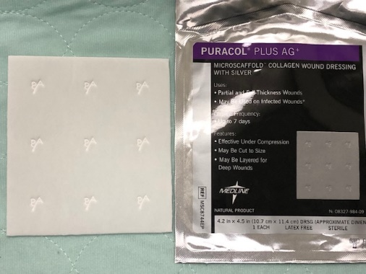
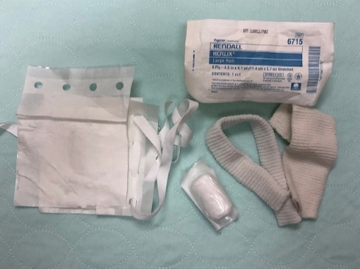
Wound Dressings
Porcine extracellular wound matrix: Contains critical components of porcine small intestine submucosa (SIS), such as collagen, proteoglycans and growth factors which are thought to promote granulation and epithelialization in dermal wounds. Assess for religious or vegan reasons in case of conflict. Oasis
Collagen dressing: Puracol Plus Ag (Micro-scaffold ) Is a completely bio-degradable Bovine collagen dressing with up to 7 days wear time. Adds collagen to the wound bed and encourages collagen migration and granulation. Assess for religious or vegan reasons in case of conflict.
Wraps: Securing dressings, tape
Kling, Kerlix, Coban, Surgilast, Mepitac Tape, Micro-foam, silk, plastic and paper tape.

Slide 51
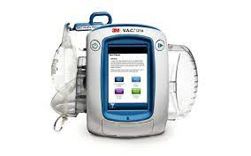
Wound Treatment
Negative Pressure Therapy: A mechanical wound care treatment that uses controlled negative pressure to assist with wound healing.
Pulls excess drainage from wound into a canister
Stimulates cell growth
Pulls on wound bed and sides of wound to assist in contraction
Changed 2-3x weekly, so reduces chance for infection
Maintains moist wound environment.
Settings Are in Orders
3 Types of VAC dressings: Black GranuFoam, Silver Foam, White Foam

Slide 52
Risk Assessment
Braden QD

Slide 53
Braden QD
5 subscales and device scoring
Activity and moisture management were eliminated
3 scoring levels
0 = no problem/no impairment
1 = limited problem/potential impairment
2 – problem area/compromised
High numbers = High risk
At risk > 13
Includes devices in risk assessment

Slide 54
Definition and Purpose
Definition: The Braden QD (BQD) scale is a revision and simplification of the commonly used Braden Q scale.
Conceptually-based risk assessment instrument that reliably predicts both immobility related and medical device related pressure injuries in pediatric acute care environment
Purpose: Changing to the BQD scale will assist in accurately identifying pediatric patients at risk for immobility-related and medical device related pressure injuries.
Use of the BQD scale can help monitor the quality of care and identify interventions needed to prevent pressure injury

Slide 55
Benefits of Using Braden QD
Valid and reliable pediatric specific pressure injury risk assessment tool
Evaluates both immobility and device related pressure injuries
Easy to use: high score = high risk
Facilitates identification and understanding of risk factors: includes device assessment in risk score
Accurately predicts both patients at-risk and those not at risk for Hospital Acquired Pressure Injuries

Slide 56
Documentation & Escalation of Pressure Injuries

Slide 57
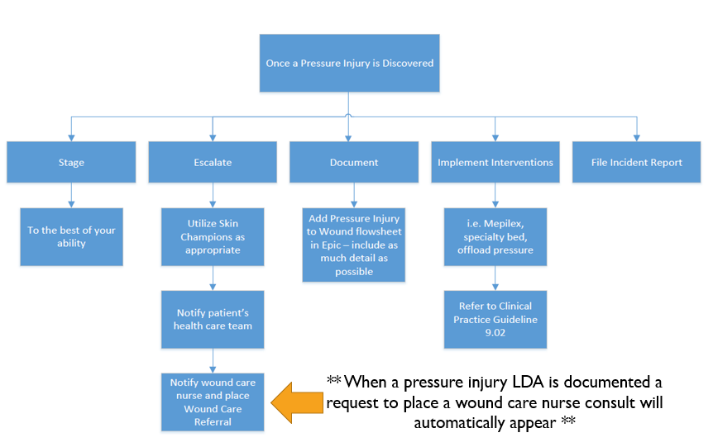

Slide 58
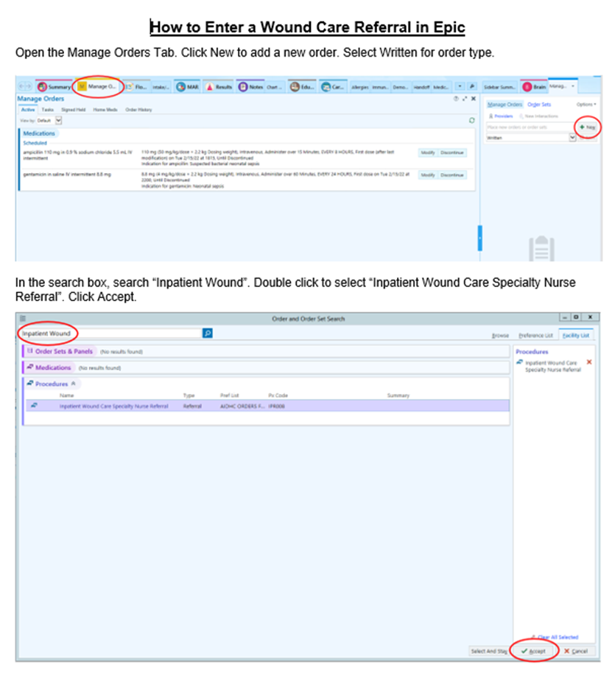
Placing a Wound Care Referral in Epic
This CAN be done by nursing!

Slide 59
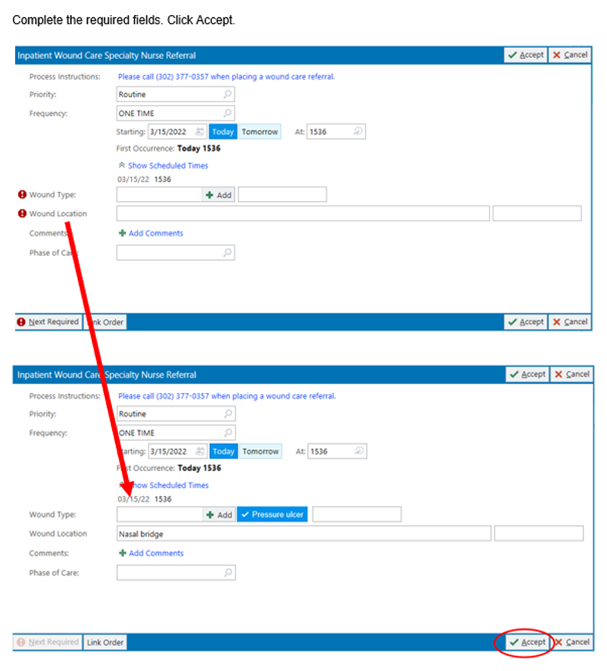
Placing a Wound Care Referral in Epic

Slide 60
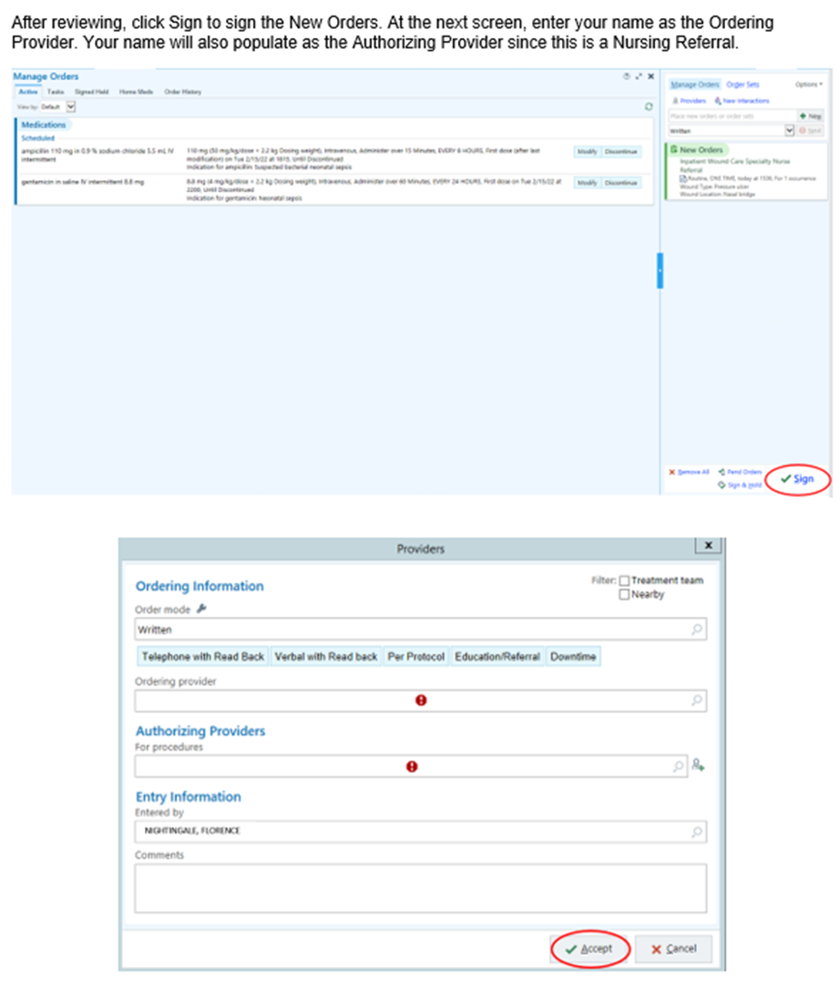
Placing a Wound Care Referral in Epic

Slide 61
After Pressure Injury Identification
Once you’ve assessed an area of skin with redness and concern for pressure injury, what do you do?
Stage the injury (to the best of your knowledge)
Notify the patient’s healthcare team
Implement appropriate interventions (Mepilex, offload pressure, specialty bed, etc.)
Notify wound care nurse
Place a wound care referral in Epic
Increase assessment interval
Add Pressure Injury LDA to Epic with as much detail as possible
Complete an Incident Report (RL) for ALL new onset skin concerns

Slide 62
Epic Documentation
Wound flowsheet or Avatar→add LDA
Select “Pressure injury” as the wound type
Include as much detail about the wound
as possible
Document all appropriate flowsheet rows
Take pictures and add to Epic when able

Slide 63
Description of Wound Drainage
Describe any exudate including type, amount, or odor
Types of exudate:
Sanguineous: thin, bright red
Serosanguineous: thin, watery, pale red to pink
Serous: thin watery, clear
Purulent: thick or thin, opaque tan to yellow
Foul purulent: thick opaque yellow to green with offensive odor

Slide 64
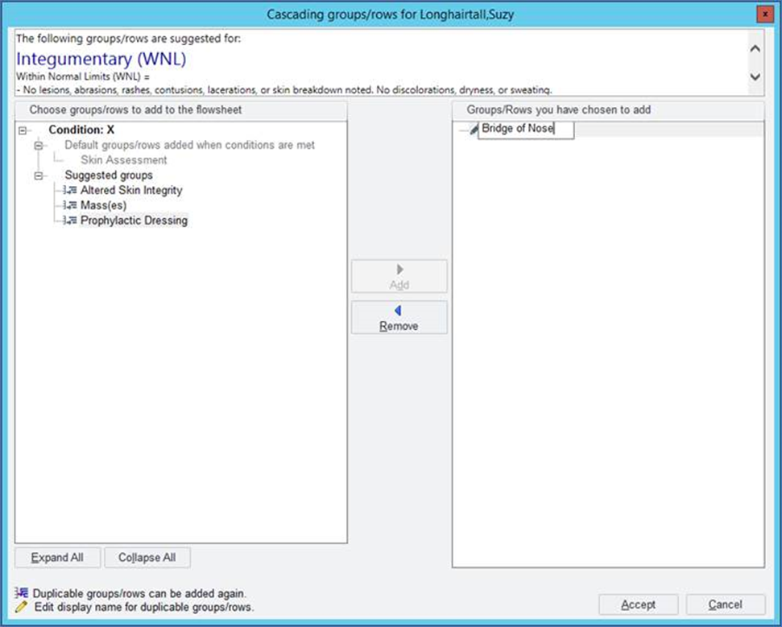
Skin Assessment Updates
Add ability to capture multiple
different “altered skin integrity”
options and name them
Add ability to document
“prophylactic dressing” and
name for body location

Slide 65
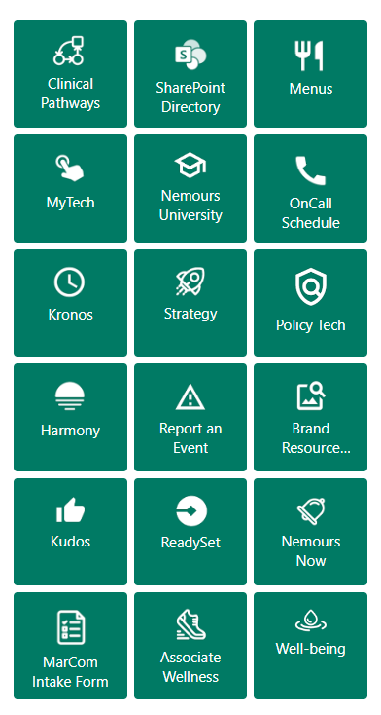
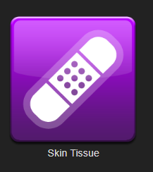
Enter an Incident Report/RL
Access via Epic or intranet home page
Select “Skin Tissue” as incident type
Provide as much detail as possible
Voalte Marie and Melissa (if possible)

Slide 66
Resources & Defining Your Role

Slide 67
Standard of Care
Contains detailed information about:
Risk scoring (Braden QD)
Standard for prophylaxis
Products available for pressure injury prevention
Specialty beds
Policy tech: SOC #1.25 Skin Integrity and Pressure Injury Prevention (PIP)

Slide 68
Taskforce Leaders
Marie Haddock BSN, RN, CWOCN
Wound care nurse
Available Monday-Friday 0700-1700
Logged into Voalte
*New* PIP taskforce co-lead!
Melissa Romeo BSN, RN , CPN, CMSRN
Wound care nurse
Available Monday-Friday 0700-1700
Logged into Voalte
*New* PIP taskforce co-lead!
Lauren Stracuzzi MSN, APRN, ACCNS-P, RNC-NIC
Clinical Nurse Specialist, NICU
Erin Dwyer MSN, APRN, ACCNS-P, CCRN-K
Harm Prevention Manager

Slide 69
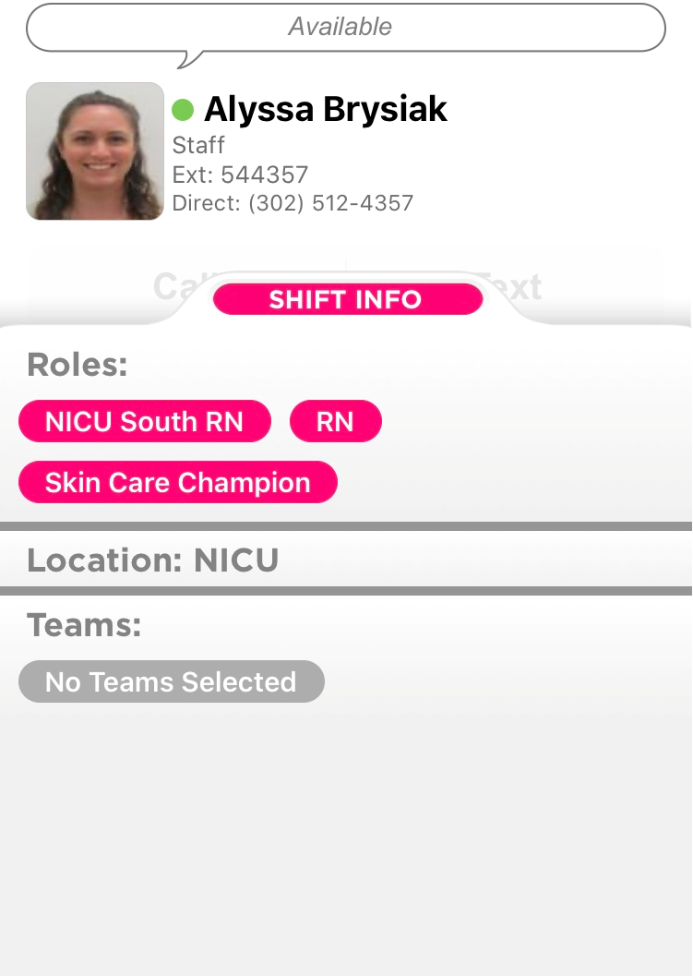
Skin Care Champion Role in Voalte
Assign yourself the role
of a Skin Care Champion
Can search Skin Care Champions
throughout the hospital

Slide 70
Case Studies

Slide 71
Case Study #1
13-year-old on 2 west
Admitted for bilateral lower extremity surgery
Patient was in supine position in the OR for 8 hours
On POD 4, you notice an area of non-blanchable, dark purple/black tissue with intact, fluid filled blisters on sacrum, measuring 7 x 4.8 x 0 cm.

Slide 72
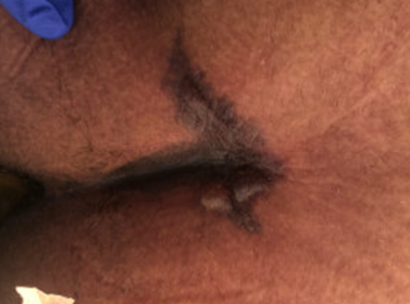
Case Study #1
How would you stage this injury?
What are your initial actions?
What interventions would you recommend?
What would you document/who would you notify?

Slide 73
Interventions
Place a wound care referral
Notify primary service
Specialty mattress- Dolphin bed
Cover with Adaptic and sacral Mepilex
Offload completely. Turn left/right only. No supine
Document deep tissue pressure injury in flowsheet

Slide 74
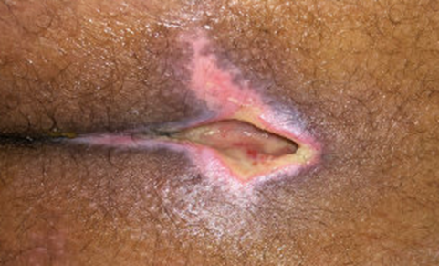
Evolution of DTI
After use of Santyl, the injury evolved.
No bone or structures are visible or palpable in the wound bed.
How would you stage this injury?

Slide 75
Case Study #2
3-year-old on 4 east
Admitted acute hypoxic respiratory failure related to influenza A
10 days after admission, you note a strong malodor and discovered that the source was thick drainage on left scalp under hair braid.
After undoing the braid, a scalp wound was discovered on left occiput. The wound presents as 100% yellow slough

Slide 76
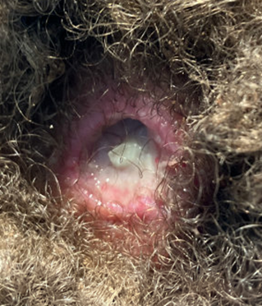
Case Study #2
How would you stage this injury?
What are your initial actions?
What interventions would you recommend?
What would you document/who would you notify?

Slide 77
Interventions
Place a wound care referral and notify primary service
Take all braids out after checking with caregivers and inspect entire scalp. After removing all braids, another pressure injury discovered.
Santyl, gauze wet with NSS, dry gauze, and Surgilast netting
Document as unstageable pressure injury

Slide 78
Case Study #3
12-year-old in PICU
Admitted for posterior spinal fusion
Patient was in prone position in the OR for 21 hours
On POD 1, you notice an area of non-blanchable erythema with intact fluid filled blisters
Scab noted to knee upon admission, but not documented

Slide 79
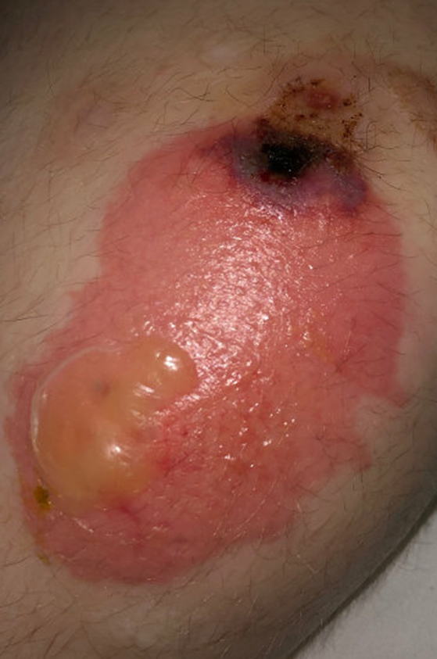
Case Study #3
How would you stage this injury?
What are your initial actions?
What interventions would you recommend?
What would you document/who would you notify?

Slide 80
Interventions
Place a wound care referral. Notify primary service
Offload injury completely
Leave open to air
If blister ruptures or wound opens, apply bacitracin twice a day and cover with Adaptic and Mepilex border
Document as stage 2 pressure injury

Slide 81
Case Study #4
17-year-old on 2 west
Admitted for seizures. While inpatient, serial casting of lower extremities being done every 2 weeks under sedation
Patient with history of ASD and self-injurious behaviors. C/o lower extremity pain. This was attributed to muscle pain
After removal of casts, wounds noted to bilateral anterior ankles. The left ankle wound measured 2 x 3 x 0.3 cm. This presented as 100% slough. Right ankle wound measured 3 x 3 x 0.1 cm. This presented as 80% slough, 10% brown devitalized tissue and 10% pink tissue.

Slide 82
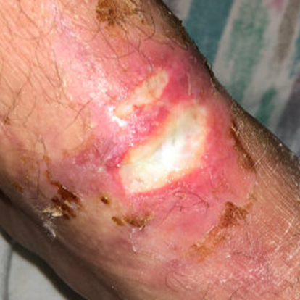
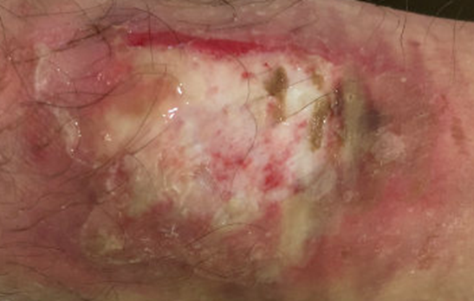
Case Study #4
How would you stage this injury?
What are your initial actions?
What interventions would you recommend?
What would you document/who would you notify?
Right ankle
Left ankle

Slide 83
Interventions
Place a wound care referral and notify primary team
Do not recast until injuries are healed
Clean with Vashe. Apply Santyl and Mepilex border
Document both injuries as unstageable pressure injuries

Slide 84
Case Study #5
9-week-old in CICU
Admitted for cardiac surgery
After removal of PIV on foot, an area of non-blanchable erythema with a blanched center noted. After several days, the injury darkened and presented as dark purple discoloration with erythematous borders.

Slide 85
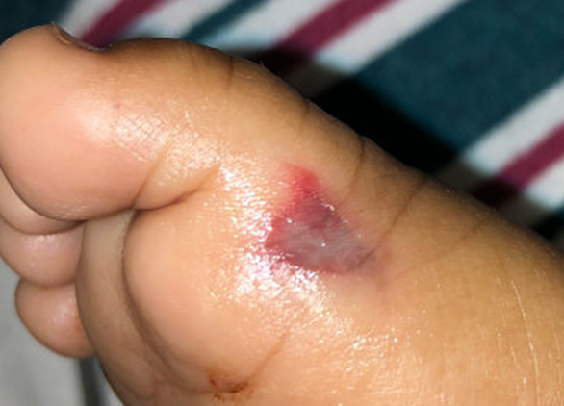
Case Study #5
How would you stage this injury?
What are your initial actions?
What interventions would you recommend?
What would you document/who would you notify?

Slide 86
Interventions
Place a wound care referral and notify primary team
Leave open to air
Offload injury. Do not apply medical devices such as PIV or pulse ox to area.
Document as a deep tissue pressure injury

Slide 87
Thank You!

Slide 88
To earn 3.25 contact hours for this activity, complete the following steps:
Step 1:
Record your attendance
Text TAFDOD to 904-506-7609
Step 2:
Complete the evaluation
Go to ce.Nemours.org and locate the conference in your pending activities tab and then click “Resume course”.
Nemours Children’s Hospital, Delaware is approved as a provider of nursing continuing professional development by Pennsylvania State Nurses Association, an accredited approver by the American Nurses Credentialing Center’s Commission on Accreditation.

