Slide 1
CCRN Review Class
Laura McKenzie, BN, RN, CPN, CCRN
2023

Slide 2
AACN Eligibility
PRIDE/VALIDATION/EXCELLENCE/RECOGNITION/CAREER ADVANCEMENT/ROLE MODEL
Licensure: current, unencumbered US RN or APRN
Practice: 1750 hours in direct care in 2 years with 875 in most recent year or minimum of 2000 hours over past 5 years with 144 in most recent year
Practice Verification: name and contact information of a professional associate must be given for verification of eligibility related to clinical practice hours

Slide 3
Certification Renewal
Initial certification is granted for 3 years
Requirements for renewal:
1. RN/APRN license
2. 432 hours of direct care within the 3- year period
3. Completion of CERPS (100 total )- Free in AACN Member OR Renewal by Exam

Slide 4
Synergy Model for Patient Care

Slide 5
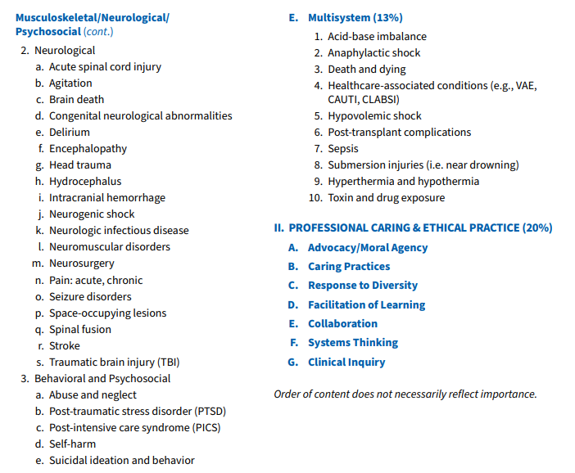
Test Plan

Slide 6
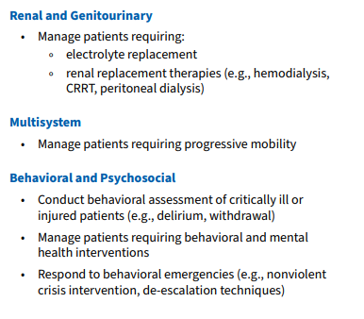
Testable Nursing Actions

Slide 7
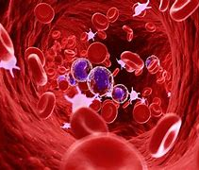
Hematology
Testable Nursing Actions:
Manage patients receiving transfusion of blood products
Monitor patients and follow protocols; pre, intra and post intervention (plasmapheresis, exchange transfusion, leukocyte depletion)
Monitor patients and follow protocols related to blood conservation

Slide 8
Blood Component Therapy Table
Blood Component | Indication
Whole Blood | Symptomatic deficit of oxygen-carrying capacity + hypovolemic shock, exchange therapy; massive hemorrhage
PRBCs | Symptomatic anemia; hypovolemia (blood loss)
Platelets | Thrombocytopenia, abnormal platelet function
Fresh Frozen Plasma | Deficit of coagulation factors; plasma volume expansion with all coagulation factors
Granulocytes | Adjunct to infection measures in high-risk patients and neonates
Cryoprecipitate | Hemophilia A; hypofibrinogenemia, Factor XIII deficiency, von Willebrand disease
Albumin 5% or 25% | Hypovolemia; hypoproteinemia

Slide 9
Disseminated Intravascular Coagulopathy (DIC)
Bleeding disorder characterized by hemorrhage and thrombosis
Exaggerated intravascular coagulation
Fibrinogen converted to fibrin insetting of increased platelet aggregation
Thrombosis

Slide 10
Causes
Infection
Shock
Trauma
Malignancies
Obstetric procedures
Vascular abnormalities
Venomous snakebite
Transfusion reaction
Heatstroke

Slide 11
Clotting & Bleeding
Clotting
Rapid, widespread formation of thrombi
Leads to ischemic injury
Organ dysfunction
Bleeding
Clots are lysed-> consumption of clotting factors, fibrinogen, platelets
Blood eventually loses ability to clot
Clotting factors cannot be replaced by the body as quickly as they are being used

Slide 12
Systemic Inflammatory Response
Prolonged PT and PTT
Thrombocytopenia
Decreased fibrinogen
Increased D-dimer
Decreased coagulation factors
Increased fibrin degradation products
Treatment: treat underlying cause; blood product products, heparin, clotting factors!

Slide 13
Idiopathic Thrombocytopenia (ITP)
Isolated thrombocytopenia
Antibodies to own platelets-> platelet destruction
Usually precipitated by viral illness
Management:
Steroids, IVIG, immunosuppression, transfusion, monitor for complications

Slide 14
Heparin Induced Thrombocytopenia (HIT)
Antibody mediated complication to heparin exposure that increases risk of thrombosis
Initiates the formation of blood clots by abnormal platelet activation
Management:
Stop the immune response: STOP Heparin
Inhibit thrombin production
Treat and prevent new thrombosis

Slide 15
Question #1
All of the following are potential complications of blood component administration except:
Acute hemolytic reaction
Infection
Anemia
Coagulopathy

Slide 16
Rationale #1
C. Anemia
Symptomatic anemia is an indication for blood component therapy and not a complication

Slide 17
Question #2
Twenty minutes after initiation of a PRBC transfusion, your patient becomes hypotensive, anxious and dyspneic and beigns to shake uncontrollably. You suspect that which of the following in occurring?
Citrate toxicity
Acute hemolytic transfusion reaction
Acute nonhemolytic transfusion reaction
anaphylaxis

Slide 18
Rationale #2
B. Acute hemolytic transfusion reaction
These symptoms are consistent with an acute reaction or anaphylaxis; however the latter would be seen within minutes

Slide 19
Question # 3
Your first intervention to manage your patient’s acute hemolytic reaction will be to:
Notify the physician
Treat shock and/or respiratory distress
Stop the transfusion
Keep vein open with an infusion of NS 0.9%

Slide 20
Rationale #3
C. Stop the transfusion
You will need to make each intervention proposed, but the FIRST intervention must be to stop the transfusion if you suspect that your patient is having a acute reaction.

Slide 21
Question #4
Which of the following electrolyte disturbances would you monitor for in the patient who is receiving multiple, large volume blood tranfusions?
Hypernatremia and hyperphosphatemia
Hypocalcemia and hypophosphatemia
Hyperkalemia and hyponatremia
Hypocalcemia and hyperkalemia

Slide 22
Rationale #4
D. Hypocalcemia & hyperkalemia
Patients who receive large volume blood tranfusions must be monitored for the development of hypocalcemia and hyperkalemia The hypocalcemia is the result of the calcium binding to the citrate used as a preservative in the blood; the hyperkalemia is associated with the breakdown of the cells in older blood.

Slide 23
Question #5
Amy, age 22 months was admitted to the PICU 2 weeks ago with RSV. She was nasally intubated ad mechanically ventilated, but her respiratory status has improved significantly, she was extubated 2 days ago. She has had minor bleeding from her nares, ut is otherwise doing well. The team is considering transferring her to the floor later today. You notice that the bleeding from Any’s nares has increased, and she has two large bruises on her chest and petechiae on all extremities. You notify the critical care physician and send off the following labs: CBC, coagulants, and D-dimer. PT/PTT and D-dimer are normal; but she has decreased platelet count. What do you suspect that Amy may have developed?
Disseminated intravascular coagulopathy
Thrombotic thrombocytopenic purpura
Idiopathic thrombocytopenic purpura
Hemolytic uremic syndrome

Slide 24
Rationale #5
c. ITP
Immune-mediated decrease in platelet count. It often occurs following a viral infection. Diagnostic studies will reveal a low platelet count but normal PT/PTT and D-dimer.

Slide 25
Reference
American Association of Critical Care Nurses. (2015). Pediatric CCRN Certification Review Course: Hematology, in AACN Certification Review.

