Slide 1
CCRN Review #4:Cardiovascular
Laura McKenzie, BN,RN,CPN,CCRN
Clinical Nurse Educator, Cardiac Services

Slide 2
Part 2 Focus:
Structural disease
Cardiac surgery- general principles
Overview of cardiac assist devices

Slide 3
Fetal vs Neonatal Circulation
Fetal: high pulmonary vascular resistance (PVR); low systemic vascular resistance (SVR), low cardiac output, gas exchange in the placenta
Neonatal: Low PVR, high SVR, high cardiac output, gas exchange in the lungs

Slide 4
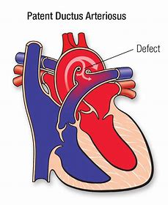
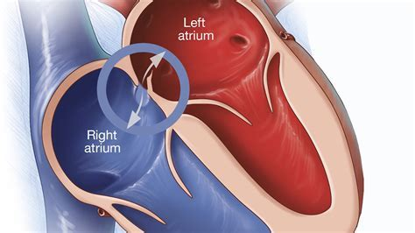
Neonatal Anatomical Shunts
Ductus arteriosus
Foramen Ovale
Fetus: R-L shunt
Neonate: L-R shunt

Slide 5
Shunting
Left to Right: oxygenated blood from systemic to pulmonic circulation, body still receives oxygenated blood; ACYANOTIC
Right to Left: deoxygenated blood from pulmonic to systemic circulation, body received deoxygenated blood; CYANOTIC

Slide 6
Suspect CHD in a neonate when….
Murmur AND cyanosis
Crying worsens cyanosis
Failed hyperoxia test
Abnormal weight loss, poor feeding wit tachypnea
Discordant upper and lower pulses
Septic appearing infant
Diagnosed with syndrome
Trisomy 21- AVSD
Trisomy 18; VSD, HLHS
45X Turners- VSD, coarctation of aortia, aortic stenosis
Williams syndrome- supravalvular stenosis
DiGeorge syndrome- interrupted aortic arch
Noonan syndrome- pulmonary valve stenosis

Slide 7
Classification of CHD
Acyanotic with increased pulmonary blood flow
Acyanotic with ventricular outflow obstruction
Cyanotic with decreased pulmonary blood flow
Cyanotic with increased pulmonary blood flow

Slide 8
Need to Know Terminology
ATRESIA: missing or not developed
STENOSIS: narrowed, stiff
HYPOPLASTIC: small, not developed
SEPTAL: refers to location, atrial or ventricular
ANONMALOUS: strong connection/direction
TETRALOGY: four

Slide 9
Acyanotic with Increased Pulmonary Blood Flow
Ventricular septal defect(VSD)
Atrial septal defect (ASD)
Atrioventricular Septal Defect (AVSD)
Patent ductus arteriosus (PDA)

Slide 10
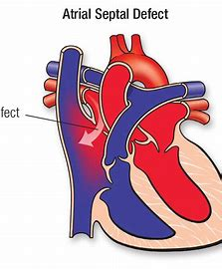
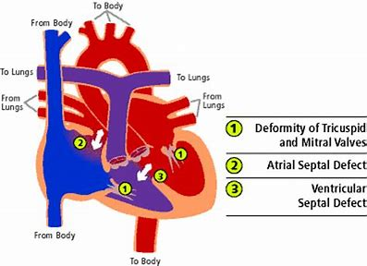
VSD/ASD/AVSD/PDA

Slide 11
Acyanotic with Ventricular Outflow Obstruction
Aortic Stenosis(AS)
Coarctation of the Aorta (CoA)
Pulmonary Stenosis(PS)

Slide 12
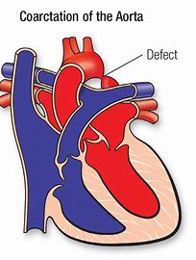
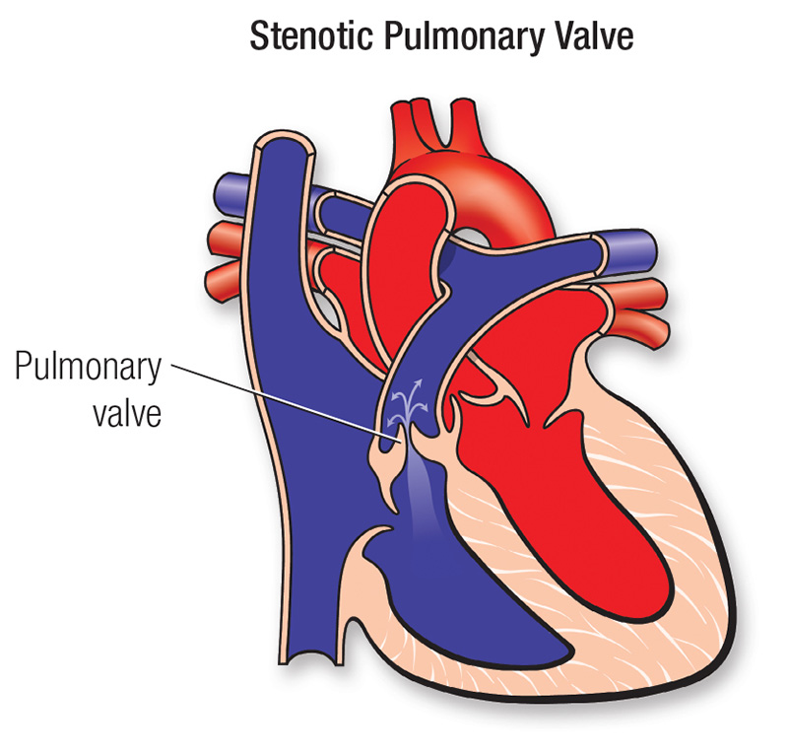
AS/PS/CoA

Slide 13
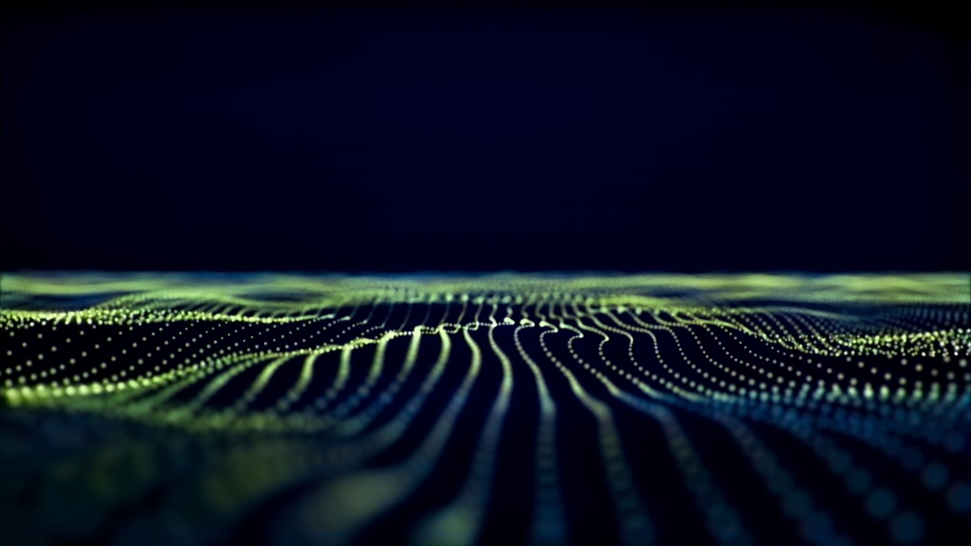
Cyanotic with Decreased Pulmonary Blood Flow
Tetralogy of Fallot
Tricuspid stenosis

Slide 14
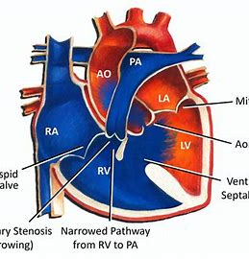
TOF
TET SPELLS
Hypoxic spells
Begins with irritability and hyperpnea
Followed by prolonged period of intense cyanosis leading to syncope
Comfort and calm
Knee to chest position
Supplemental oxygen
Sedation-morphine
Volume
Sodium bicarbonate
Propanolol
Phenylephrine

Slide 15
Tricuspid Atresia

Slide 16
Cyanotic with Increased Pulmonary Blood Flow
Transposition of the Great Arteries (TGA)
Truncus Arteriosus
Total anomalous pulmonary venous return
Hypoplastic Left Heart Syndrome

Slide 17
TGA

Slide 18
Truncus

Slide 19
Total Anomalous Pulmonary Venous Drainage

Slide 20
Truncus

Slide 21
HLHS

Slide 22
HLHS: Palliation Stage 1: Norwood

Slide 23
HLHS: Stage II Palliation: GLENN

Slide 24
HLHS: Stage III Palliation: Fontan

Slide 25
Pre and Postoperative Considerations : Family
Fetal diagnosis
Reality shock
Multidisciplinary team effort
Fragile child post op
Multiple surgeries and long term follow up
Medications
Feeding issues
Growth and development
Support groups
Genetic counseling
Social work consults
Spirituality/religious counseling
Bereavement counseling
Family dynamics: parents, siblings
Education: newborn care, defect, pre/post surgery, home care

Slide 26
Post op General Principles
Hemorrhage and clotting
Hemodynamic assessment
Ventilation
Fluid and electrolyte status
Acid-base status
Pharmacologic support
Arrhythmias and pacing

Slide 27
Perioperative Interventions
Repair vs palliation
Cardiopulmonary bypass
Myocardial protection
Hypothermia and circulatory arrest
Aortic cross clamping
cardioplegia

Slide 28
Hemorrhage and Clotting
Postoperative bleeding
CT drainage decreases rapidly
Hourly assessment
Amount and characteristics
Monitor for TAMPONADE

Slide 29
Hemodynamic Assessment: HR and Rhythm
Continuous ECG monitoring
Rhythm disturbances are not uncommon
Junctional ectopic tachycardiac and atrial ectopic tachycardia
Causes
Surgical sequelae, anesthesia, cardiopulmonary bypass/hypothermia, conduction system damage, catecholamines, metabolic derangements
DON’T FORGET to check electrolytes!!!!

Slide 30
Systemic Arterial BP
Indwelling arterial catheter: beat to beat assessment of BP
Accuracy of noninvasive BP: affected by vascular tone & hemodynamics
High potential for low CO and perfusion

Slide 31
Atrial Pressures
RAP or CVP | LAP
Systemic venous return | Pulmonary venous pressure
Right heart preload | Left heart preload
Right heart function | Left heart function
Right ventricular end diastolic pressure | Left ventricular end diastolic pressure
Decreased indicates hypovolemia | Decreased indicates hypovolemia
Increased can indicate RV failure or PHTN | Increased indicates LV failure or increased LV afterload
MAINTAIN ADEQUATE PRELOAD AND REDUCE AFTERLOAD

Slide 32
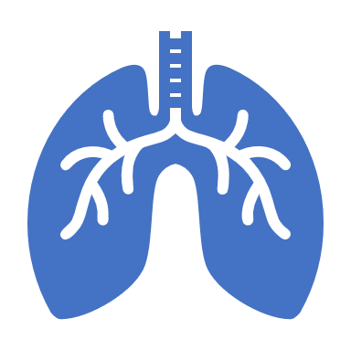
Ventilation
Airway protection and gas exchange
Typically have healthy lungs
Volume or pressure control ventilation
Careful suctioning
Close monitoring of ABGs
Impact of single-ventrile physiology

Slide 33
Fluid & Electrolyte Status
Idiopathic ventricular fibrillation choice variable
+/- sodium restriction
CPB patients- 50% maintenance x 24 hours
Monitor all sources of I&O
Monitor closely for lyte imbalances
Monitor glucose levels
Monitor renal function and urinary output

Slide 34
Acid-Base Status
Acidosis in BAD
Adversely affects myocardial function
Metabolic acidosis: indication of inadequate tissue perfusion
Sodium bicarbonate

Slide 35
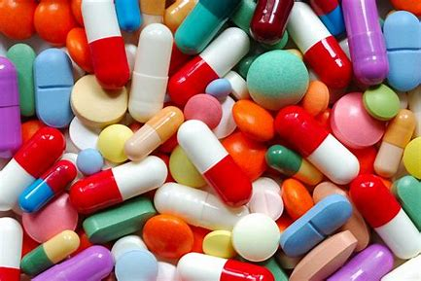
Pharmacologic Support
Catecholamines
Afterload reducers/vasodilators
diuretics

Slide 36
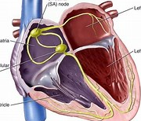
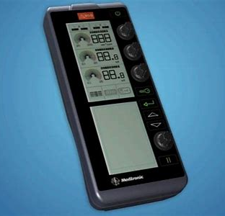
Arrhythmias and Pacing
Temporary pacing wires may be placed intra-op
Identify the cause
Monitor:
Local/systemic infection
Bleeding after removal
Oversensing/undersensing
noncapture

Slide 37
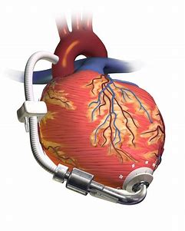
Cardiac Assist Devices
Postcardiotomy low cardiac output syndrome
Persistent low cardiac output
Systemic illness

Slide 38
Cardiac Assist Devices
Type | Patient Size | Type of Support
ECMO | >2kg | Nonpulsatile flow, support cardiac and pulmonary function
Centrifugal pump | >2kg | Nonpulsatile flow, left ,right or biventricular assist device (BIVAD)
Pneumatic pump-Thoratec | >17kg | Pulsatile flow, left, right or BIVAD
Pneumatic pump-Berlin heart | >3kg | Pulsatile flow, left, right or BIVAD
Intraaortic balloon pump | >3kg | Nonpulsatile counter pulsation; left heart support

Slide 39
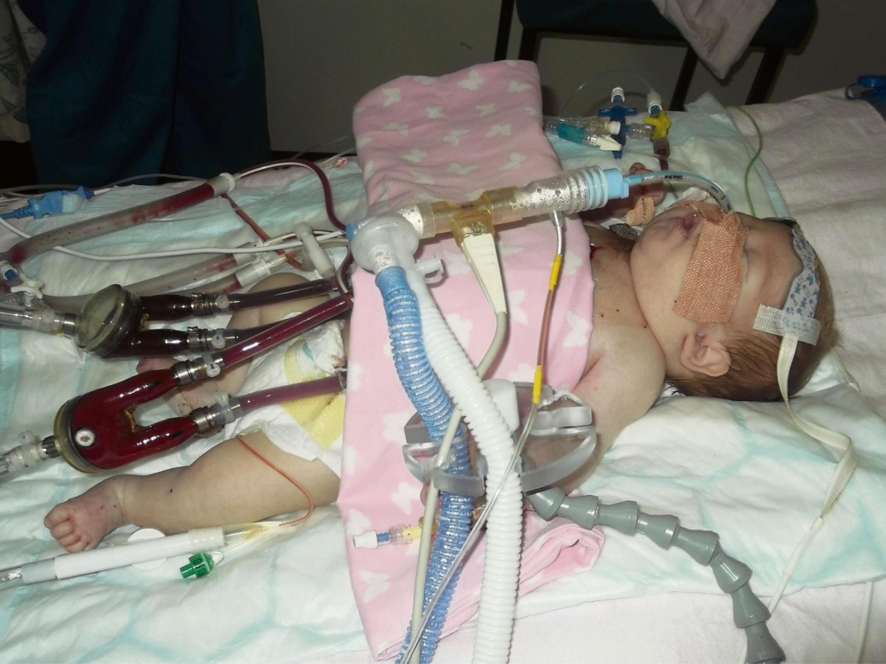
Caring for a Child with a Cardiac Assist Device
Goals
Adequate cardiac output; prevent multiorgan system failure
Prevention on infection
Prevent bleeding
Hemodynamic monitoring
Assessment of cardiac output
Monitor assist device flowrates
Assessment of volume status and replacement needs
Monitor for signs of tamponade
Titration of inotropes/vasopressors

Slide 40
Review Questions
A 3-year-old girl is admitted to the ICU following reparo of coarctation of the aorta. Her vital signs are: HR80 (sinus rhythm); RR 18; arterial BP 155/84; CVP 10. Arterial blood gas results are: pH 7.35, pC02 42; pO2 96; HCO3 25. She is comfortable and sleeping soundly. The most likely cause of her hypertension is:
Inadequate pain control
Expected systemic response to an aortic incision
Fluid volume overload
Diminished baroreceptor sensitivity to changes in arterial pressure

Slide 41
Rationale
D. Diminished baroreceptor sensitivity to changes in arterial pressure

Slide 42
Review Question
Medications used in the management of a persistent PDA include:
Digoxin
Milrinone
Indomethacin
prostaglandin

Slide 43
Rationale
C. Indomethacin
The goal of treatment is closure of the PDA. Administration of Indomethacin will stimulate ductal closure. Prostaglandins would have the opposite effect. Digoxin and milrinone will have no impact on the closure of the PDA

Slide 44
Review Question
Congenital heart defects that result in increased pulmonary blood flow place an infant at greatest risk for:
Stroke
Hypoxemia
Congestive heart failure
Syncopal events

Slide 45
Rationale
C. Congestive heart failure
CHDs that result in increased pulmonary blood flow create increased work for the right hear. Over time, the combination of increased blood flow and increased workload can lead to congestive heart failure

Slide 46
Review Question
Two cardiac anomalies associated with TOF are:
PDA and IAA
ASD and PFO
VSD and PS
TGA and AS

Slide 47
Rationale
C. VDS and PS
The four components of TOF are : pulmonary stenosis/right ventricular outflow obstruction, right ventricular hypertrophy, overriding aorta and VSD

Slide 48
Review Question
In the infant with TOF, what are the goals of treating a “tet” spell:
Increase pulmonary blood flow and relax the infundibulum
Decrease systemic blood flow and increase pulmonary vascular resistance
Decrease pulmonary blood flow and increase SVR
Increase systemic blood flow and relax the left ventricular outflow tract

Slide 49
Rationale
Increase pulmonary blood flow and relax the infundibulum
Spells are hypoxic episodes triggered by episodes of agitation which result in spasm of the infundibulum or a drop in the SVR. The goal of management is to increase pulmonary blood flow through intervention which relax the infundibulum and increase SVR

Slide 50
Review Question
A newborn is admitted with transposition of the great arteries. Pulse oximetry reveals a saturation of 46%. No murmur is heard. Until a balloon septostomy can be performed, which one of the following should be administered to the patient?
Indomethacin
Digoxin
Phenylephrine
alprostadil

Slide 51
Rationale
D. Alprostadil
The newborn with TGA is “ductal dependent”. Administration of alprostadil(PGE) will maintain patency of the ductus arteriosus until the balloon septostomy can be performed

Slide 52
Review Question
Emergent management of the patient with suspected cardiac tamponade should include:
Pleurocentesis
Dialysis
Pericardiocentesis
thoracentesis

Slide 53
Rationale
C. Pericardiocentesis
Cardiac tamponade is compression of the heart caused by an accumulation of blood in the pericardiac sac and required evacuation of the blood via pericardiocentesis.

